Slide 1

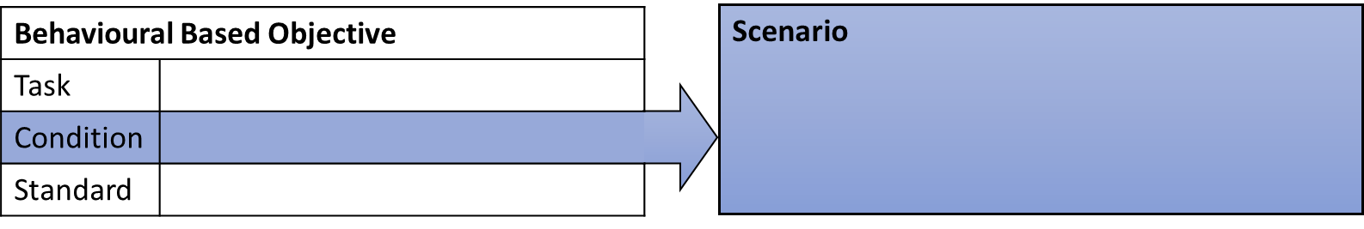
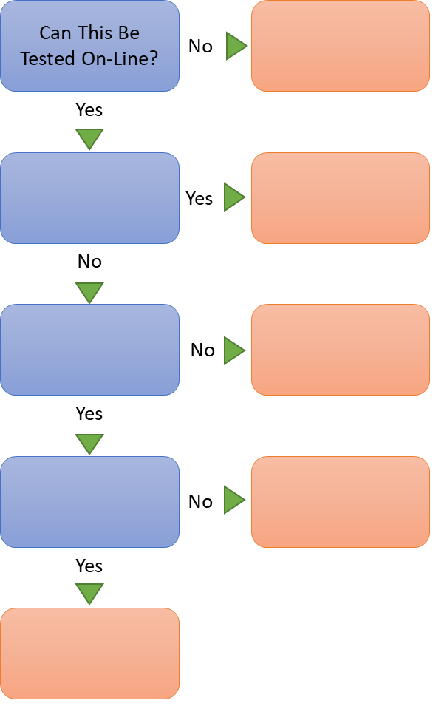
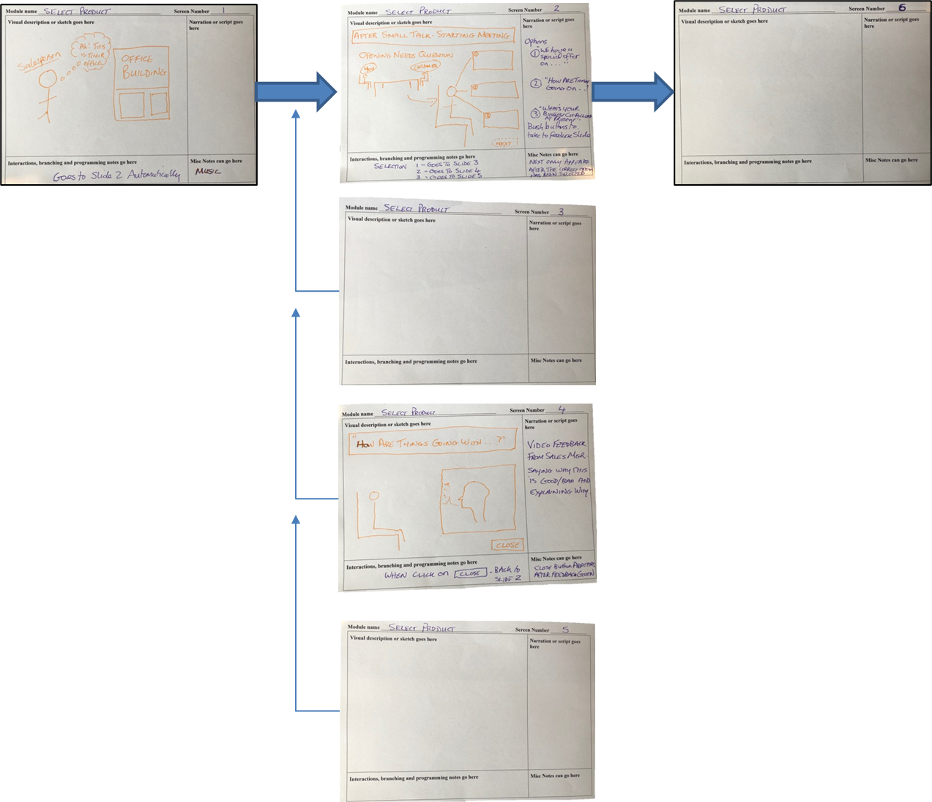
From eReading To eLearning
Step 1
Is eLearning The Best Transfer Method For Your Content?
Step 2 - Context
eLearning - Include
Step 3 – Learner Testing
Step 4 – Storyboard
eLearning - Avoid
Step 5 – Create
Notes

