Slide 1
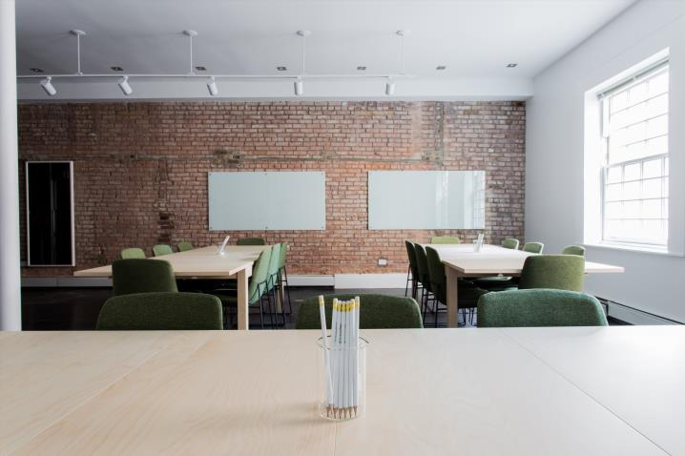
Looking At
Design and Training Differently
Rules
Welcome to your
Virtual Training Room
David
If you can Test It on-line
You can Teach It on-line
Participate
Share Ideas
Make notes
Have Fun
Remember to print
your workshop materials
David will be your Virtual Trainer.
david@eureka-tp.com
19 May 2022

Slide 2


Have Your Say
https://www.menti.com
Code 6724 0077

Slide 3

Your
Challenge
Create your virtual training Priming, Opening and Close

Slide 4
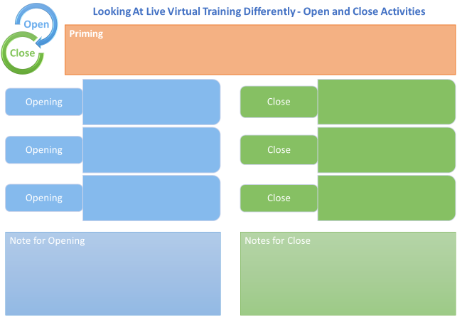

Slide 5
Creating time to be Interactive

Slide 6



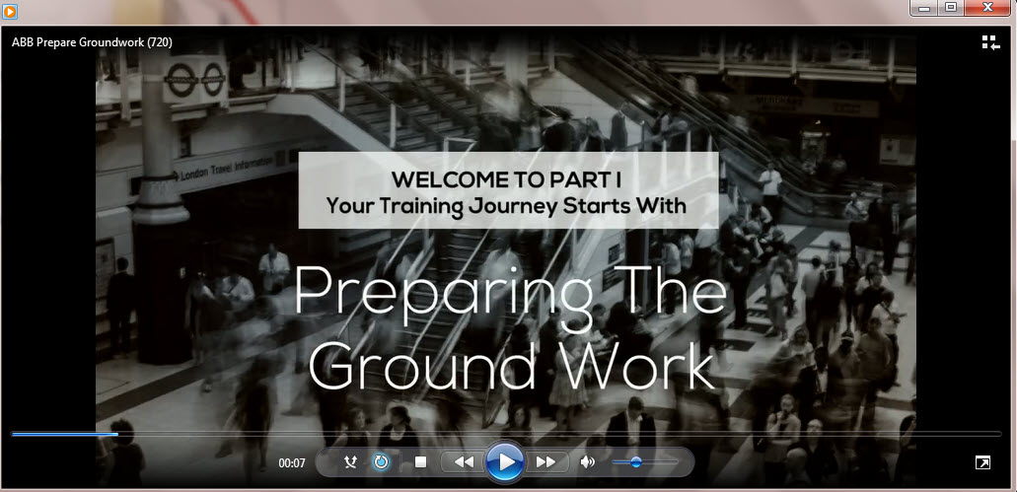
Creating time to be Interactive
Send Legislation
Web Link
Send Video Explainer
Policy Summary

Slide 7
Opening

Slide 8
My Circles of Skill and Knowledge
Things that I know and use relating to
[Training Topic eg Negotiations]
What do I need from this training [eg How to counter offer]
Take-aways

Slide 9
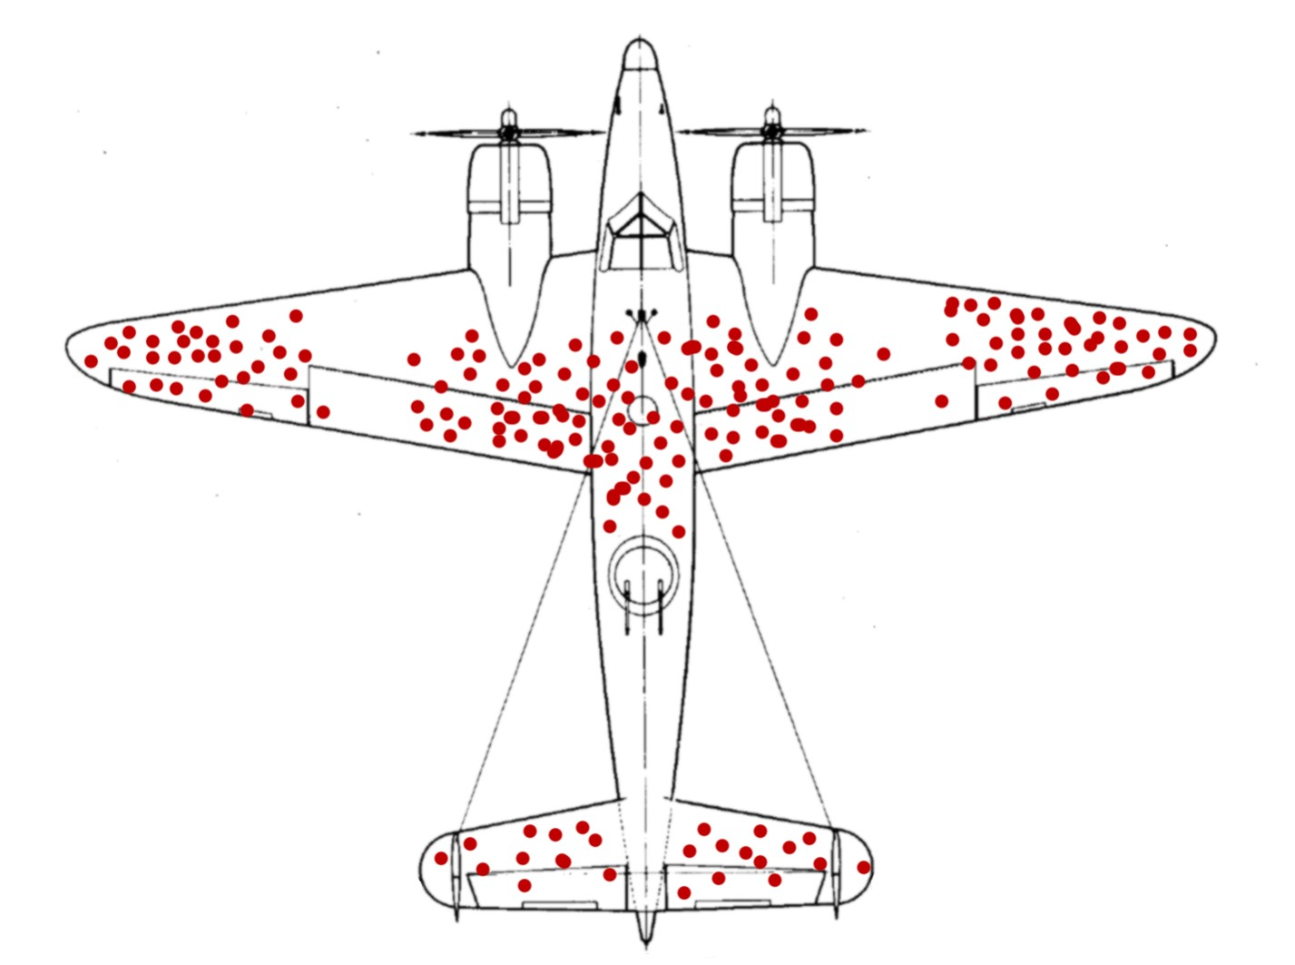

Slide 11
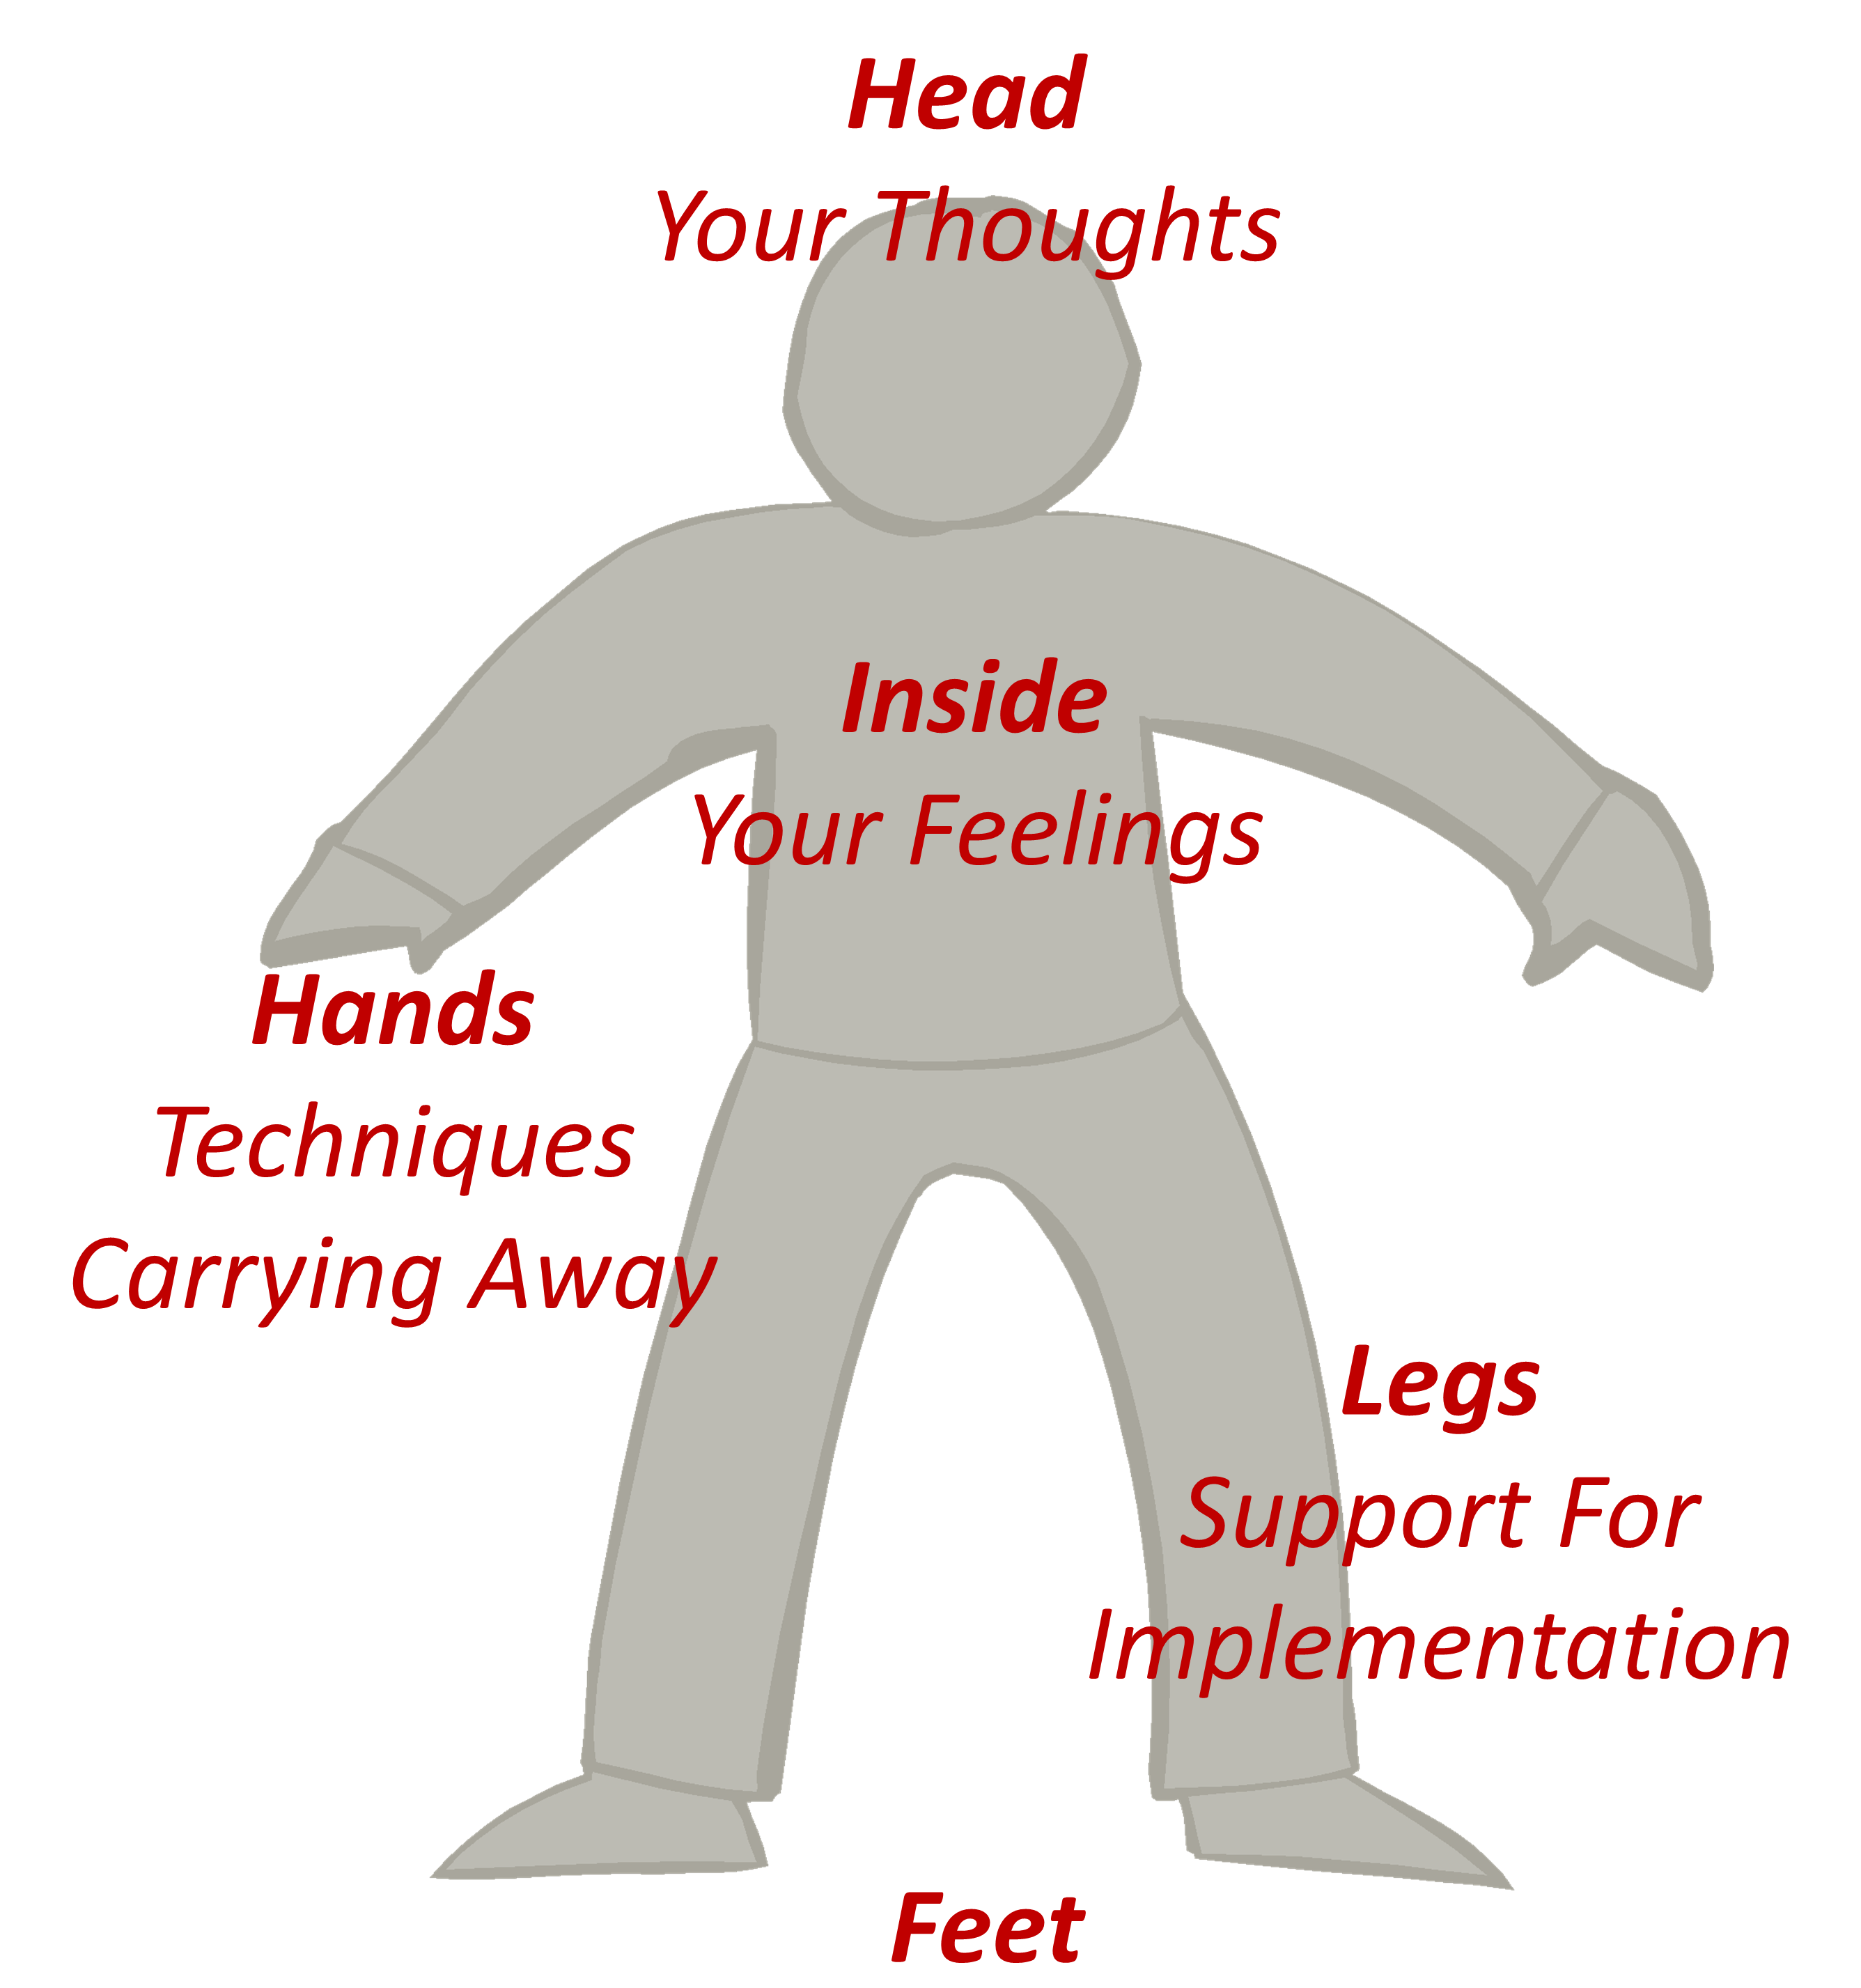
Next Steps

Slide 12
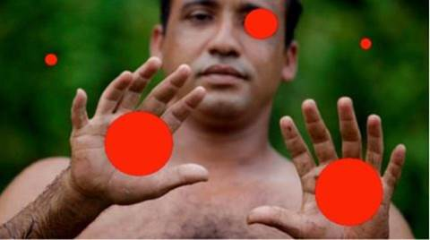

Slide 13
A-Z of Recruitment
A | B | C | D
E | F | G | H
I | J | K | L
M | N | O | P
Q | R | S | T
U | V | W | XYZ

Slide 14
OAIENRITCTN
ENPO
OESLC
BRCOIOTLNOLAA
NIMRPIG
IBTCEJVEO
ROUF ENUITM
EALVNRET
UFN

Slide 15
V | D | D | N | X | N | C | W | K | R | A | N | J | Z | W
A | Y | M | N | M | O | W | H | O | Q | O | E | R | E | R
R | Y | X | Y | M | I | M | I | O | K | D | A | B | A | V
I | W | L | Z | H | T | R | T | B | Z | Z | C | N | R | M
E | N | O | K | K | A | S | E | K | F | A | I | U | K | G
T | O | T | F | M | R | G | B | R | M | B | W | Y | N | Z
Y | H | T | E | G | O | M | O | O | E | X | V | I | L | U
R | X | O | X | R | B | O | A | W | J | D | N | G | V | S
X | T | Z | K | R | A | A | R | P | K | E | F | B | U | J
B | O | J | M | F | L | C | D | T | P | E | S | O | L | C
L | X | L | M | A | L | D | T | O | A | R | W | P | O | M
M | L | Y | F | U | O | F | T | I | Z | H | S | P | B | H
R | H | O | I | J | C | F | V | V | O | G | C | F | R | M
S | S | P | P | F | O | U | R | M | I | N | U | T | E | S
K | F | A | V | S | N | O | C | I | T | O | M | E | Z | D
CHATROOM
CLOSE
COLLABORATION
EMOTICONS
FOUR MINUTES
INTERACTION
SOFT OPENING
VARIETY
WEBCAM
WELCOME
WHITEBOARD
WORKBOOK

Slide 16
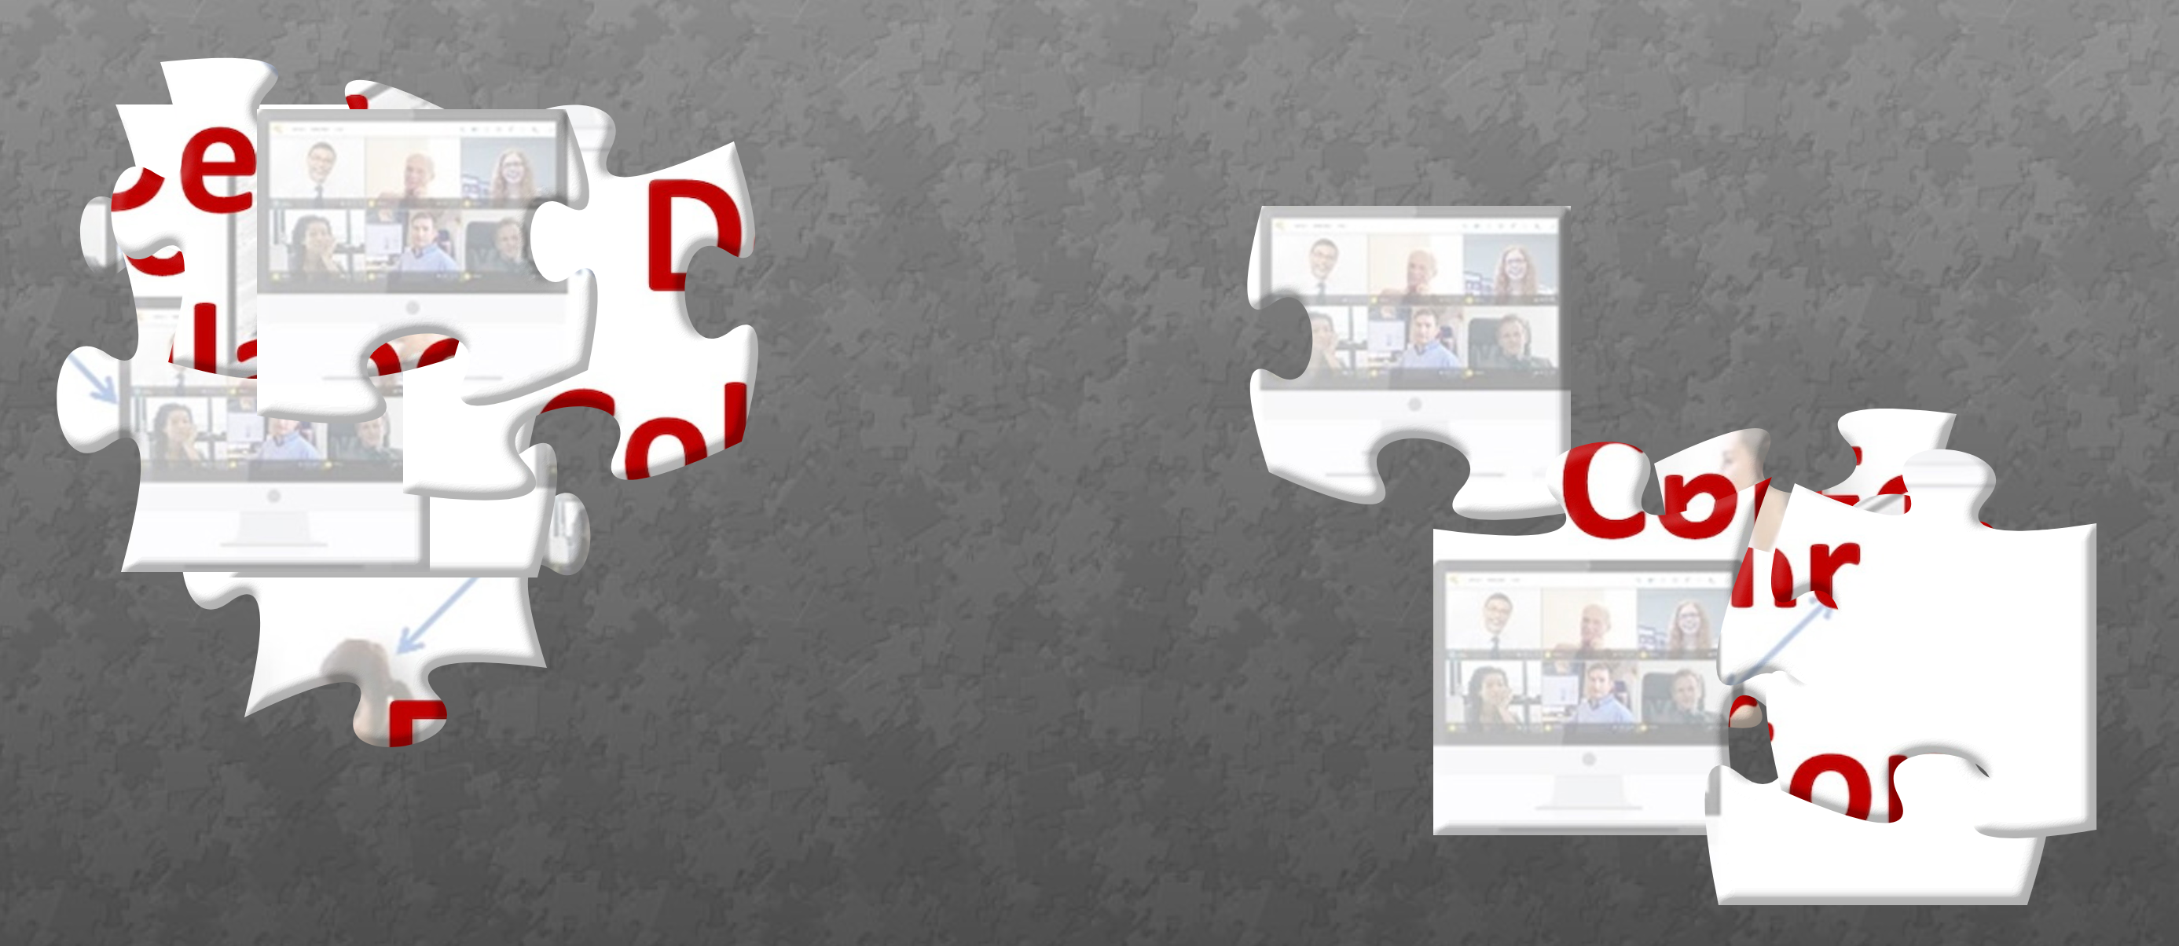
Puzzle Challenge
https://www.jigsawplanet.com/?rc=play&pid=18043a5f67bb

Slide 17

Puzzle Challenge
How is this Puzzle Like Patient Care?
Use Chat

Slide 18
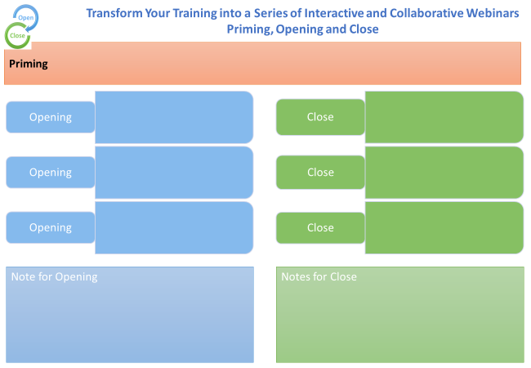

Slide 19
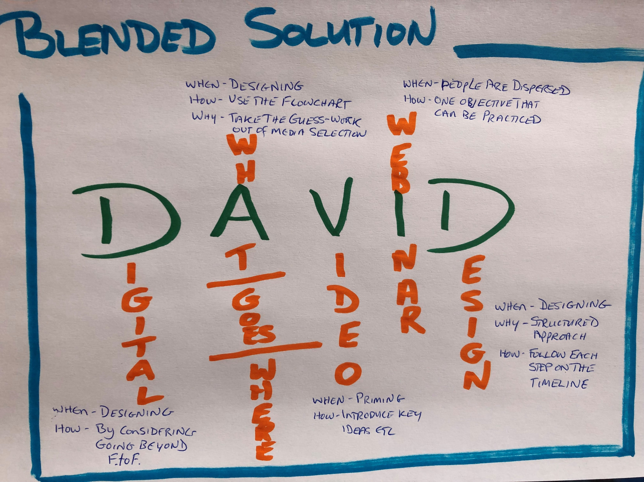
What – Where, When, How

Slide 20
FACT
AhHa
ACTION

Slide 21
START
STOP
CONTINUE

Slide 22

Our key idea from today

Slide 23
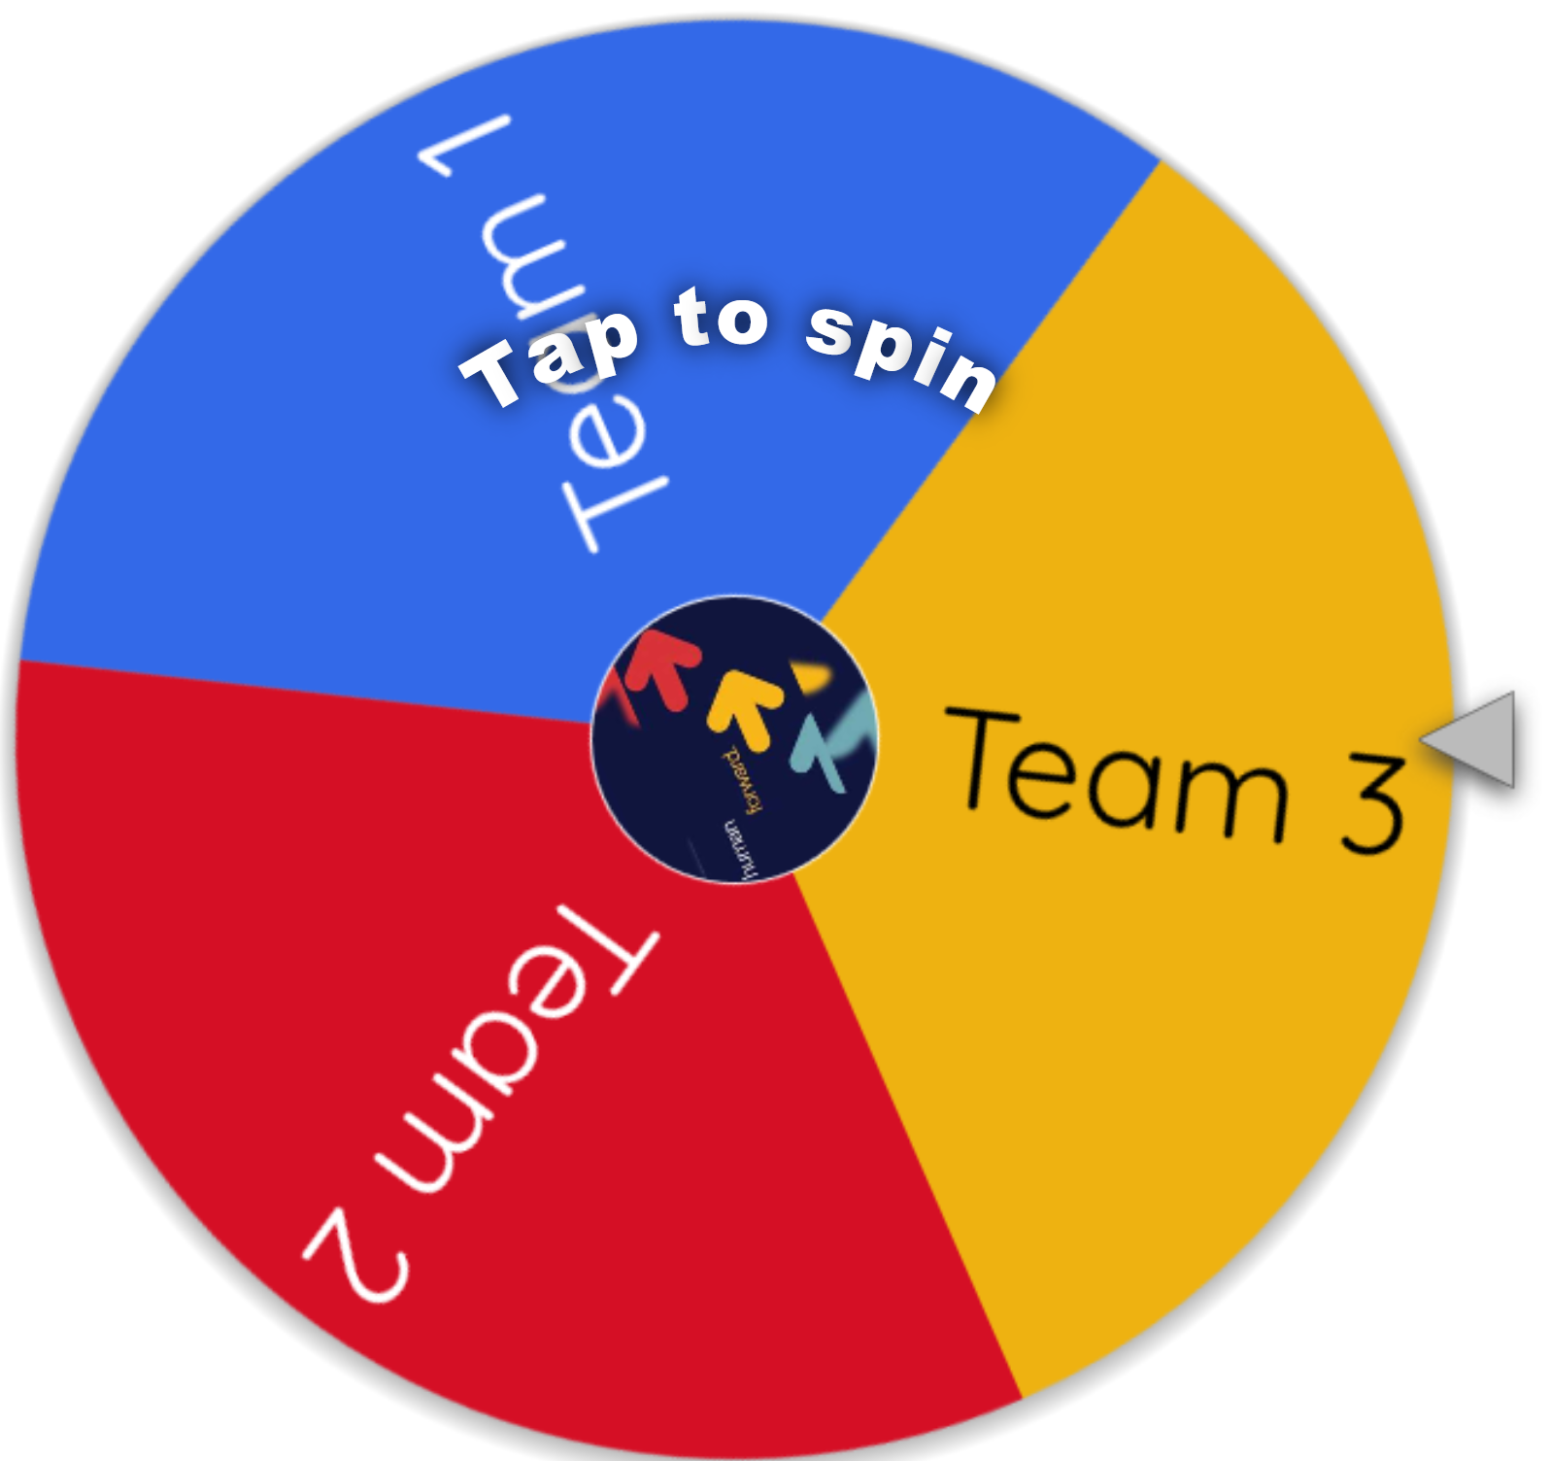
Selection Spinner
https://wheelofnames.com/

Slide 24

Your Task
Start the design of your Live Virtual Training Episode (module) and include the following slides:
- Title
- WIIFM or Challenge
- Opening
- Close

