Slide 1
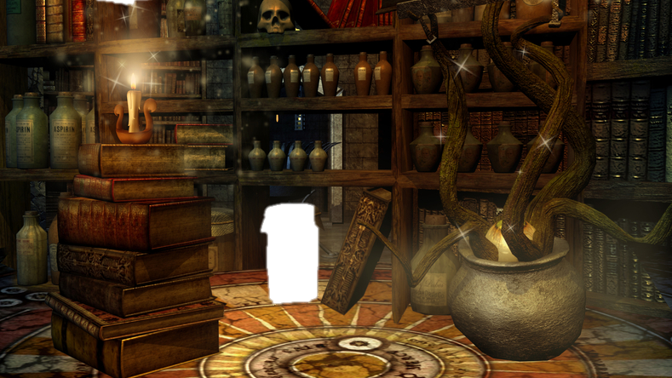





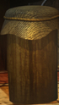




END
1-Min
2-Min
3-Min
4-Mins
CL
Welcome to the Professor's office. You need to find a
5-letter code within 4-minutes. The code was concealed by the Professor on/in objects. After 4-minutes you will automatically enter the next room.
Can you beat the clock?

Slide 2

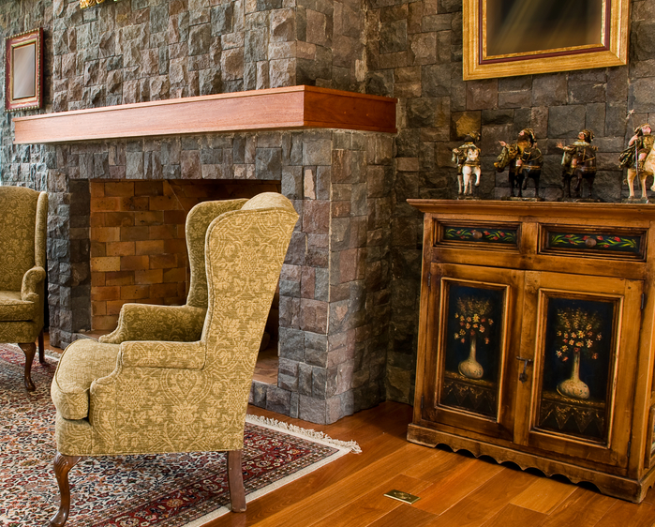
END
1-Min
2-Min
3-Min
4-Mins

Slide 3
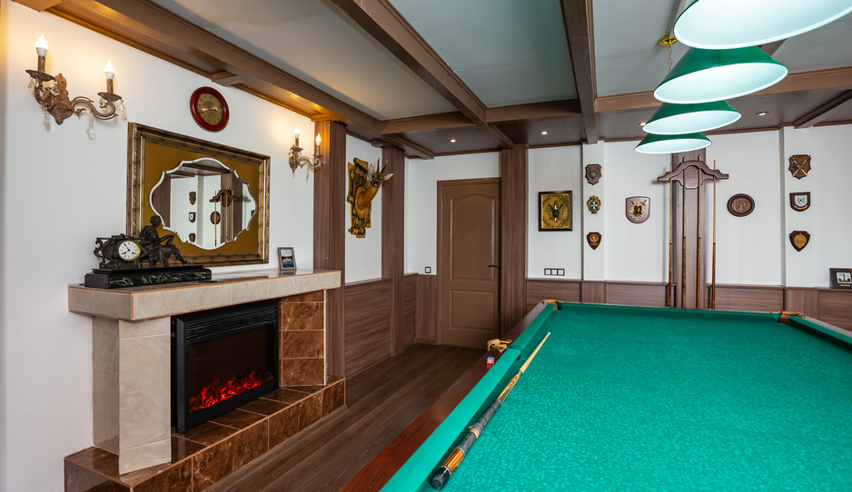
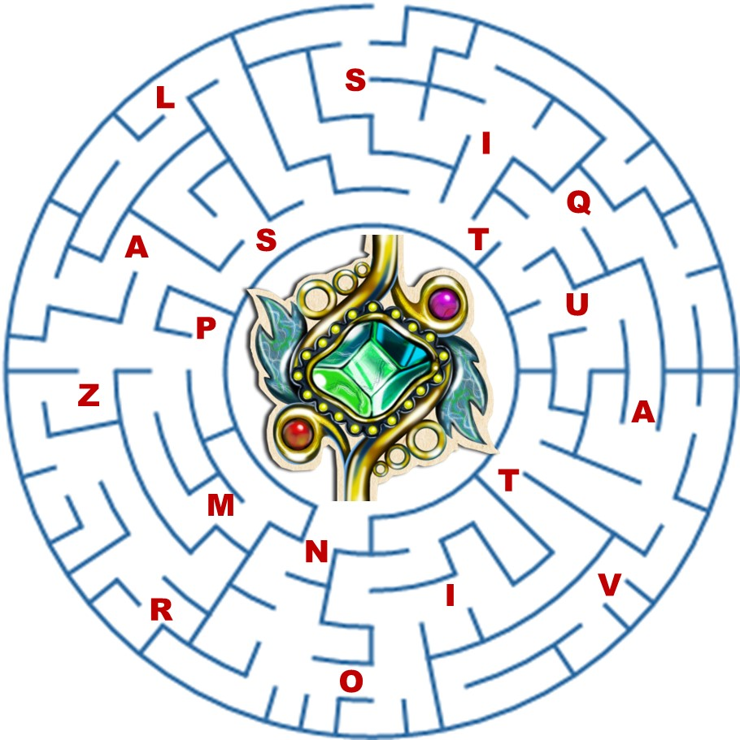
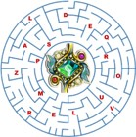
END
1-Min
2-Min
3-Min
4-Mins
Your challenge is to head to the center of this maze.
Find The entrance
collect 9 letters along your way
form the last code with the 9 letters collected

Slide 4
