Slide 1



https://www.menti.com
Code 64 59 55 8

Slide 2


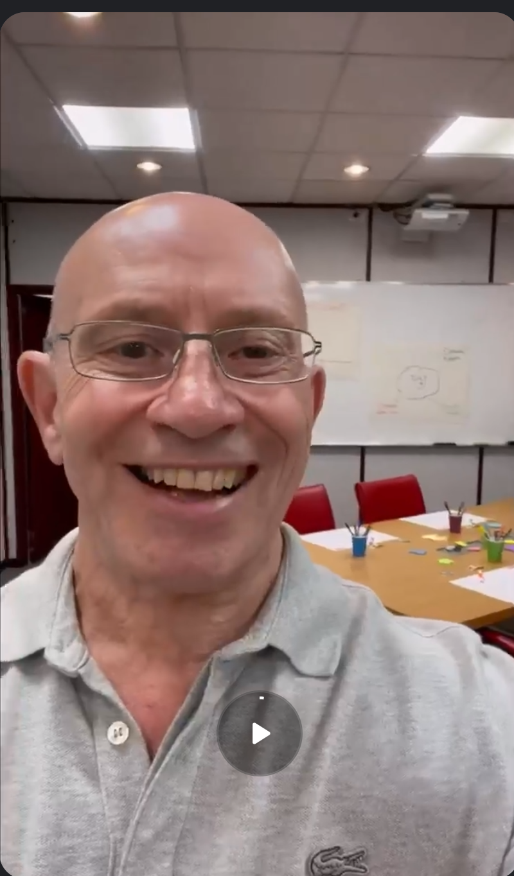
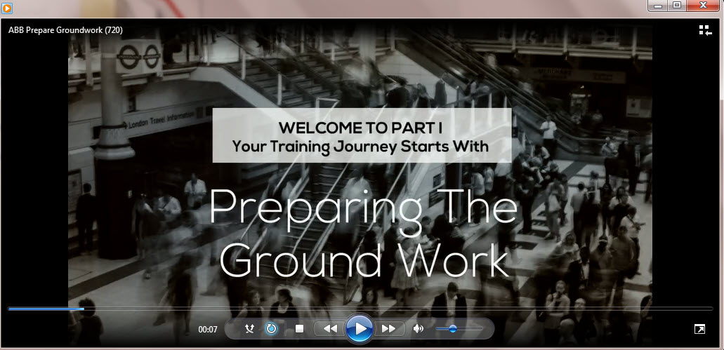
Creating time to be Interactive
Send Legislation
Web Link
Send Video Explainer
Personal Video Welcome

Slide 3


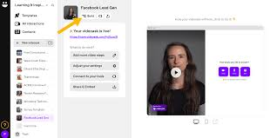
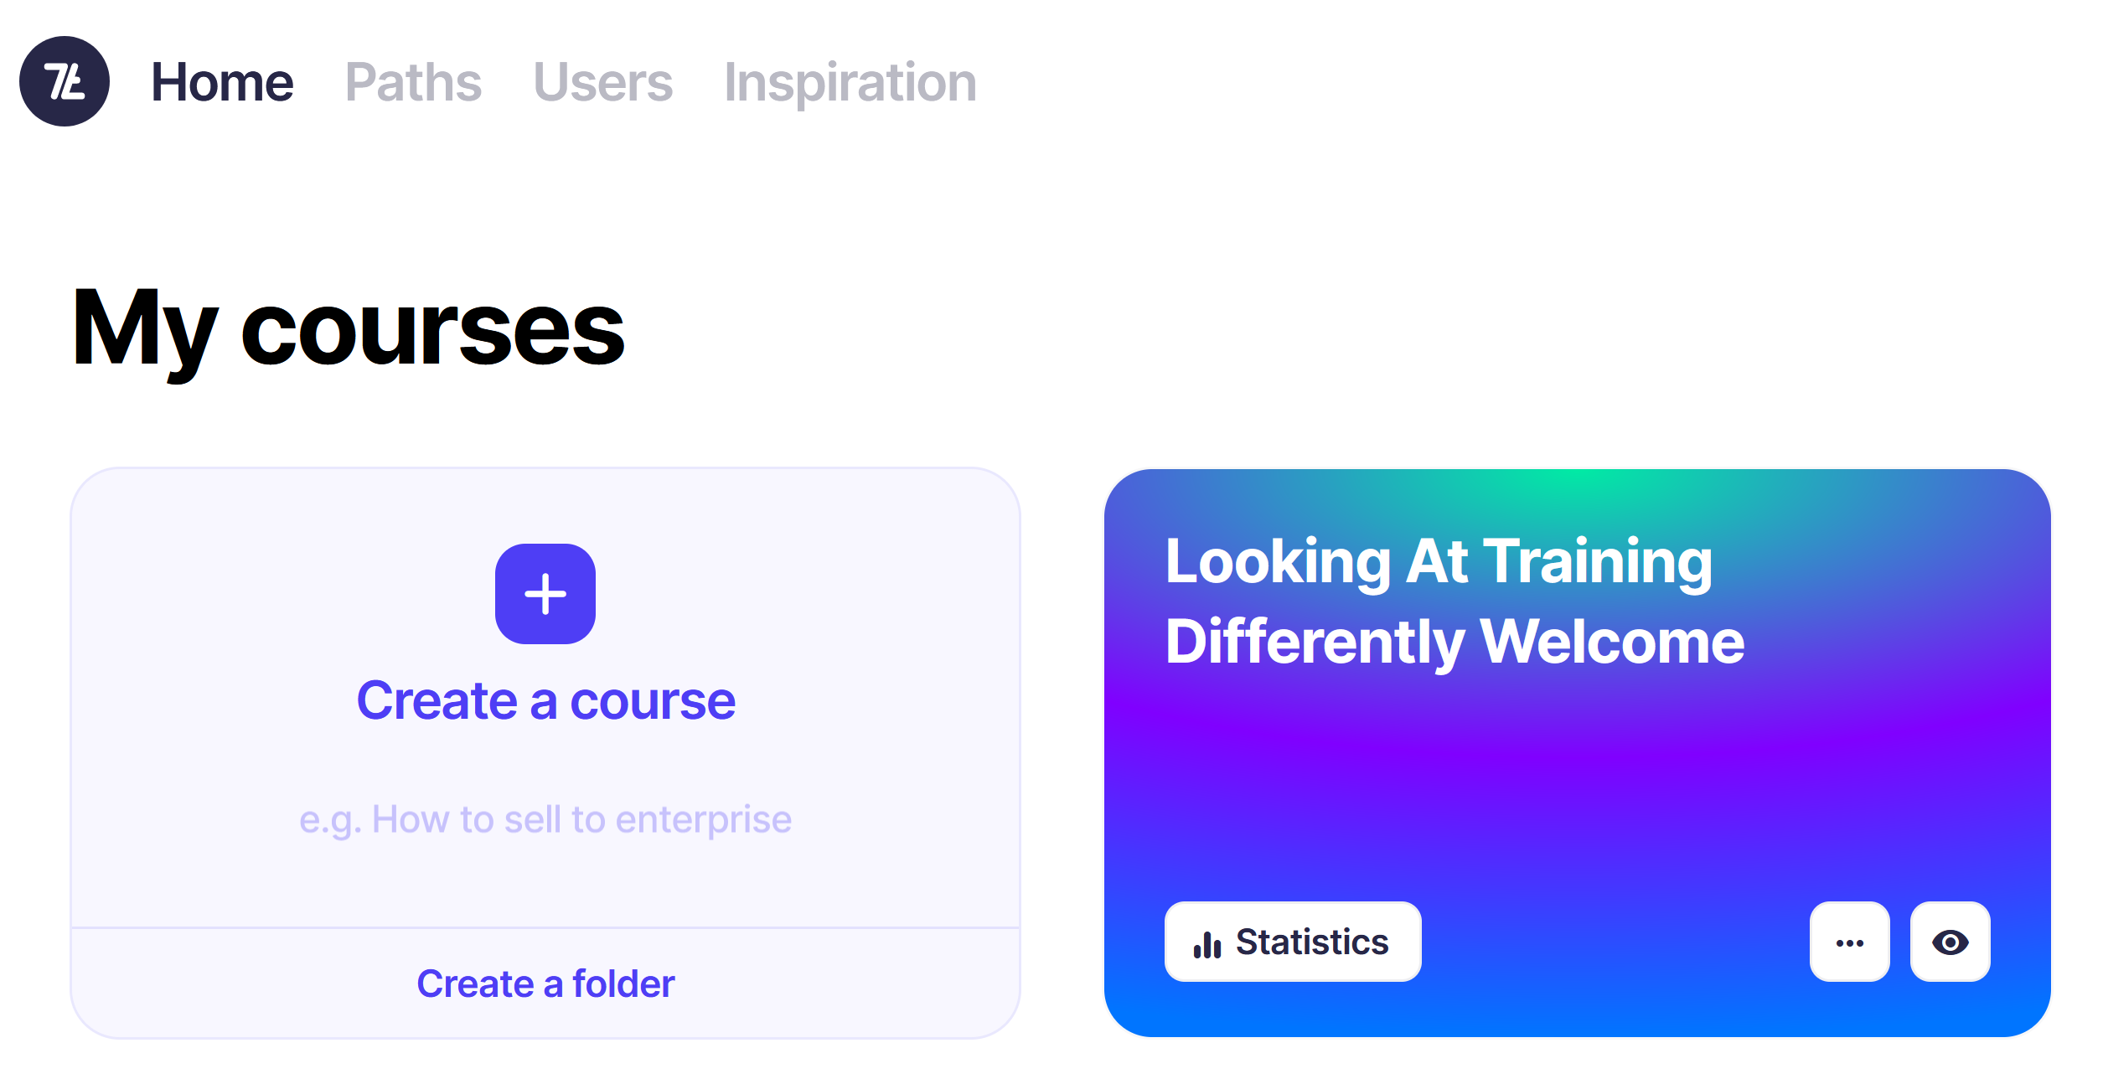
Pre-Training (Priming)
www.videoask.com
https://app.7taps.com/gedNudZLsq

Slide 4
Opening

Slide 5
My Circles of Skill and Knowledge

Slide 6
Designing Scenario Based eLearning

Slide 7
My Circles of Skill and Knowledge
Things that I know and use relating to
[Training Topic eg Leadership]

Slide 8
My Circles of Skill and Knowledge
Things that I know and use relating to
[Training Topic eg Leadership]
What do I need from this training [eg How To Lead]

Slide 9
My Circles of Skill and Knowledge
Things that I know and use relating to
[Training Topic eg Leadership]
What do I need from this training [eg How To Lead]
Take-aways

Slide 10
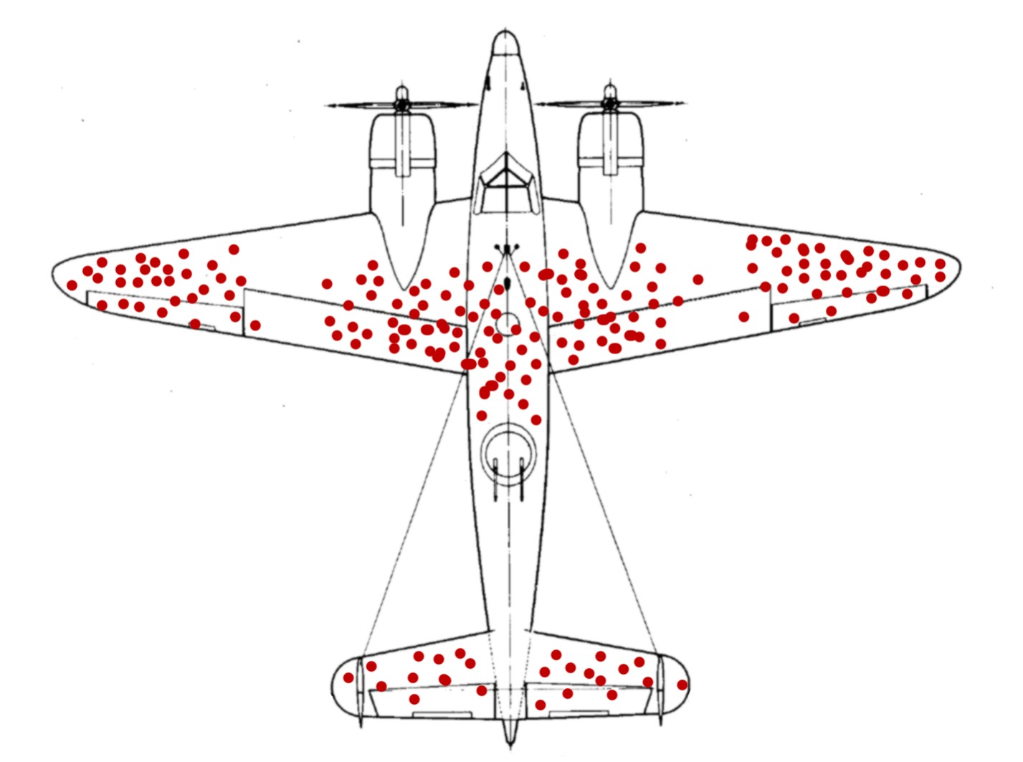

Slide 12
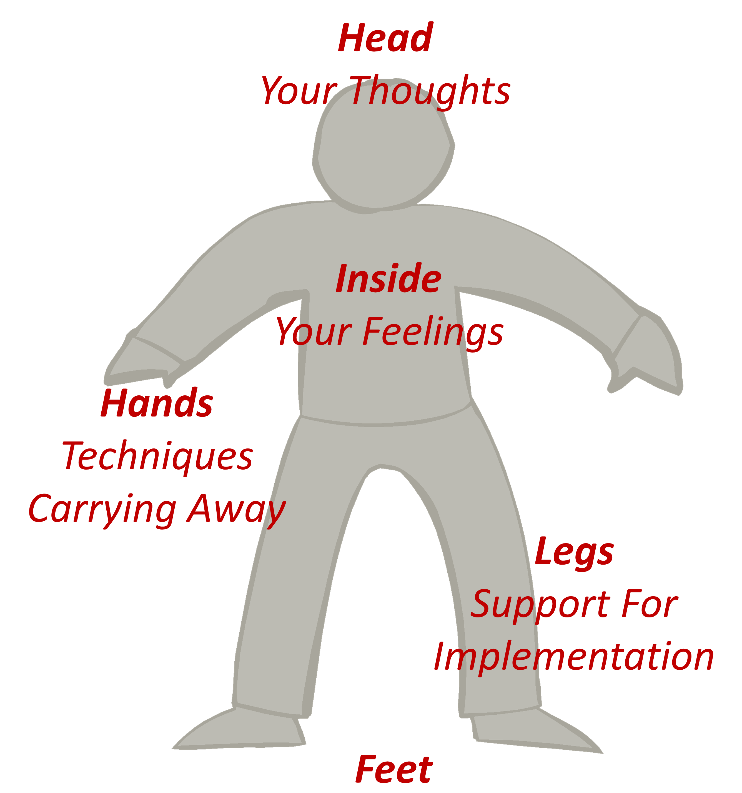
Next Steps

Slide 13
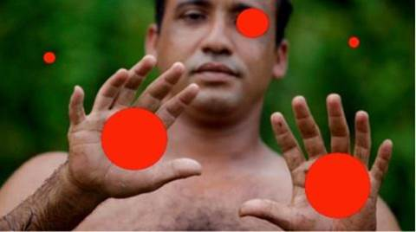

Slide 14
Add your answer into chat

Slide 16
A-Z of Player Engagement
A | B | C | D
E | F | G | H
I | J | K | L
M | N | O | P
Q | R | S | T
U | V | W | XYZ

Slide 17
OAIENRITCTN
ENPO
OESLC
BRCOIOTLNOLAA
NIMRPIG
IBTCEJVEO
ROUF ENUITM
EALVNRET
UFN

Slide 18
V | D | D | N | X | N | C | W | K | R | A | N | J | Z | W
A | Y | M | N | M | O | W | H | O | Q | O | E | R | E | R
R | Y | X | Y | M | I | M | I | O | K | D | A | B | A | V
I | W | L | Z | H | T | R | T | B | Z | Z | C | N | R | M
E | N | O | K | K | A | S | E | K | F | A | I | U | K | G
T | O | T | F | M | R | G | B | R | M | B | W | Y | N | Z
Y | H | T | E | G | O | M | O | O | E | X | V | I | L | U
R | X | O | X | R | B | O | A | W | J | D | N | G | V | S
X | T | Z | K | R | A | A | R | P | K | E | F | B | U | J
B | O | J | M | F | L | C | D | T | P | E | S | O | L | C
L | X | L | M | A | L | D | T | O | A | R | W | P | O | M
M | L | Y | F | U | O | F | T | I | Z | H | S | P | B | H
R | H | O | I | J | C | F | V | V | O | G | C | F | R | M
S | S | P | P | F | O | U | R | M | I | N | U | T | E | S
K | F | A | V | S | N | O | C | I | T | O | M | E | Z | D
CHATROOM
CLOSE
COLLABORATION
EMOTICONS
FOUR MINUTES
INTERACTION
SOFT OPENING
VARIETY
WEBCAM
WELCOME
WHITEBOARD
WORKBOOK

Slide 19

Puzzle Challenge
https://www.jigsawplanet.com/?rc=play&pid=18043a5f67bb

Slide 20

Puzzle Challenge
How is this Puzzle Like A Blended Solutions For Training?
Use Chat

Slide 21
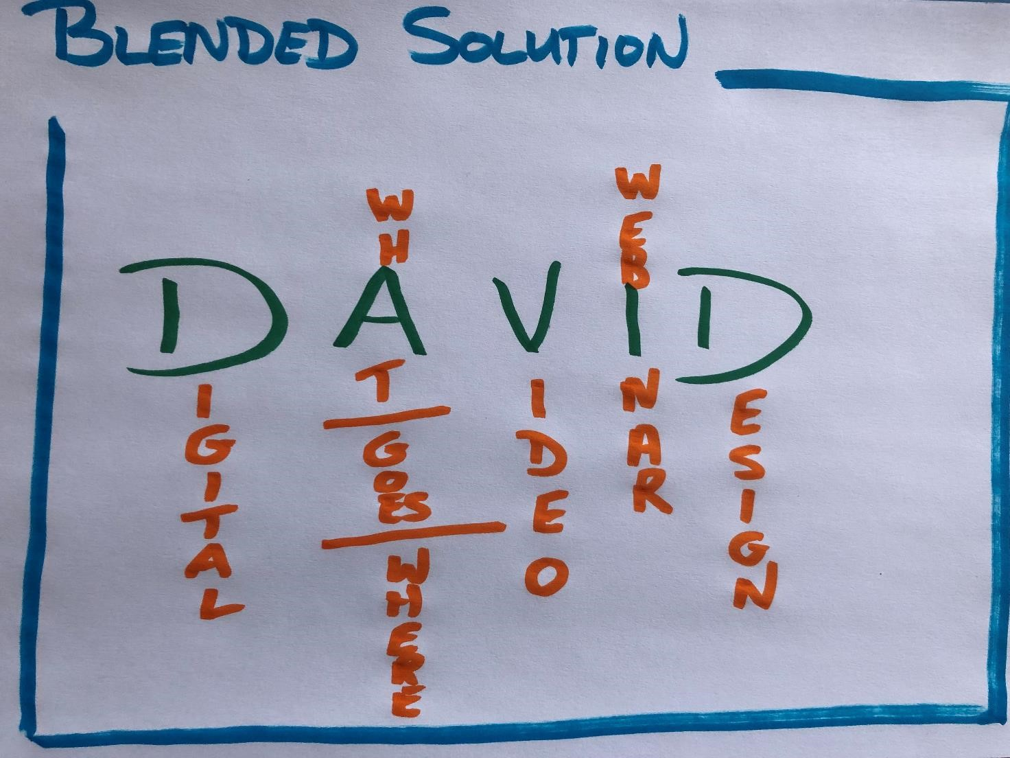

What – Where, When, How

Slide 22
What – Where, When, How

Slide 23
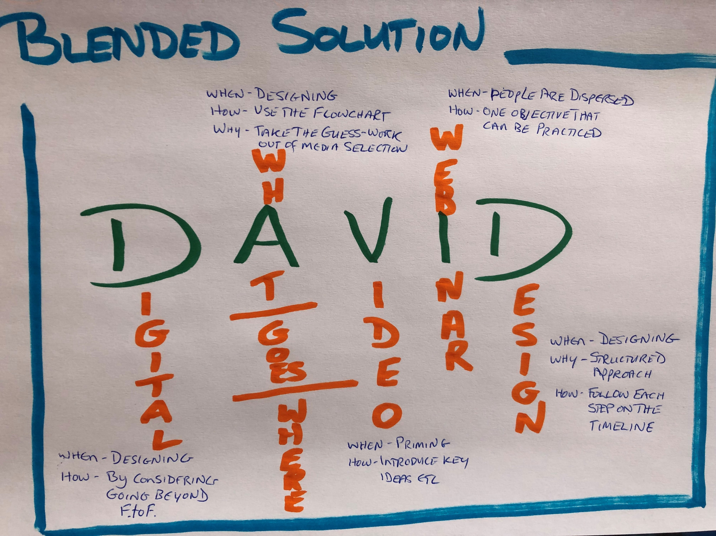
What – Where, When, How

Slide 24
FACT
AhHa
ACTION

Slide 25
START
STOP
CONTINUE

Slide 26

Have in mind your key idea from today

Slide 27
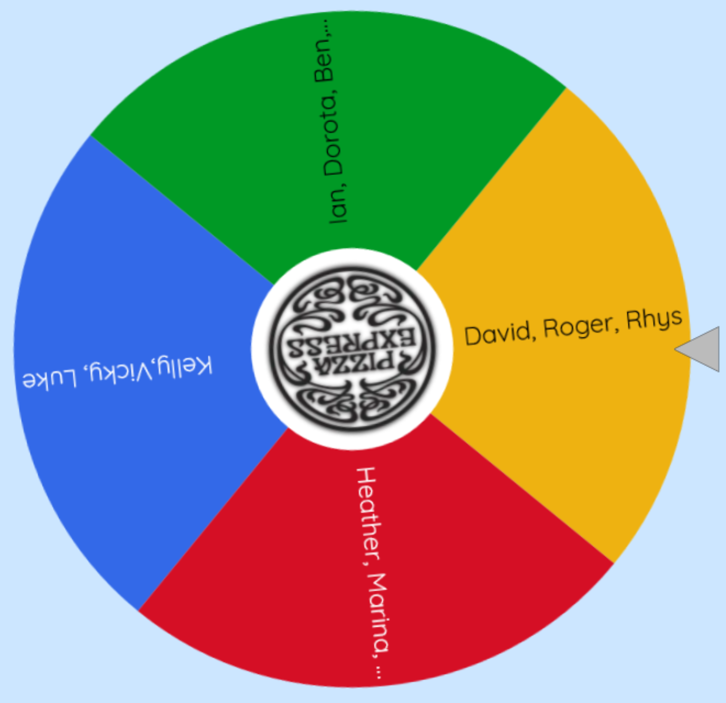
Selection Spinner
https://wheelofnames.com/

