Slide 1
Your colleague asks you, ‘If you have to apply only one thing as a result of this training so far, what would it be?’
Notes:
Review
Look back at notes to find their one thing.
Ask to summarise into 4 words and write it down
Into Breakout rooms (4-5 per room)
Share their 4 words and explain how they’ll apply
Allow 4-5 mintues

Slide 2
Accepting your challenge to create your next virtual training, you’ve created all of your training elements, selected key content, written the objectives, created your opening and close, added interaction and collaboration. Now it’s time to piece it all together.
Your
Challenge
Complete your virtual training design!

Slide 5
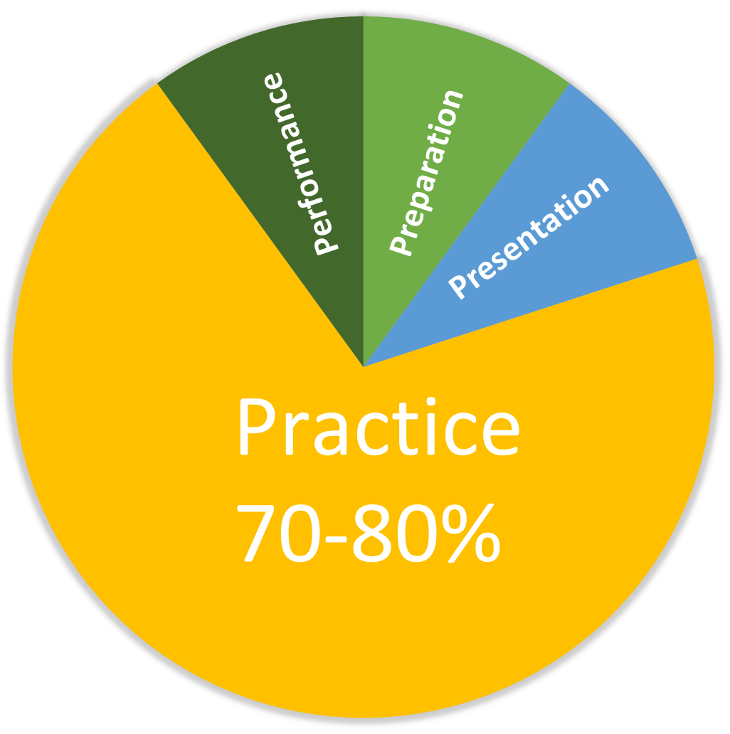

Slide 6
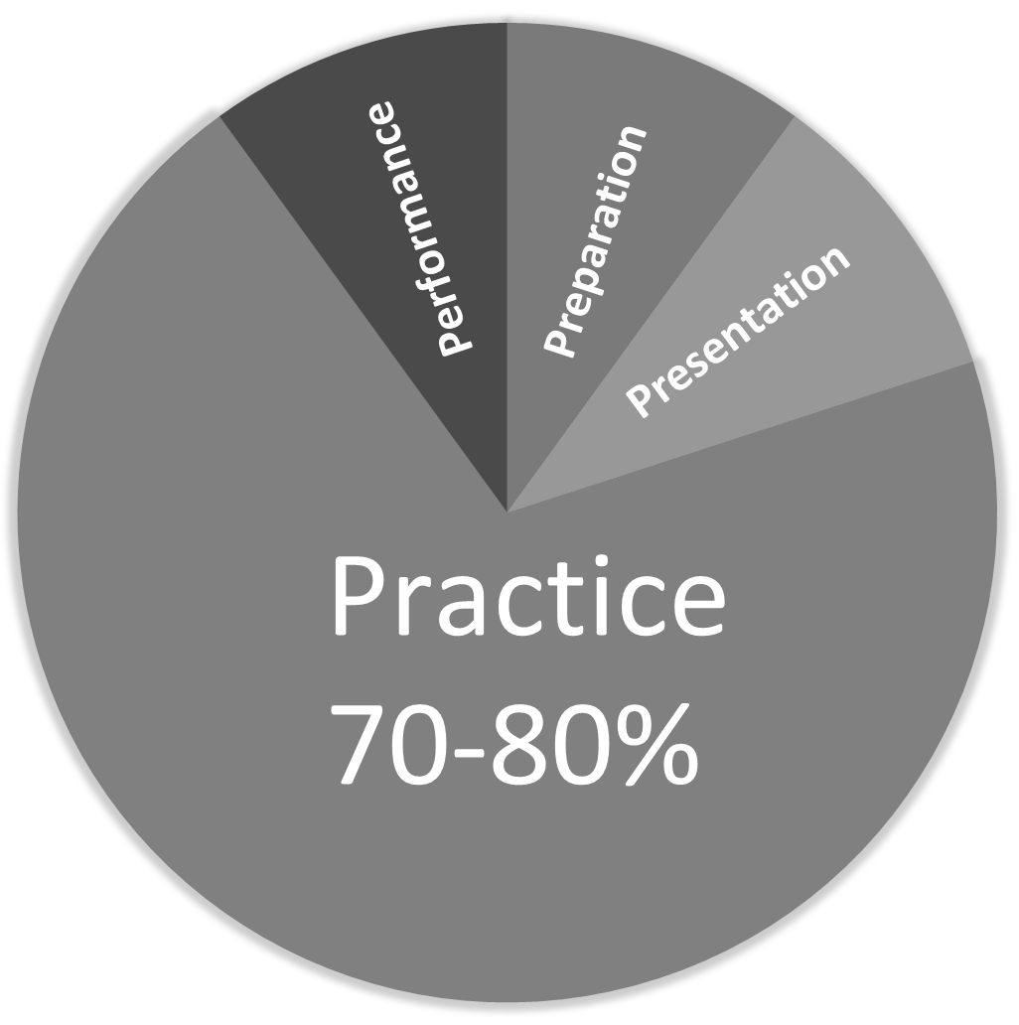
Preparation
How To Prepare Learners for this piece of Content

Slide 7
Ideas For The Preparation Phase
Steps to ….
Step 1 __________________
Step 2 __________________
Step 3 __________________
Step 4 __________________
How This Will Help Me
Pre-test
Prediction
Your Challenge
You’ve been away on business and had to pay accommodation and food yourself. You need to be reimbursed. Your Challenge is to work out how to submit your expense claim.
Notes:
Add - Where we stand

Slide 8
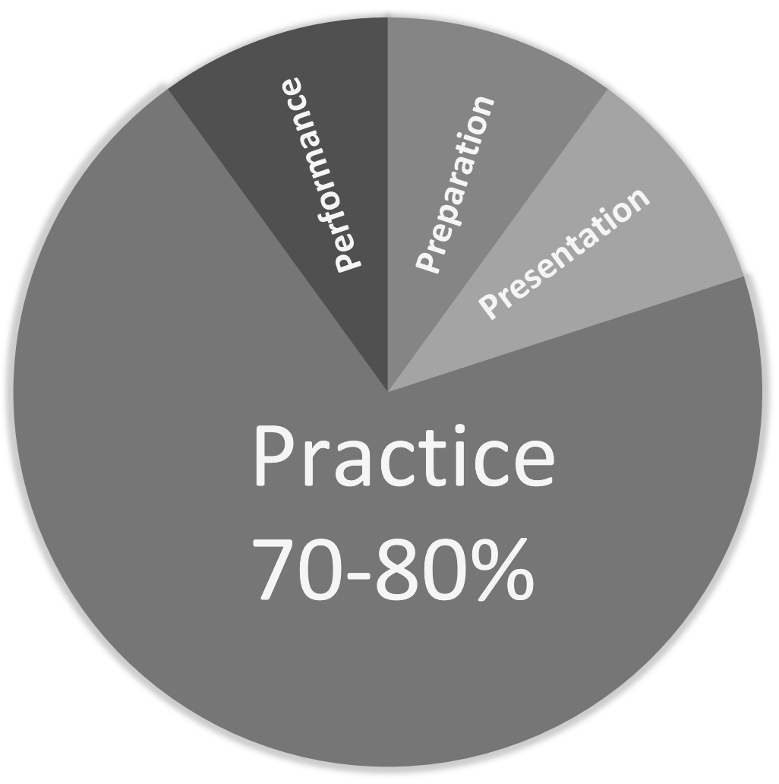
Presentation
Where you give the content (if you need to give content)

Slide 9
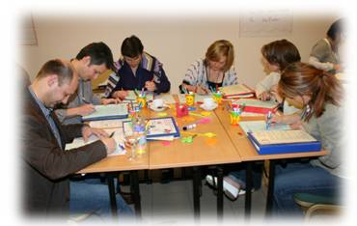
Ideas For The Presentation Phase
How Would You Design The Screen?
Make Notes During Lecture
Expense Form
Date
Expense Type
Amount
Expense Code
REF
Learners Do Research
Video With Task
Notes:
Add, if the training was in the restaurant, ask them to ask their manager and/or colleague what they know about it and report back

Slide 10
Practice
Learners try the Skill or try applying the Knowledge

Slide 11
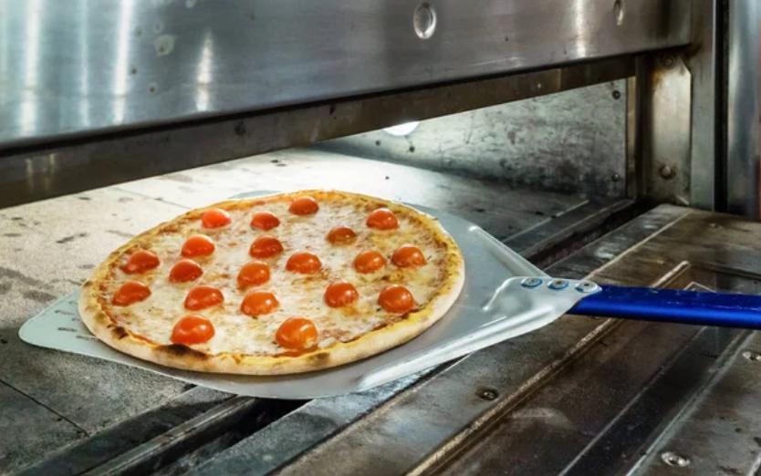
Ideas For The Practice Phase
Create A Case Study For Another Team
Test Teams From Lecture (then apply)
Practice The Skill or Applying The Knowledge
Divide and Conquer

Slide 12
Performance
You Observe Learners DOING what you said they’d be able to do.

Slide 13
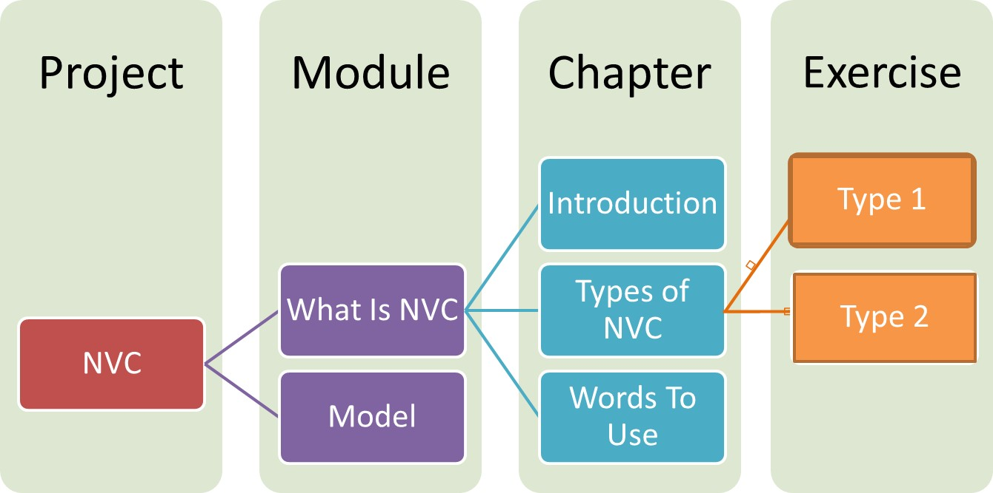
Ideas For The Performance Phase
Complete A The Full Task
Create A Dummies Guide To …
Create a Process Flow Chart, Checklist or FAQ
Set A Challenge For Another Group To Complete
Cause problem for troubleshooting
Create a scenario eg Open the restaurant kitchen
Shuffle the sequence of a process and ask to recreate

Slide 14
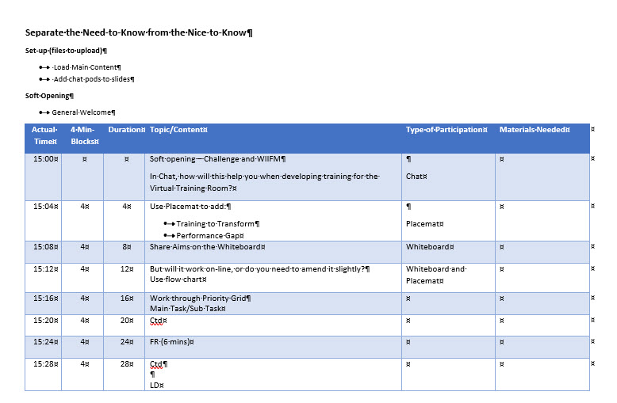
4-Minutes Rule

Slide 16
One Objective = One Learning Cycle
One Objective = One Digital Lesson
70-80% In The Practice Phase

Slide 17
Time to Play

Slide 18
Share
Notes:
https://eurekatp-my.sharepoint.com/:p:/g/personal/david_eureka-tp_com/EYM4JYeb3M1Dq05o-rsU7igBhtAzzO08L7J91vBhwYj5YA?e=PBYLSe

Slide 19
Next Steps
Complete your virtual training design.
Notes:
Remember to say about Tips for Trainers.

