Slide 1
Accessible and Inclusive Design
Where Do You Start?
Notes:
In Teams, try out the closed captioning and language features.
Make sure everyone has the worksheet open.

Slide 2
Why should we make our documents accessible?
Please use the chat feature to raise your hand and provide a response.
Notes:
Duration
4 minutes.
Ask the question on the slide.
Allow the participants 2 minutes to provide their answers.
Potential Answers
It is legislated (e.g. Accessible Canada Act)
Fairness
Inclusivity
It attract more talent to the federal government
Good design can be helpful to all
Makes people feel more welcome – removes barriers/kindness
No need to make multiple versions
Web Content Accessibility Guidelines (WCAG) 2.0
You could be sued for discrimination
Aging workforce – changes to hearing or vision or mobility
Not just hiring – some become disabled while working and want to continue to work
What have you seen in public that makes things accessible? E.g. curb cuts, braille in elevator. What about when we’re at work and working on documents?

Slide 3




Is it possible to make documents completely accessible?
Notes:
Duration
6 minutes
Ask the question on the slide.
Ask the participant to use the polling feature for yes or no or ask them to virtually raise their hand for a yes response.
Ask what other ways a yes/no question or a true/false question can be asked in virtual training to ensure that all individuals can participate.
Display each symbol one at a time. Describe the symbol and ask the participants to guess the meaning of the symbol.
Ask them to respond by using the chat feature or respond out loud.
Give a minute for them to add to worksheet.
Answers
There is no perfect or end point!
Accessibility design is ever evolving and growing as we develop skills.
We are starting with low hanging fruit and deal mostly with visual impairments and how screen readers work with content, colour blindness, improving visibility, and contrast. If we have audio, we add closed captioning. Where possible, we also consider other accessible design factors.
To save time, design the accessibility in right from the start. It also helps to get you in the habit of making your documents accessible by design.
Try to make your material as accessible as possible, but remember, it’s okay if an alternate version of your material is necessary. Ask yourself though, if the material really needs to be in a non-accessible version to improve learning. Having only one version has the added benefit of being less work for us to create and maintain. Also, there isn’t just one way to make material accessible.

Slide 4
Plain Language – Short and Simple
Who will be benefitting from plain language?
Who will it benefit?
Who benefits?
Notes:
Duration
2 minutes
Note
The first thing you should do is make your words themselves accessible by using plain language.
The Canadian Government has a directive to use plain language in all communications with the public.
Writing text using plain language can sometimes take a few steps. For example:
I wanted to ask, “Who will be benefitting from plain language?”
I then shortened it to, “Who will it benefit?”
I then realized that all I really needed to ask is “Who benefits?”
Start with simplifying language – don’t show off with big words if they don’t add to meaning. Then remove unnecessary words - this isn’t grade school, you don’t need to pad your word count. What is the shortest sentence that still has the same meaning?
Ask, “So, who benefits?”
Answer: Everyone! Especially individuals using screen readers, and/or anyone with learning disabilities.

Slide 5
Plain Language – Practice
How can you rewrite this sentence using plain language?
Any, and all citizens, humans, and individuals profit mightily from discourse that is not obfuscated with complex jargon and byzantine, obtuse and complex terminology, using an unclear lexicon.
Everyone benefits from plain language.
Notes:
Duration
2 minutes
Ask the question on the slide. Allow one minute.
Ask the participants to respond out loud.
Allow several participants to respond before revealing a suggested response.

Slide 6
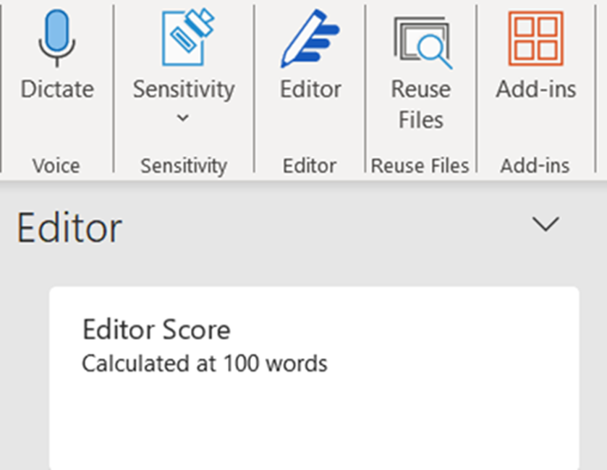
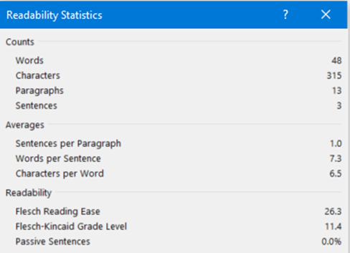
Accessibility Help in MS Office – Word
Readability statistics
Editor
Document stats – Readability level
Notes:
Duration
4 minutes
MS Word has an editor that provides readability statistics and a grade level analyzers. It is found under the Review tab/Spelling and Grammar/Editor, then choose Document stats. It uses North American school levels but it translates to approximately the number of years of education. For example, we aim for an 8th grade level which is about a 13-year-old grade. There are charts online that will show you the comprehension level of each score. 8th grade is conversational English.
Share screen if needed to show where to find these tools.
Access a recent Word document and check the readability of your document. (Allow 2 minutes)
Ask three or four participants to share their results using the chat function.

Slide 7
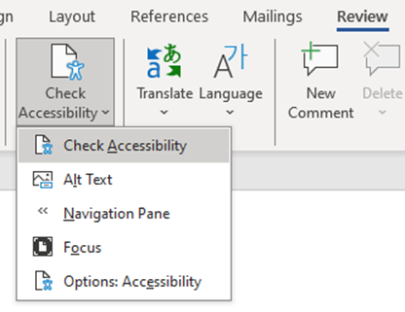
Accessibility Help in MS Office – Word/PowerPoint
MS Office Applications include accessibility tools
Notes:
Duration
1 minute
Note
MS Office has built in tools to help you check the accessibility of your document. They are found under the Review tab and include a checker that finds any errors and makes recommendations.
Share screen if needed to show where to find these tools.
Try this now with the worksheet for this course.
What did it show are the issues?
Not all accessibility issues will be found by the accessibility checker, you’ll need to manually check for some things, but the checker will cover some basic issues.
Give a minute for them to add to worksheet.

Slide 8
Assistive Technologies
Screen Readers
Dolphin, JAWS, TalkBack
Screen Magnification Software
ZoomText, MAGic, Dolphin
Voice Recognition Systems
Dragon Naturally Speaking
Keyboards vs Mouse
Notes:
Duration
2 minutes
Note
There are several assistive technologies participants may use. Here are some examples of popular software.
Keyboards vs. Mouse
Mobility issues, i.e., Carpal Tunnel syndrome
Also, Windows Ease of Access tools for contrast, size, etc.
Do you know of any others?
Give a minute for them to add to worksheet.

Slide 9
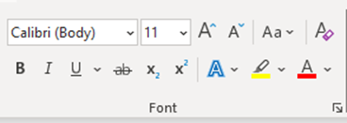
Word Tips
Font
Navigation Pane
Built in formats and headings
Italics
Text colour
Colour to differentiate
Notes:
Duration
3 minutes
Note
Use at least a size 12 font and a non-serif font like Arial.
Use the navigation pane to check your text headings.
Use headings in order, and do not skip headings.
Use heading styles instead of just changing the look of a heading. The screen reader reads out the heading level and it goes in order of heading levels. Users can also skim a document using headings. Also, different levels should look different.
Ensure any empty lines are using Normal, as carriage returns after a heading will use the heading style so when you type there, it will be in the wrong style. Check for this using the Paragraph marks.
Also check for extra spaces – use tabs for spacing text instead of extra spaces. Otherwise, the screen reader will say space, space, space.
Built in formats like bullets are important for screen readers – don’t just use dashes. The screen reader will say that it is a list.
Only use italics for Acts or Laws. Screen readers do not recognize font changes so making it look different won’t be communicated using the screen reader. It also can be an issue for those with other vision issues.
Use automatic text colour, not black.
If you use black as the text colour, it will remain black, even if the user has a high contrast (black) background.
If you use automatic as the text colour, it will change according to user’s setting.
Don’t just use colour to indicate different items. Use some other method as well, like an asterisk.

Slide 10
Links
https://youtu.be/xaK6rlzhqHc?si=rMgM6Hfqpc8x1T_j
YouTube video explaining the importance of headings
Notes:
Duration
I’d like you to go to this website: https://youtu.be/xaK6rlzhqHc?si=rMgM6Hfqpc8x1T_j
This is how the screen reader will read the link.
Links should provide a clear and accurate description of the link destination. Instead of providing just the URL of the link, create the hyperlink with text to describe it.
You could have the text to display say ‘YouTube video explaining the importance of headings’.
Don’t use “click here”, a screen reader will say Link before a hyperlink, and a sighted person will see the different colour and underline.
Give a minute for them to add to worksheet.

Slide 11
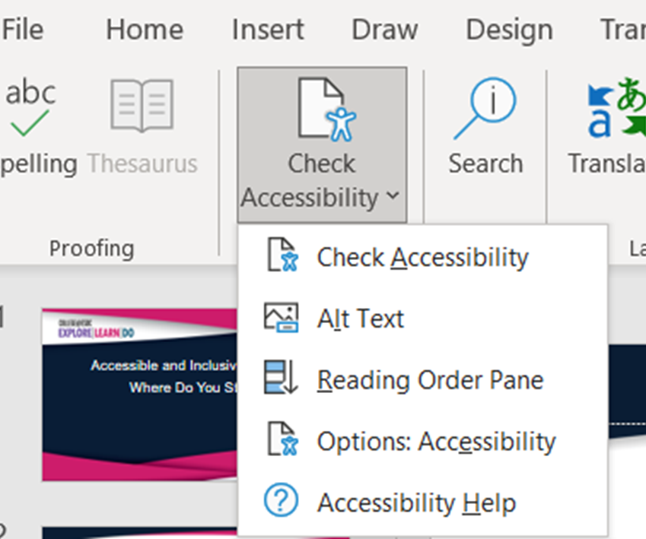
PowerPoint Tips
Not too many animations
Unique heading on each slide
Trainer notes
Notes:
Duration
8 minutes
In a moment, we will put you in breakout rooms. What are some things we should do or avoid in PowerPoint to make our presentations more accessible?
Limit the number of animations used on each slide. Excessive animations can be challenging for a screen reader to manage. Many animations can be difficult for those with cognitive issues with all the movement, and the screen reader will have difficulty with items that are moving around and if meaning is conveyed by movement.
A unique title (header) is required for each slide.
Ensure notes support the trainer in describing on screen images and also support a trainer who may have low vision.

Slide 12
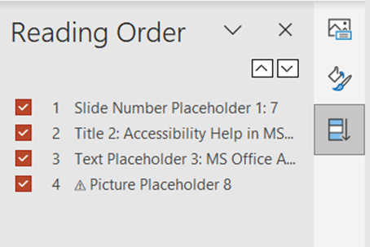
PowerPoint Tips Reading Order
Placeholders
Reading Order
Notes:
Duration
8 minutes
For PowerPoints, all content (images, text, etc.) must be added to the PowerPoint using content placeholders. It is important to place these placeholders in a specific order – the order in which a sighted person would read them. Since the order you see items on screen is not necessarily the order the screen reader will read them it’s important to check the reading order of each slide of a PowerPoint.
There are two ways to check the reading order:
As listed by using the Reading Order Pane in the Accessibility Checker (tool bar / Review / Accessibility Checker)
In reverse order when reviewing the Selection Pane (select a content placeholder, select Shape Format from the tool bar, and select Selection Pane)
Access a recent PowerPoint document and check the reading order of your document. Were the results what you expected?
Ask three or four participants to share their results using the chat function.
Instruct the participants to take a moment and correct the reading order on one or two slides. Generally, the order is slide number/title (header)/content placeholders in order of review. You can drag and drop or use the arrows to change the order.
Give a minute for them to add to worksheet.

Slide 13
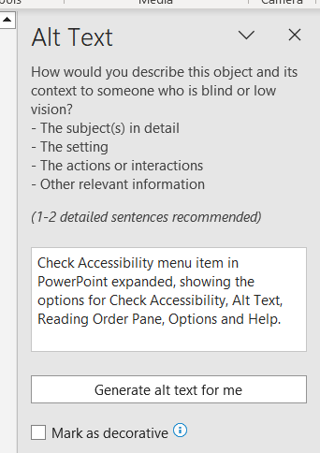
Images and Alt Text
How can a screen reader read an image?
Decorative – Mark the image as decorative
Short description – Describe the image using alt-text
Long description – Describe the image in the document text (under the image)
Notes:
Duration
3 minutes
Ask: Do you know how a screen reader can read an image?
Ask the participants to respond by raising their hand in the chat feature.
Reveal the additional information.
A screen reader needs either alt-text or a long description to describe the image to the user. Long descriptions are generally used where a detailed description is required; for example, system screen shots. It’s best to use images that are useful and limit the use of decorative images.
If an image does not have content the user needs to know, mark the image as decorative in the alt-text dialog box.
If a short description is needed, use this dialog box to write a brief sentence or two (less than 100-150 characters).
If a longer description is needed, add in the text after the image, or in the Notes section of a slide, with the heading Long Description. For Word documents, the long description should be right after the image, or added to an Annex section at the end of the document with a link to the description immediately after after the image. A link is to return the user to the image is also required.

Slide 14
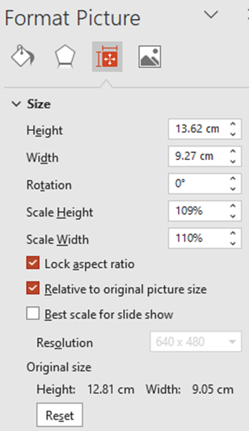
Slide Design and Replacing Images
Use slide templates with applicable placeholders.
Replace image and resize
Notes:
Duration
3 minutes
Use slide templates that have placeholders that work for what you want. If you use the same one often, or are re-using parts of it, just copy your slide and change it as needed.
To change an image, right click on the image and choose Change Picture. Then either choose from your computer, a stock image or from your clipboard. The new image will fit the shape of the old image and usually be distorted. To restore the image’s proportions, right click on the new image and choose Size and Position. The Format Picture sidebar will come up, with a Reset button, as shown in the image on screen.
Don’t forget to change the Alt text. If you`ve changed the name of the image to find it in your image library, change it in the selection pane.
Give a minute for them to add to worksheet.

Slide 15
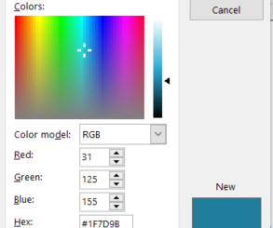
Colour Contrast Analyzer
Test Text
Notes:
Duration
Make sure your text and background have enough contrast or difference to be easily read. There are apps for analyzing colours that you can download or access online. We use Colour Contrast Analyser. They will tell you if the colour contrast passes a standard used by the Web Content Accessibility guidelines. AAA is the highest grade and AA is slightly less strict but still good.
You can find the Hex code for your image by going into the fill dialog box, and More Fill Colours.
Do you think the text box on screen will meet the standard?

Slide 16
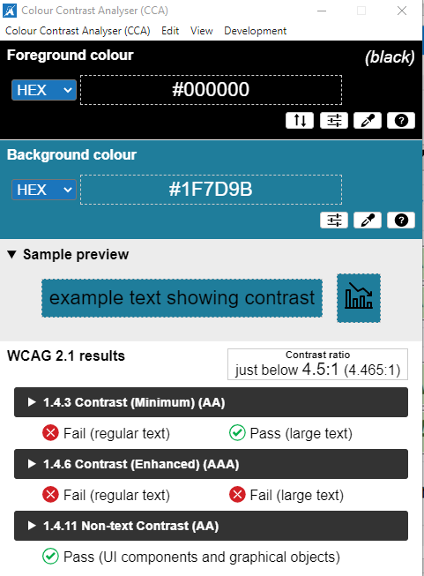
Analyzer Result
Test Text
Notes:
Duration
It depends on the size of the text – larger text may pass as it is easier to see the contrast. In this case, it failed the enhanced standard at any size, but passed the AA Minimum contrast standard if using large text, which is 18-point font or larger.

Slide 17
Tables
Stuff Additional Info |  | Additional Info
Only use when necessary |  | Hard for screen readers
Ensure there are headings |  | These organize information
No merged cells | No split cells | These are not easily read by screen readers
Notes:
Duration
Use alt text for tables to describe the meaning or purpose and a summary. Select the whole table and right click to view Alt text.
What issues do you see with this table?
Does not use content placeholder to create the table, it is in front of the content placeholder.
Not needed for this content. Tables should only be used to present data, never for formatting.
The headings are not obvious and were not made into a header row – this option is found in the Table Design ribbon. Use clear and meaningful row and column headers.
Merged and split cells make it difficult for the screen reader to read in order.
Give a minute for them to add to worksheet.

Slide 18
Let’s Practice!
Look over the worksheet and find what could be improved to make it more accessible.
Go beyond the accessibility checker and think about what we’ve discussed!
Fix any issues you find.
4 minutes
What did you find?
Share in chat or put up your hand.
Notes:
Duration
Allow 4 minutes for learners to practice fixing the document on their own, then share screen to show the document and ask them what they found and show how to fix it.
Answers:
Font is hard to read
Italics not needed
Main heading hard to read contrast, spaces in front instead of centering
Headings not in order
Some are not headings
No Alt text for image
Text is small and in the centre – if you zoom in the text is off the side
Table not really needed and has merged cell
Text in different colours to indicate categories
Carriage returns are in the style of the headings in some sections
Extra spaces instead of tab or where not needed
What is your top takeaway from today’s session?

