Slide 1
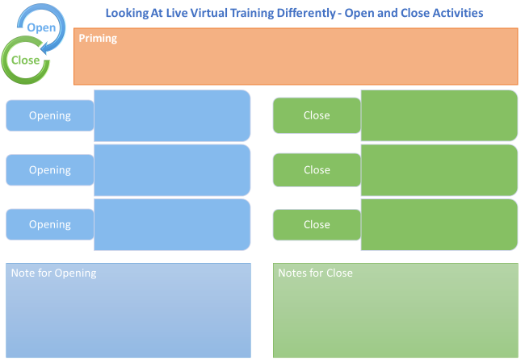

Slide 2

Creating time to be Interactive

Slide 3
34%

Slide 4



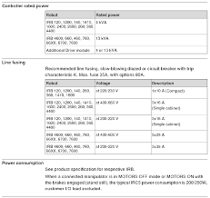
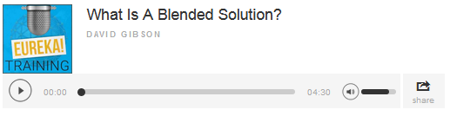

Pre-Communication and Priming
Bio of Presenter
Compliance
Summary
Explainer Video/Welcome Message
Audio File (Podcast)
Product Specification
Web Link

Slide 5


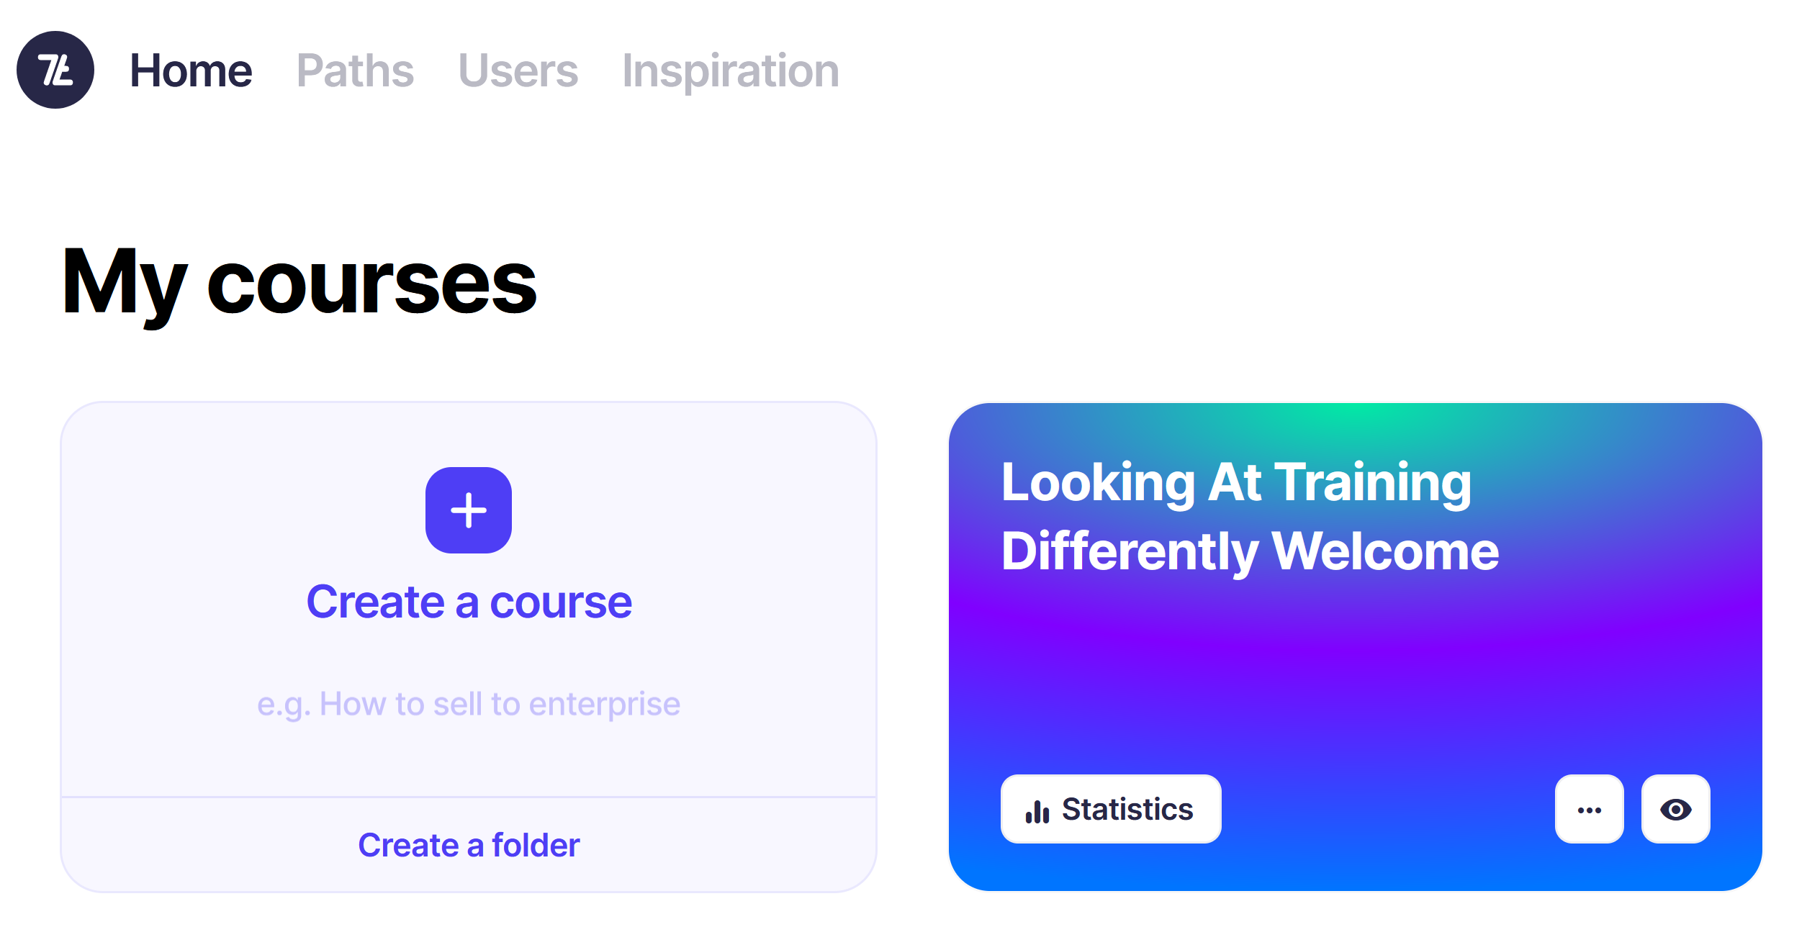
Pre-Training (Priming)
Canva – Carousel
https://app.7taps.com/mZeOoUrlZoSa
Notes:
Canva Carousel (MS Teams)
https://www.canva.com/design/DAGEdjy2b0M/bzEpkfBzJZ4X0QxNXmOldA/view?utm_content=DAGEdjy2b0M&utm_campaign=designshare&utm_medium=link&utm_source=editor
Say I’ll add link to 7 habits – how to create the carousel - timestamp
7 Taps – eMobility
https://app.7taps.com/mZeOoUrlZoSa

Slide 6
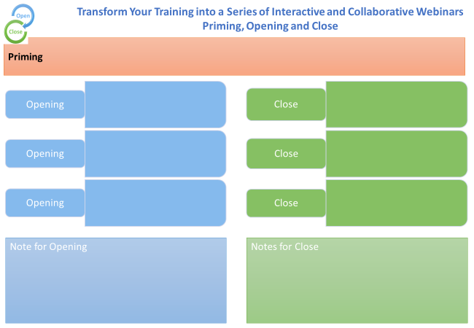

Slide 8
Opening
Notes:
Use Whiteboard

Slide 9
One Thing I Already Know About Electrification Solutions
One Question I Have About Electrification Solutions

Slide 10
My Circles of Skill and Knowledge

Slide 11
Designing Scenario Based eLearning

Slide 12
My Circles of Skill and Knowledge
Things that I know and use relating to
[Training Topic eg Electrification Solutions]

Slide 13
My Circles of Skill and Knowledge
Things that I know and use relating to
[Training Topic eg Electrification Solutions]
What do I need from this training [eg how to select the ideal solution]

Slide 14
My Circles of Skill and Knowledge
Things that I know and use relating to
[Training Topic eg Electrification Solutions]
What do I need from this training [eg how to select the ideal solution]
Take-aways

Slide 15
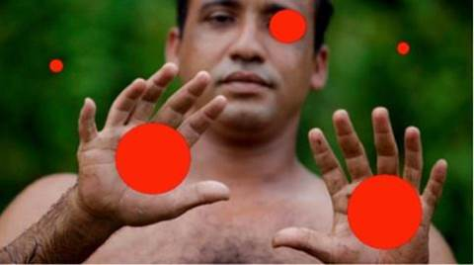

Slide 16
Add your answer into chat

Slide 18
A-Z of Electrification Solutions
A | B | C | D
E | F | G | H
I | J | K | L
M | N | O | P
Q | R | S | T
U | V | W | XYZ

Slide 19
OAIENRITCTN
ENPO
OESLC
BRCOIOTLNOLAA
NIMRPIG
IBTCEJVEO
ROUF ENUITM
EALVNRET
UFN

Slide 20
V | D | D | N | X | N | C | W | K | R | A | N | J | Z | W
A | Y | M | N | M | O | W | H | O | Q | O | E | R | E | R
R | Y | X | Y | M | I | M | I | O | K | D | A | B | A | V
I | W | L | Z | H | T | R | T | B | Z | Z | C | N | R | M
E | N | O | K | K | A | S | E | K | F | A | I | U | K | G
T | O | T | F | M | R | G | B | R | M | B | W | Y | N | Z
Y | H | T | E | G | O | M | O | O | E | X | V | I | L | U
R | X | O | X | R | B | O | A | W | J | D | N | G | V | S
X | T | Z | K | R | A | A | R | P | K | E | F | B | U | J
B | O | J | M | F | L | C | D | T | P | E | S | O | L | C
L | X | L | M | A | L | D | T | O | A | R | W | P | O | M
M | L | Y | F | U | O | F | T | I | Z | H | S | P | B | H
R | H | O | I | J | C | F | V | V | O | G | C | F | R | M
S | S | P | P | F | O | U | R | M | I | N | U | T | E | S
K | F | A | V | S | N | O | C | I | T | O | M | E | Z | D
CHATROOM
CLOSE
COLLABORATION
EMOTICONS
FOUR MINUTES
INTERACTION
SOFT OPENING
VARIETY
WEBCAM
WELCOME
WHITEBOARD
WORKBOOK
Notes:
Whiteboard

Slide 21

Puzzle Challenge
https://www.jigsawplanet.com/?rc=play&pid=18043a5f67bb
Notes:
https://www.jigsawplanet.com/?rc=play&pid=18043a5f67bb

Slide 22

Puzzle Challenge
How is this Puzzle Like Patient Care?
Use Chat

Slide 25
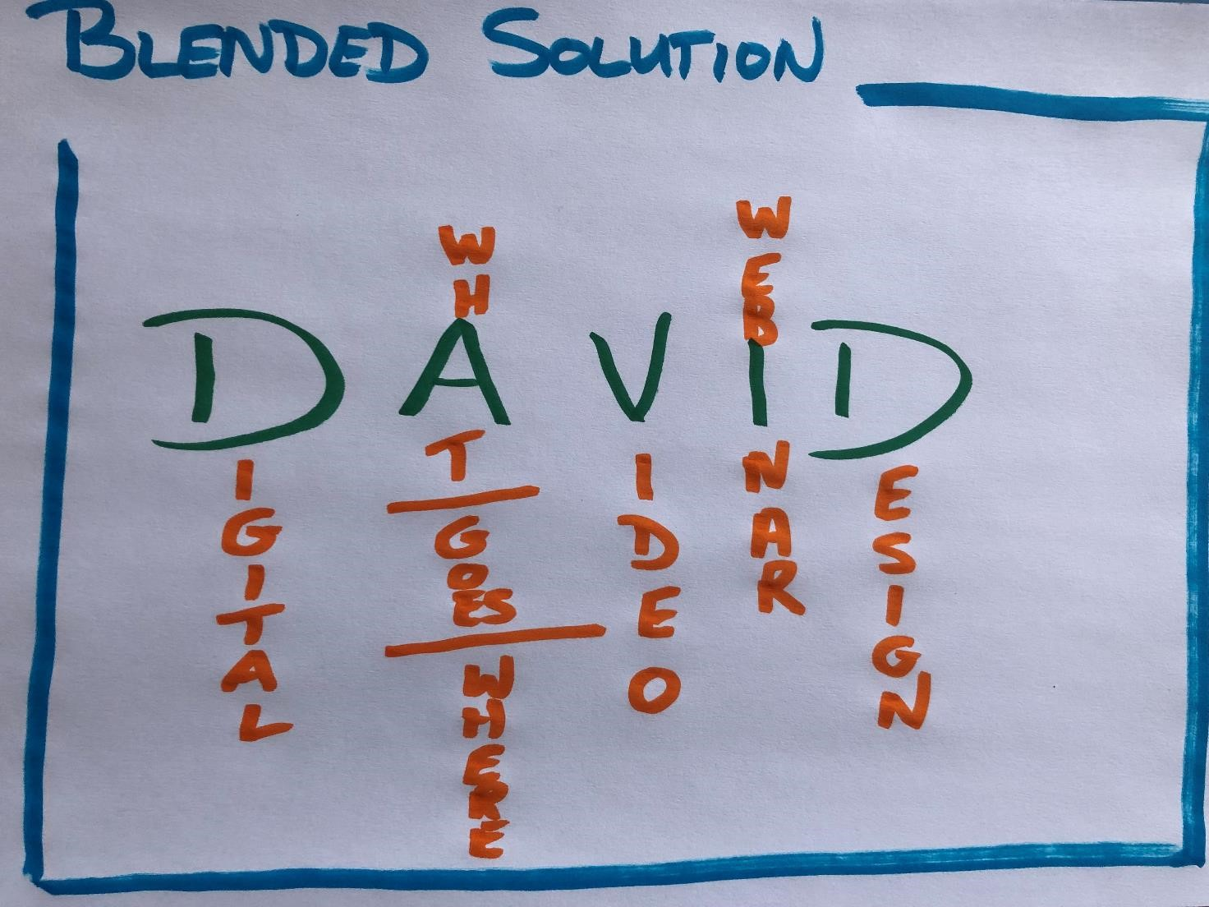

What – Where, When, How

Slide 26
What – Where, When, How

Slide 27
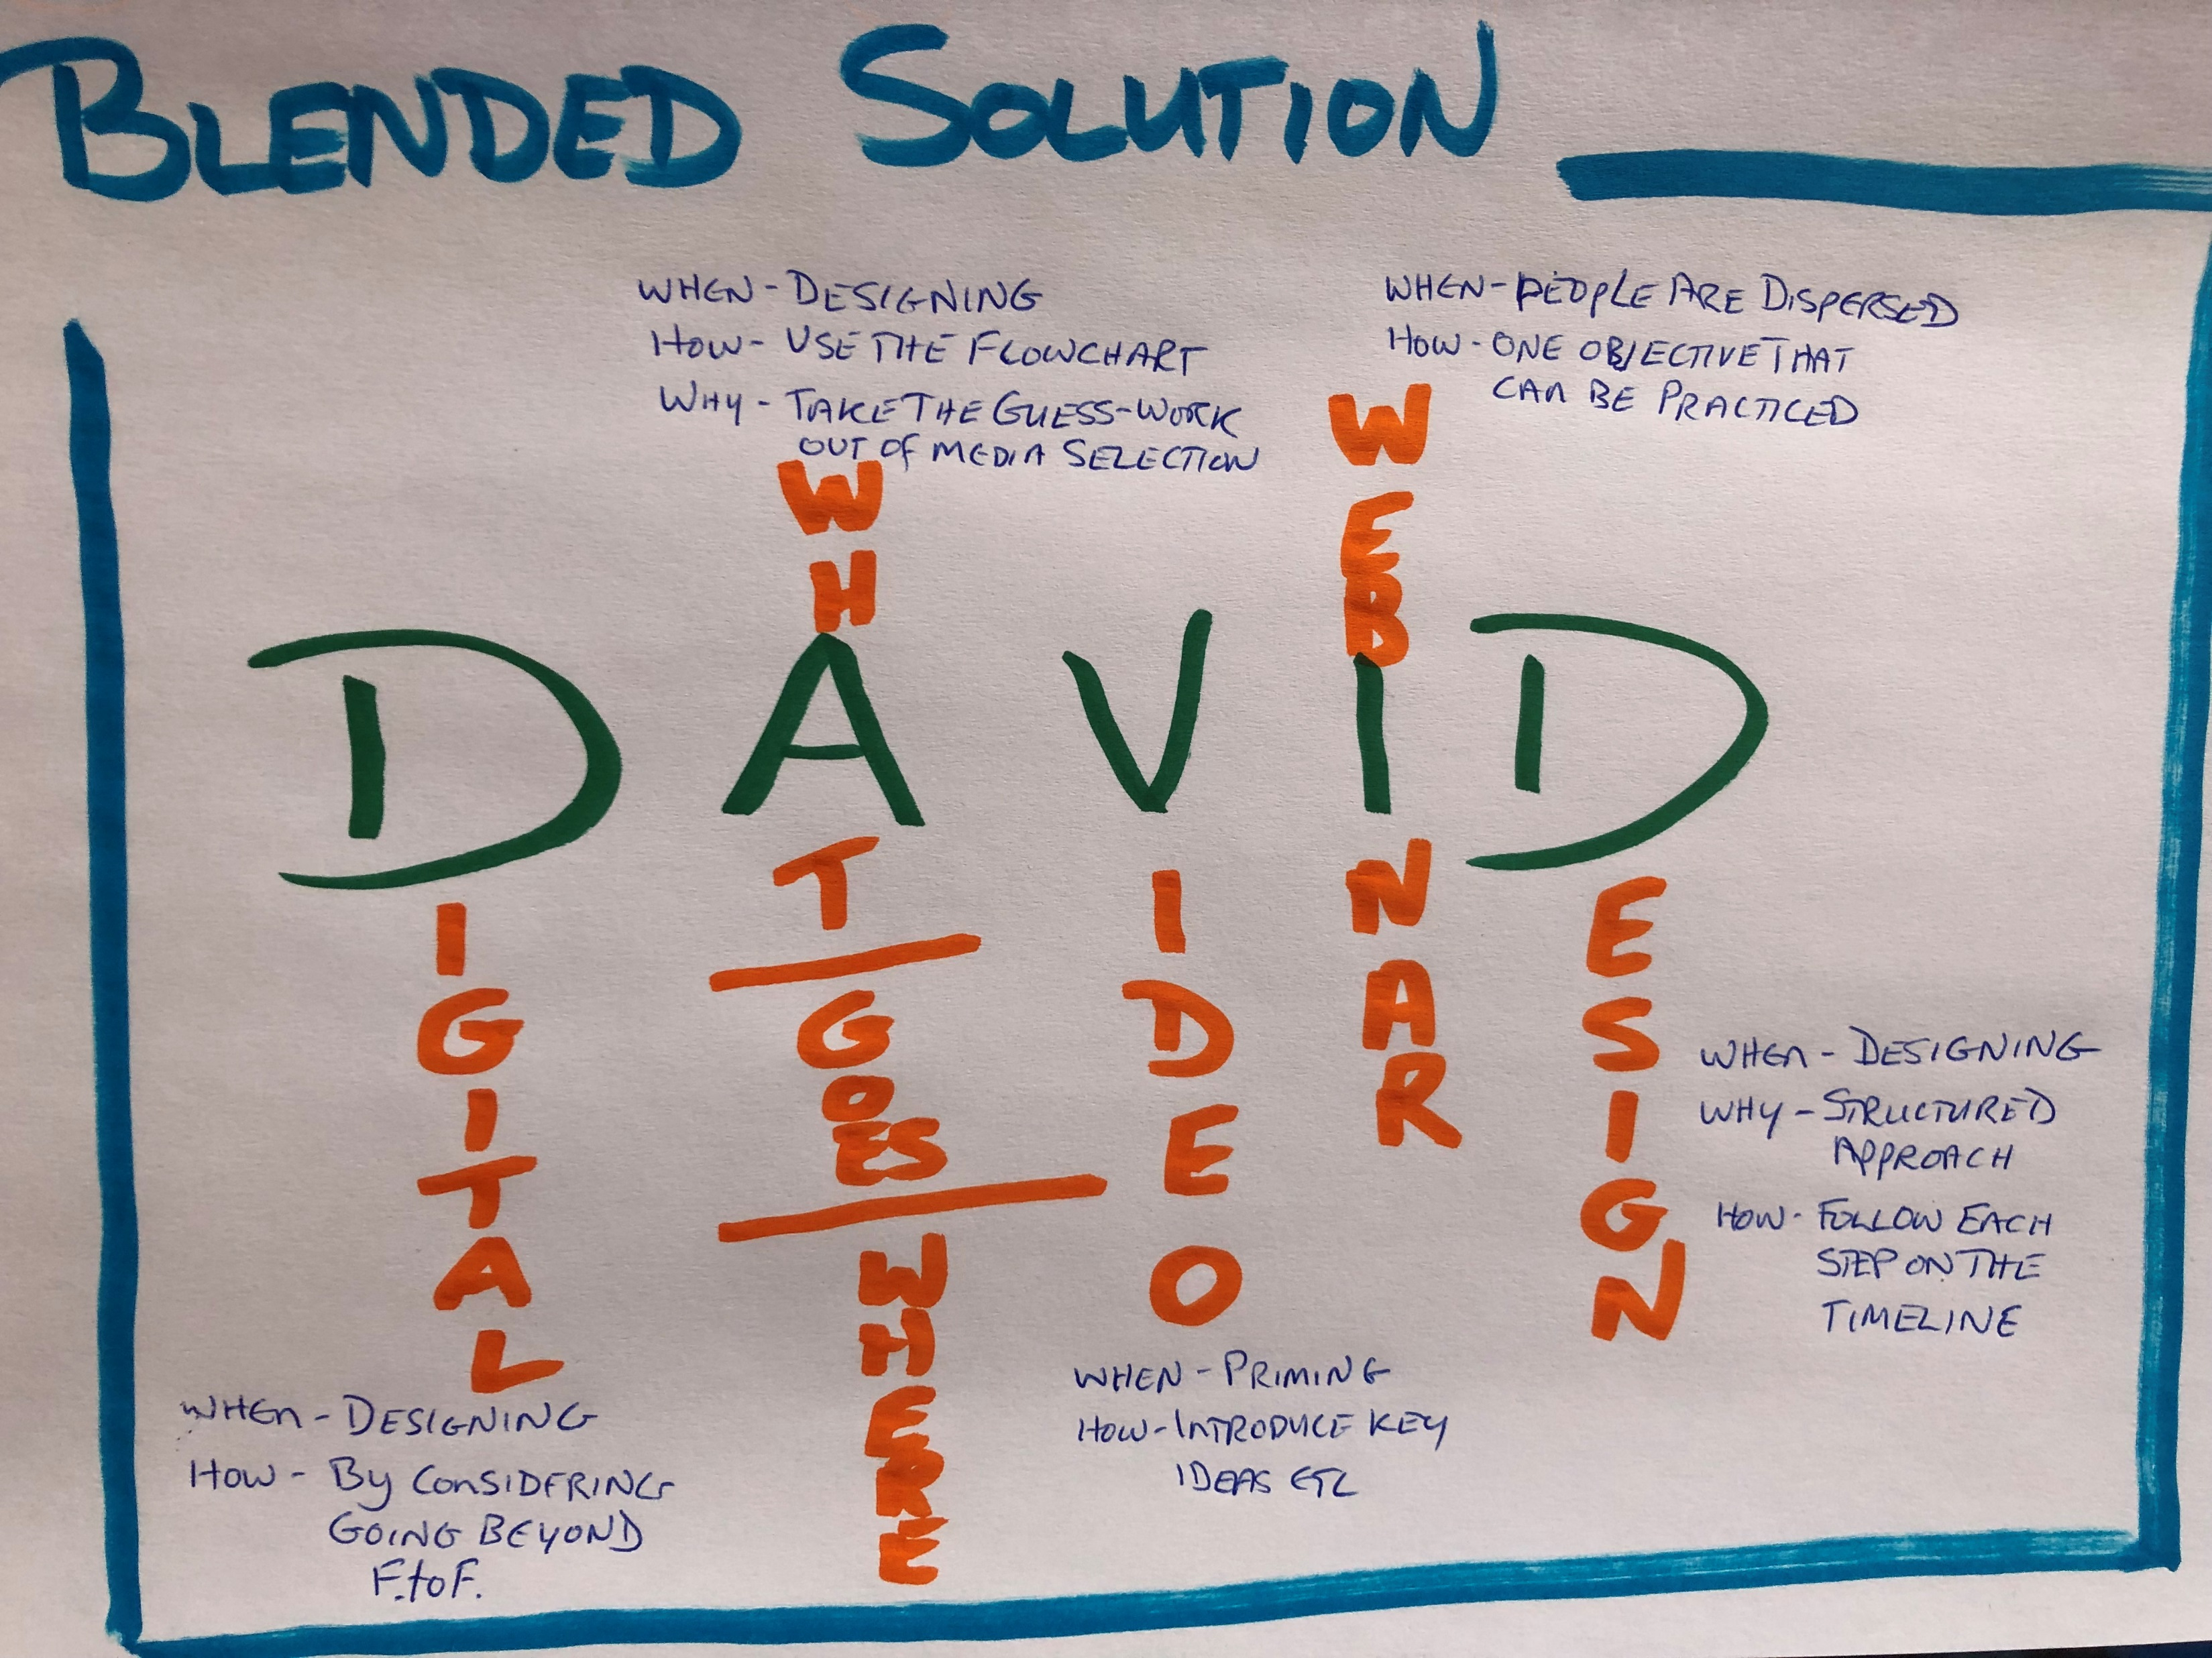
What – Where, When, How

Slide 28
FACT
AhHa
ACTION

Slide 29
START
STOP
CONTINUE

Slide 30
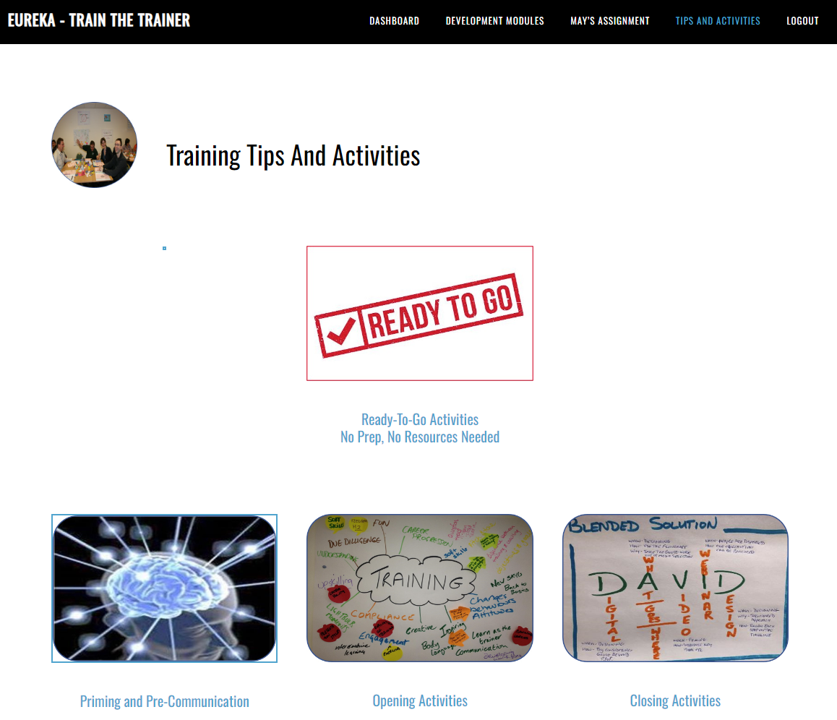
Notes:
I’ll add the link to the workshop webpage

Slide 31



https://www.menti.com
Code 8603 4891
Notes:
https://www.menti.com/alqs41bzi11j

Slide 32

Your Task
Create the Priming for the course you’re preparing.
Create the following Slides:
- Title Slide (you should have this
- Opening Slides
- Closing Slides
Notes:
I’ll ask someone to share next week

