Slide 1

Creating time to be Interactive

Slide 2
34%

Slide 3



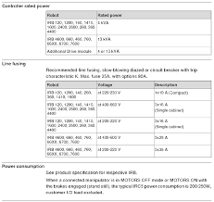
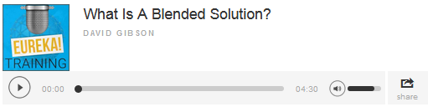

Pre-Communication and Priming
Bio of Presenter
Compliance
Summary
Explainer Video/Welcome Message
Audio File (Podcast)
Product Specification
Web Link

Slide 4


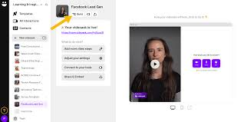
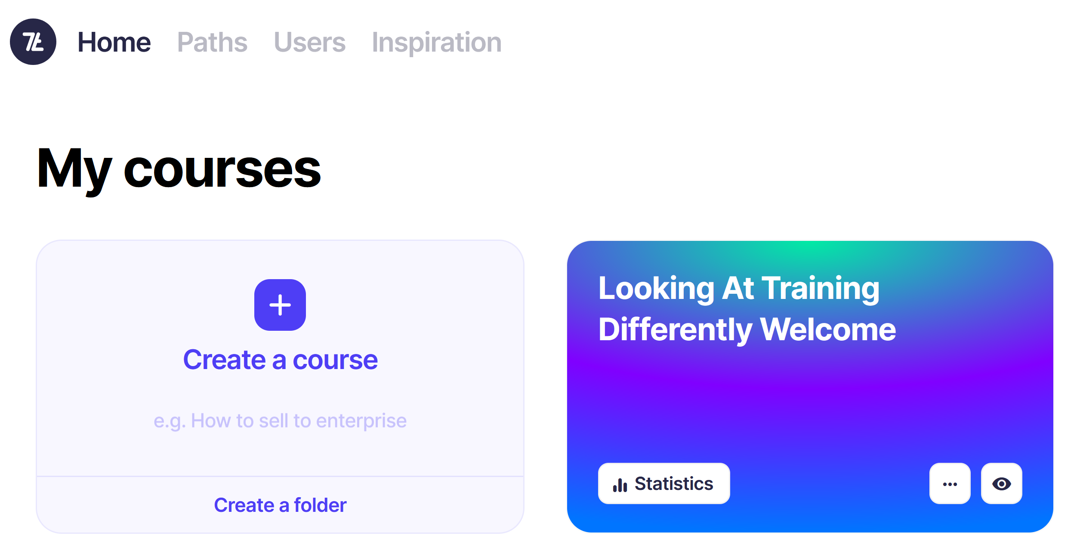
Pre-Training (Priming)
www.videoask.com
https://app.7taps.com/oQoDF2m2Sr
Notes:
www.videoask.com HP - https://www.videoask.com/fvfn8nqt9
https://app.7taps.com/courses/86643/chapters/254218/stories/1503194

Slide 5
Opening
Notes:
Use Whiteboard

Slide 6
One Thing I Already Know About Electrification Solutions
One Question I Have About Electrification Solutions

Slide 7
My Circles of Skill and Knowledge

Slide 8
Designing Scenario Based eLearning

Slide 9
My Circles of Skill and Knowledge
Things that I know and use relating to
[Training Topic eg Electrification Solutions]

Slide 10
My Circles of Skill and Knowledge
Things that I know and use relating to
[Training Topic eg Electrification Solutions]
What do I need from this training [eg how to select the ideal solution]

Slide 11
My Circles of Skill and Knowledge
Things that I know and use relating to
[Training Topic eg Electrification Solutions]
What do I need from this training [eg how to select the ideal solution]
Take-aways

Slide 12


Slide 13
Add your answer into chat

Slide 15
V | D | D | N | X | N | C | W | K | R | A | N | J | Z | W
A | Y | M | N | M | O | W | H | O | Q | O | E | R | E | R
R | Y | X | Y | M | I | M | I | O | K | D | A | B | A | V
I | W | L | Z | H | T | R | T | B | Z | Z | C | N | R | M
E | N | O | K | K | A | S | E | K | F | A | I | U | K | G
T | O | T | F | M | R | G | B | R | M | B | W | Y | N | Z
Y | H | T | E | G | O | M | O | O | E | X | V | I | L | U
R | X | O | X | R | B | O | A | W | J | D | N | G | V | S
X | T | Z | K | R | A | A | R | P | K | E | F | B | U | J
B | O | J | M | F | L | C | D | T | P | E | S | O | L | C
L | X | L | M | A | L | D | T | O | A | R | W | P | O | M
M | L | Y | F | U | O | F | T | I | Z | H | S | P | B | H
R | H | O | I | J | C | F | V | V | O | G | C | F | R | M
S | S | P | P | F | O | U | R | M | I | N | U | T | E | S
K | F | A | V | S | N | O | C | I | T | O | M | E | Z | D
CHATROOM
CLOSE
COLLABORATION
EMOTICONS
FOUR MINUTES
INTERACTION
SOFT OPENING
VARIETY
WEBCAM
WELCOME
WHITEBOARD
WORKBOOK
Notes:
Whiteboard

Slide 16

Puzzle Challenge
https://www.jigsawplanet.com/?rc=play&pid=18043a5f67bb
Notes:
https://www.jigsawplanet.com/?rc=play&pid=18043a5f67bb

Slide 17

Puzzle Challenge
How is this Puzzle Like Patient Care?
Use Chat

Slide 18
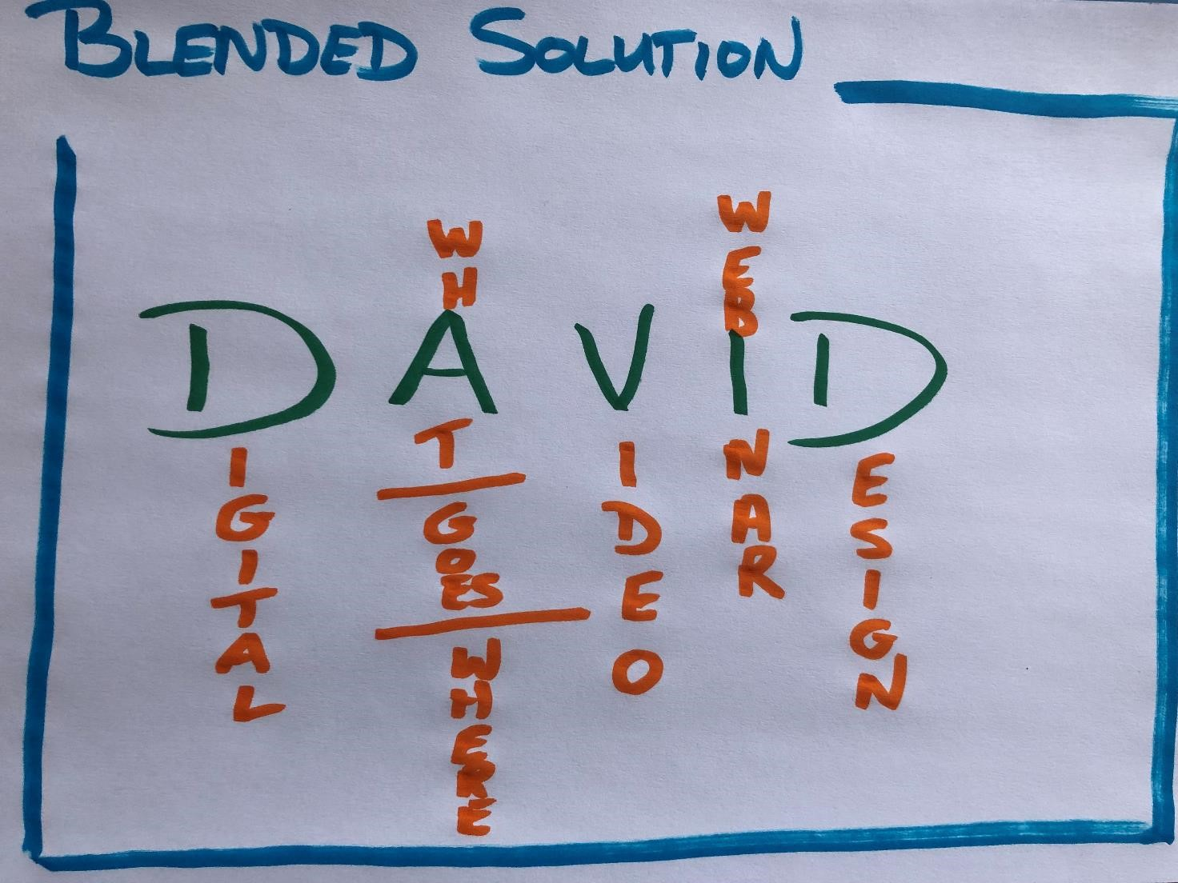

What – Where, When, How

Slide 19
What – Where, When, How

Slide 20
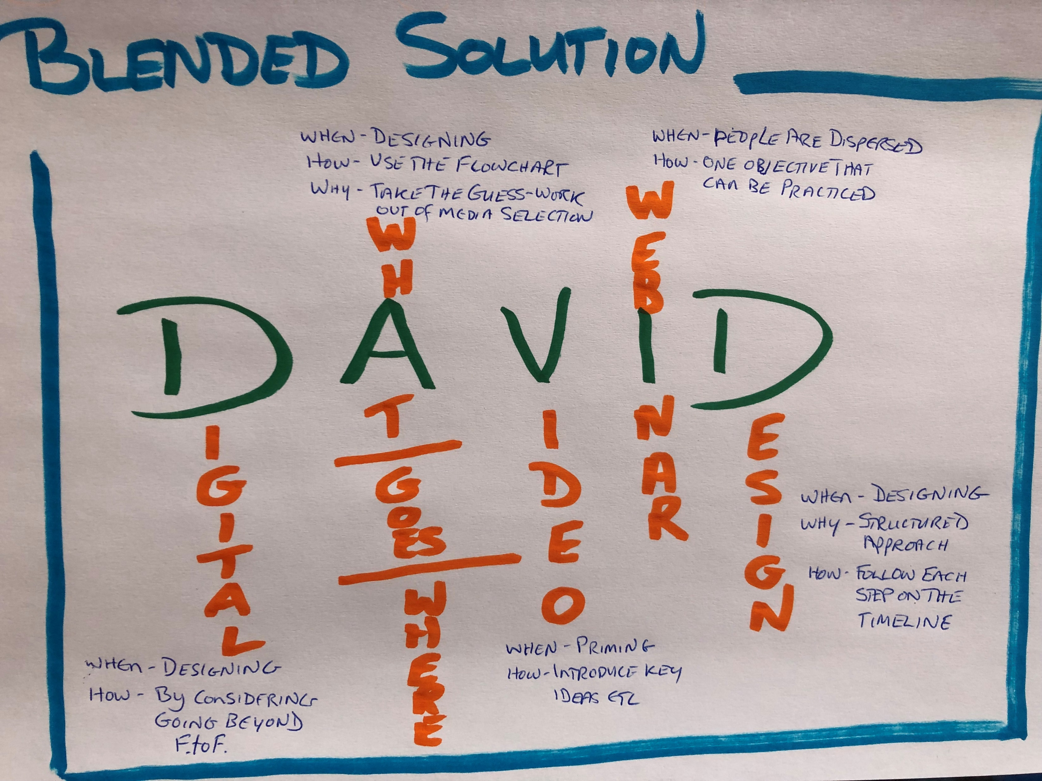
What – Where, When, How

Slide 21
FACT
AhHa
ACTION

Slide 22
START
STOP
CONTINUE

Slide 23



https://www.menti.com
Code 8853 4239
Notes:
https://www.menti.com/alnh7kbzx8bw

