Slide 1


Welcome To …
How To Use MS Teams As A Virtual Training Room
Start Time – 13:00 CET

Slide 2

Teams Experience
Expert
So-So
Novice

Slide 3
WARNING
Scary Picture Alert

Slide 4


Slide 5
Training Room
Toolkit
Notes:
First play in whiteboard then …
Whiteboard for mindmap then which of these do you think is not available virtually?
Move directly to Voting on agenda

Slide 6
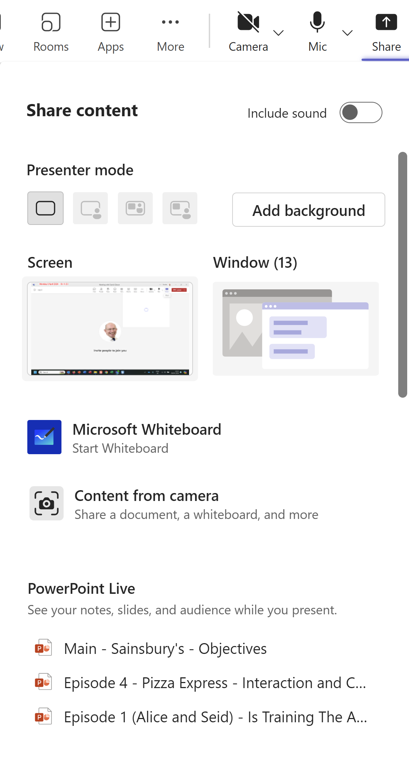
Sharing Options

Slide 7
Sharing Options
Notes:
PowerPoint and Excel live shows last 10 files accessed.
Remember to mention below you can browse PC etc

Slide 8
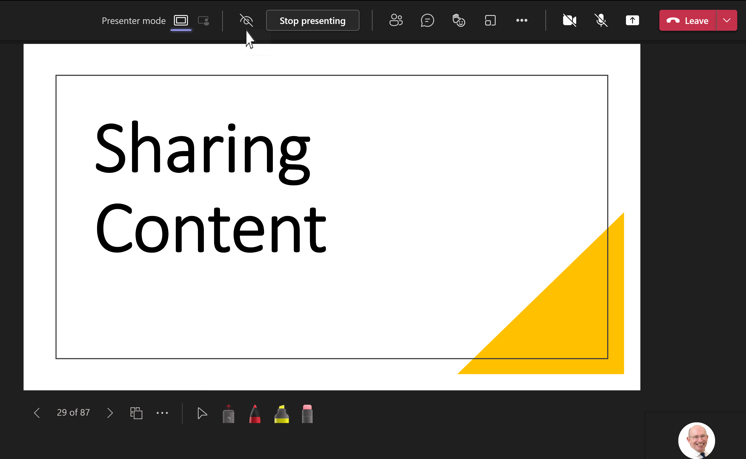

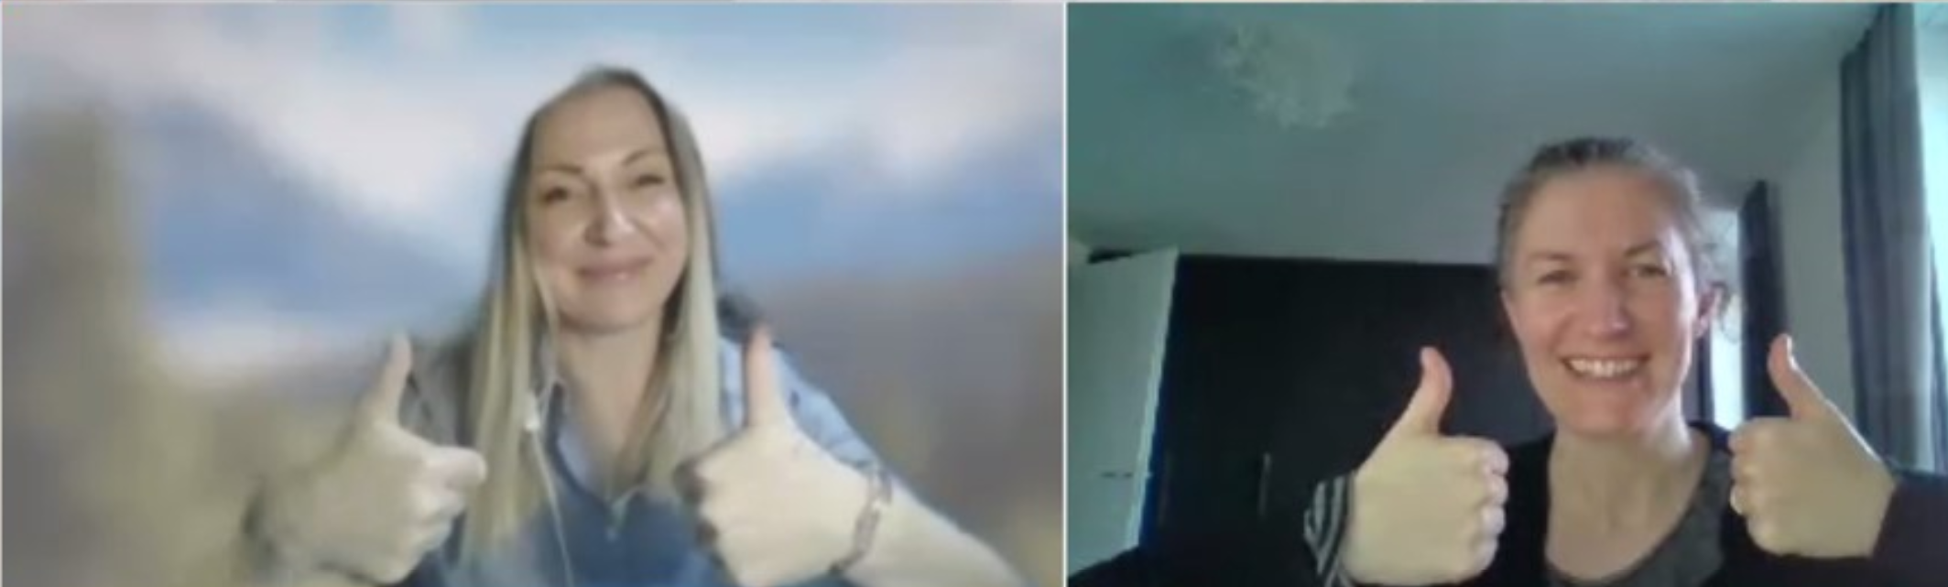

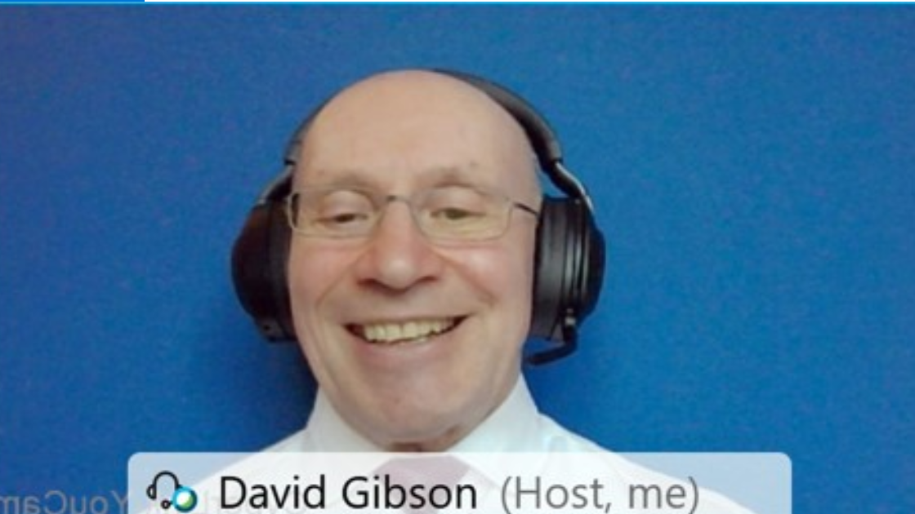
Sharing Options – PowerPoint and Excel Live

Slide 9
Sharing Options – PowerPoint and Excel Live

Slide 10
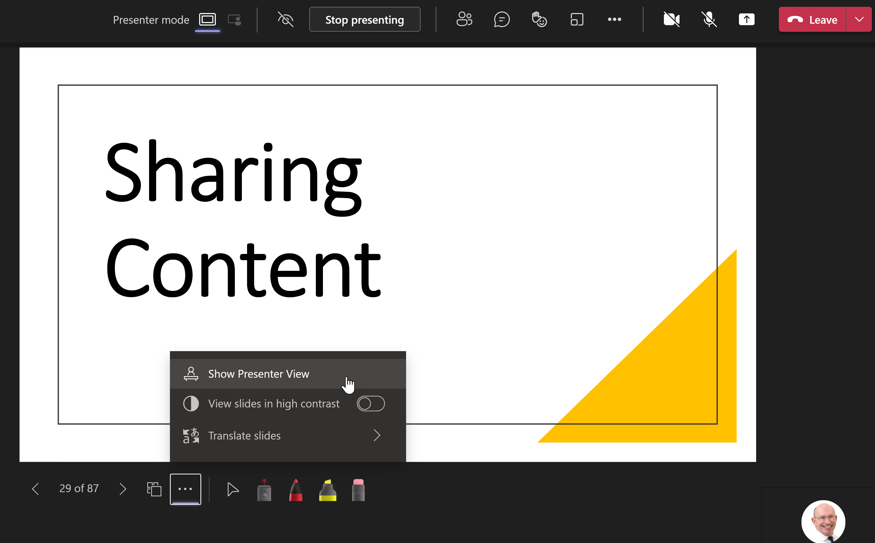
Sharing Options – PowerPoint and Excel Live

Slide 11
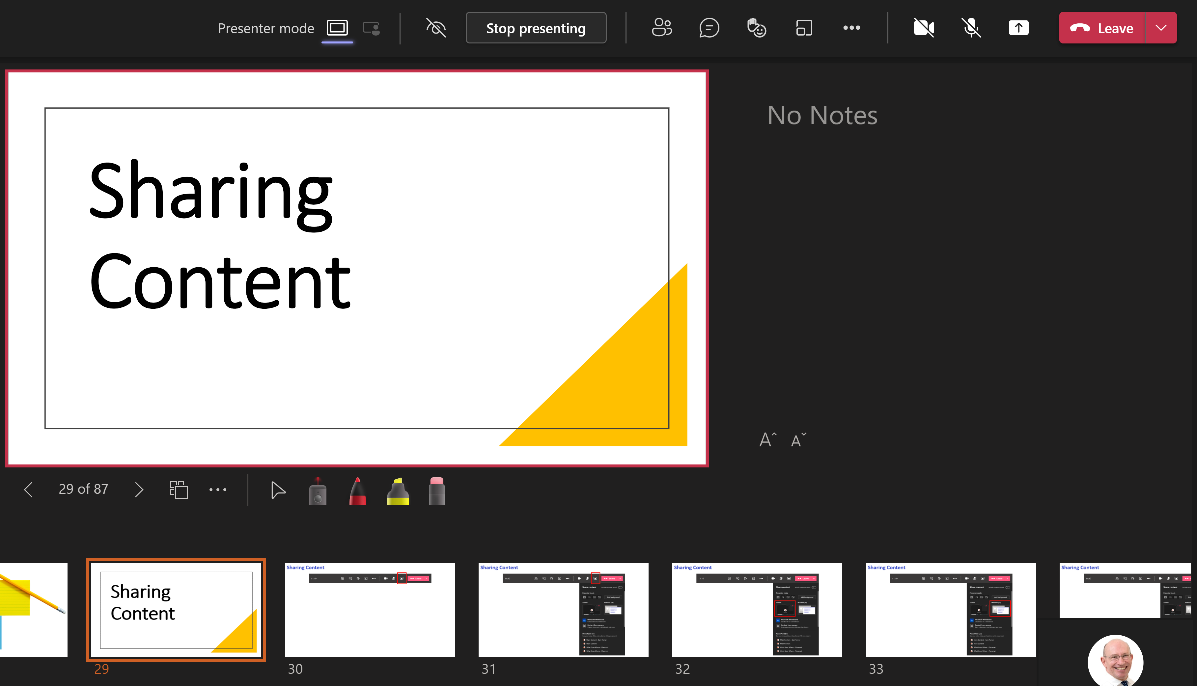
Sharing Content

Slide 12

Facilitating With A Multi-language Population

Slide 13

Live Captioning

Slide 14
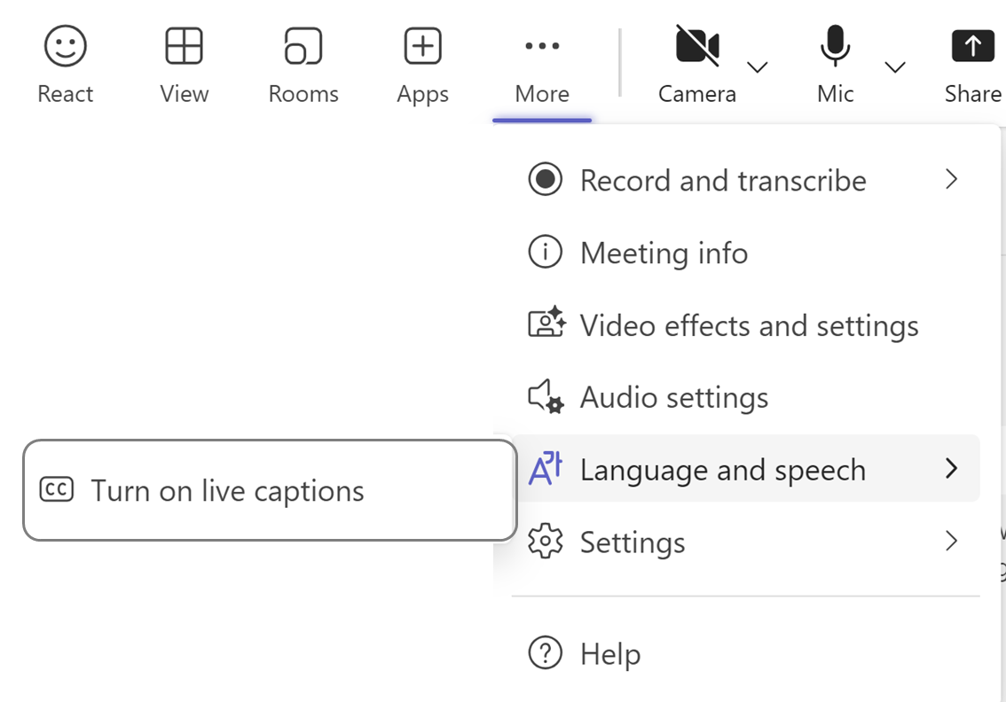
Live Captioning
Notes:
Note: Live translated captions in meetings are only available as part of Teams Premium, an add-on license that provides additional features to make Teams meetings more personalized, intelligent, and secure.

Slide 15
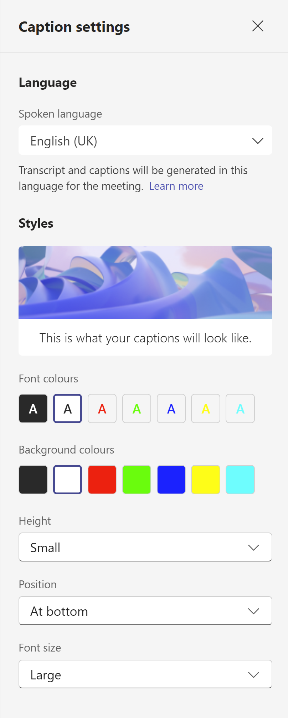
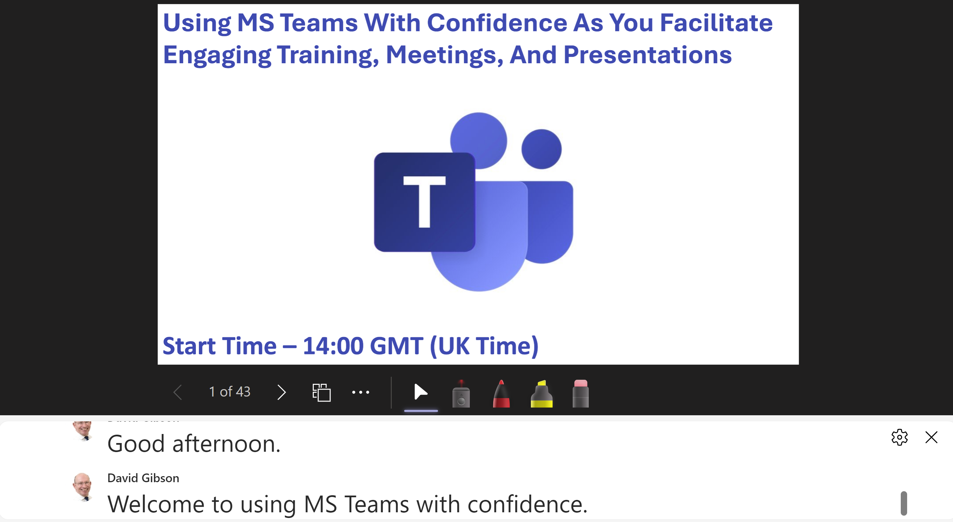
Live Captioning
Notes:
Note: Live translated captions in meetings are only available as part of Teams Premium, an add-on license that provides additional features to make Teams meetings more personalized, intelligent, and secure. To get access to Teams Premium, contact your IT admin.

Slide 16
Slide Translation
Notes:
Each learner is indepedant

Slide 17
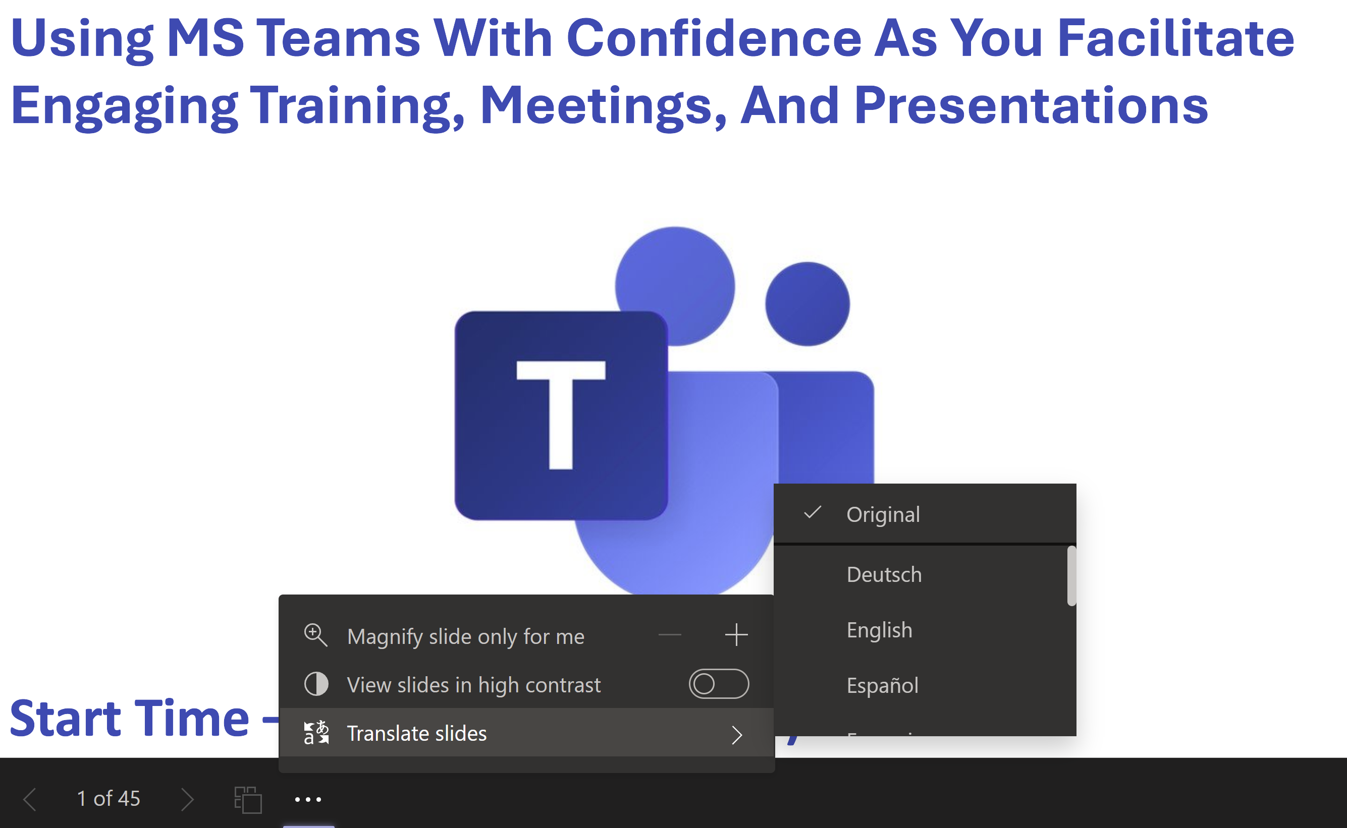
Slide Translation

Slide 18
Inviting Your Participants (3 Different Ways)

Slide 19
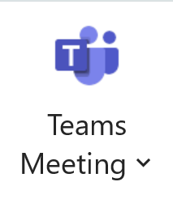


Inviting Your Participants (3 Different Ways)
Create a Meeting via Outlook
Within MS Teams
Via Registration
Notes:
Demo
Works well for both internal and external participants and you get full functionality

Slide 20
Create Smooth
Dynamic Slide
Notes:
Show the next few slides and then demo how to use the morph transition

Slide 21

Eureka Training Community
Notes:
Give demo and mention 3-months membership
Next slide – login details and ask them to ‘play’

Slide 22
Eureka Training Community
https://eureka-tp.com/tipsmembershiphomepage
Username – Your eMail Address
Password – SCC
Notes:
Membership – 3 Months:

Slide 23


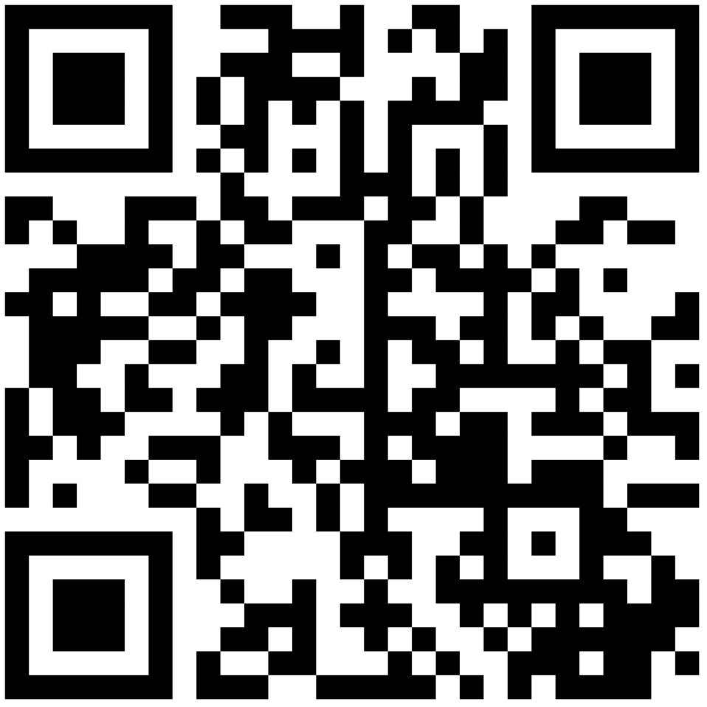
https://www.menti.com
Code 8140 3887
Notes:
To register – www.mentimeter.com

