Slide 1


Ideas For Creating Your Priming, Opening And Closing Activities

Slide 2
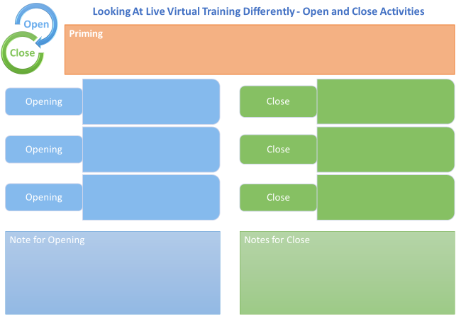

Slide 3

Creating time to be Interactive

Slide 4
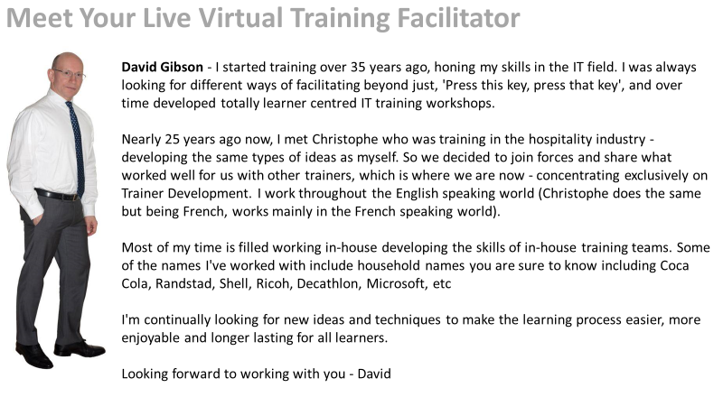


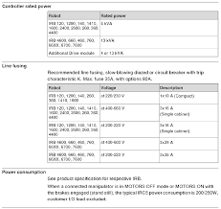

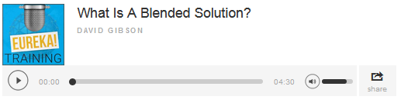
Pre-Communication and Priming
Bio of Presenter
Compliance
Summary
Explainer Video/Welcome Message
Audio File (Podcast)
Product Specification
Web Link

Slide 5


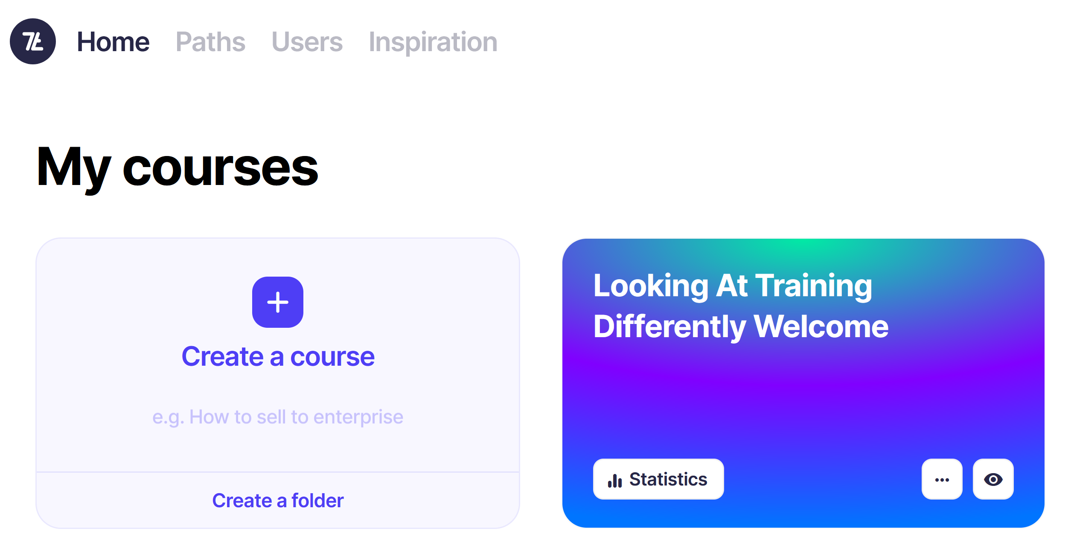
Pre-Training (Priming)
Canva – Carousel
7Taps
Notes:
Canva Carousel (MS Teams)
https://www.canva.com/design/DAGEdjy2b0M/bzEpkfBzJZ4X0QxNXmOldA/view?utm_content=DAGEdjy2b0M&utm_campaign=designshare&utm_medium=link&utm_source=editor
Say I’ll add link to 7 habits – how to create the carousel - timestamp
7 Taps – eMobility
https://app.7taps.com/mZeOoUrlZoSa

Slide 6

Design/Create Your Priming
Notes:
Remind them they can find more idea within the Community in Tips and Activities - Priming

Slide 7
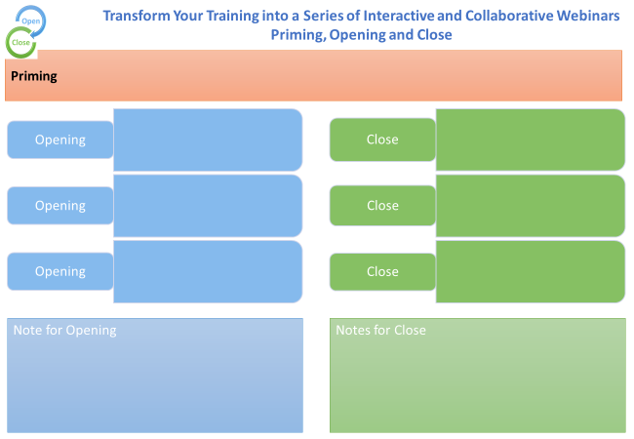

Slide 8
Opening
Notes:
Use Whiteboard

Slide 9
One Thing I Already Know About Being FAFS team leader
One Question I Have About Being FAFS team leader

Slide 10
My Circles of Skill and Knowledge
Things that I know and use relating to
[Training Topic eg Safety]
What do I need from this training [eg My responsibilities]
Take-aways

Slide 11
A-Z of Dangerous Goods
A | B | C | D
E | F | G | H
I | J | K | L
M | N | O | P
Q | R | S | T
U | V | W | XYZ

Slide 12
OAIENRITCTN
ENPO
OESLC
BRCOIOTLNOLAA
NIMRPIG
IBTCEJVEO
ROUF ENUITM
EALVNRET
UFN

Slide 13
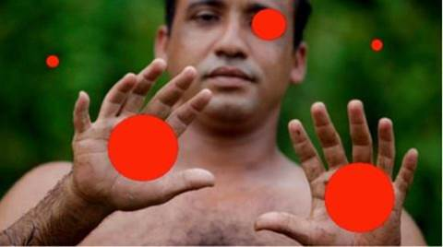

Slide 14
Add your answer into chat

Slide 16
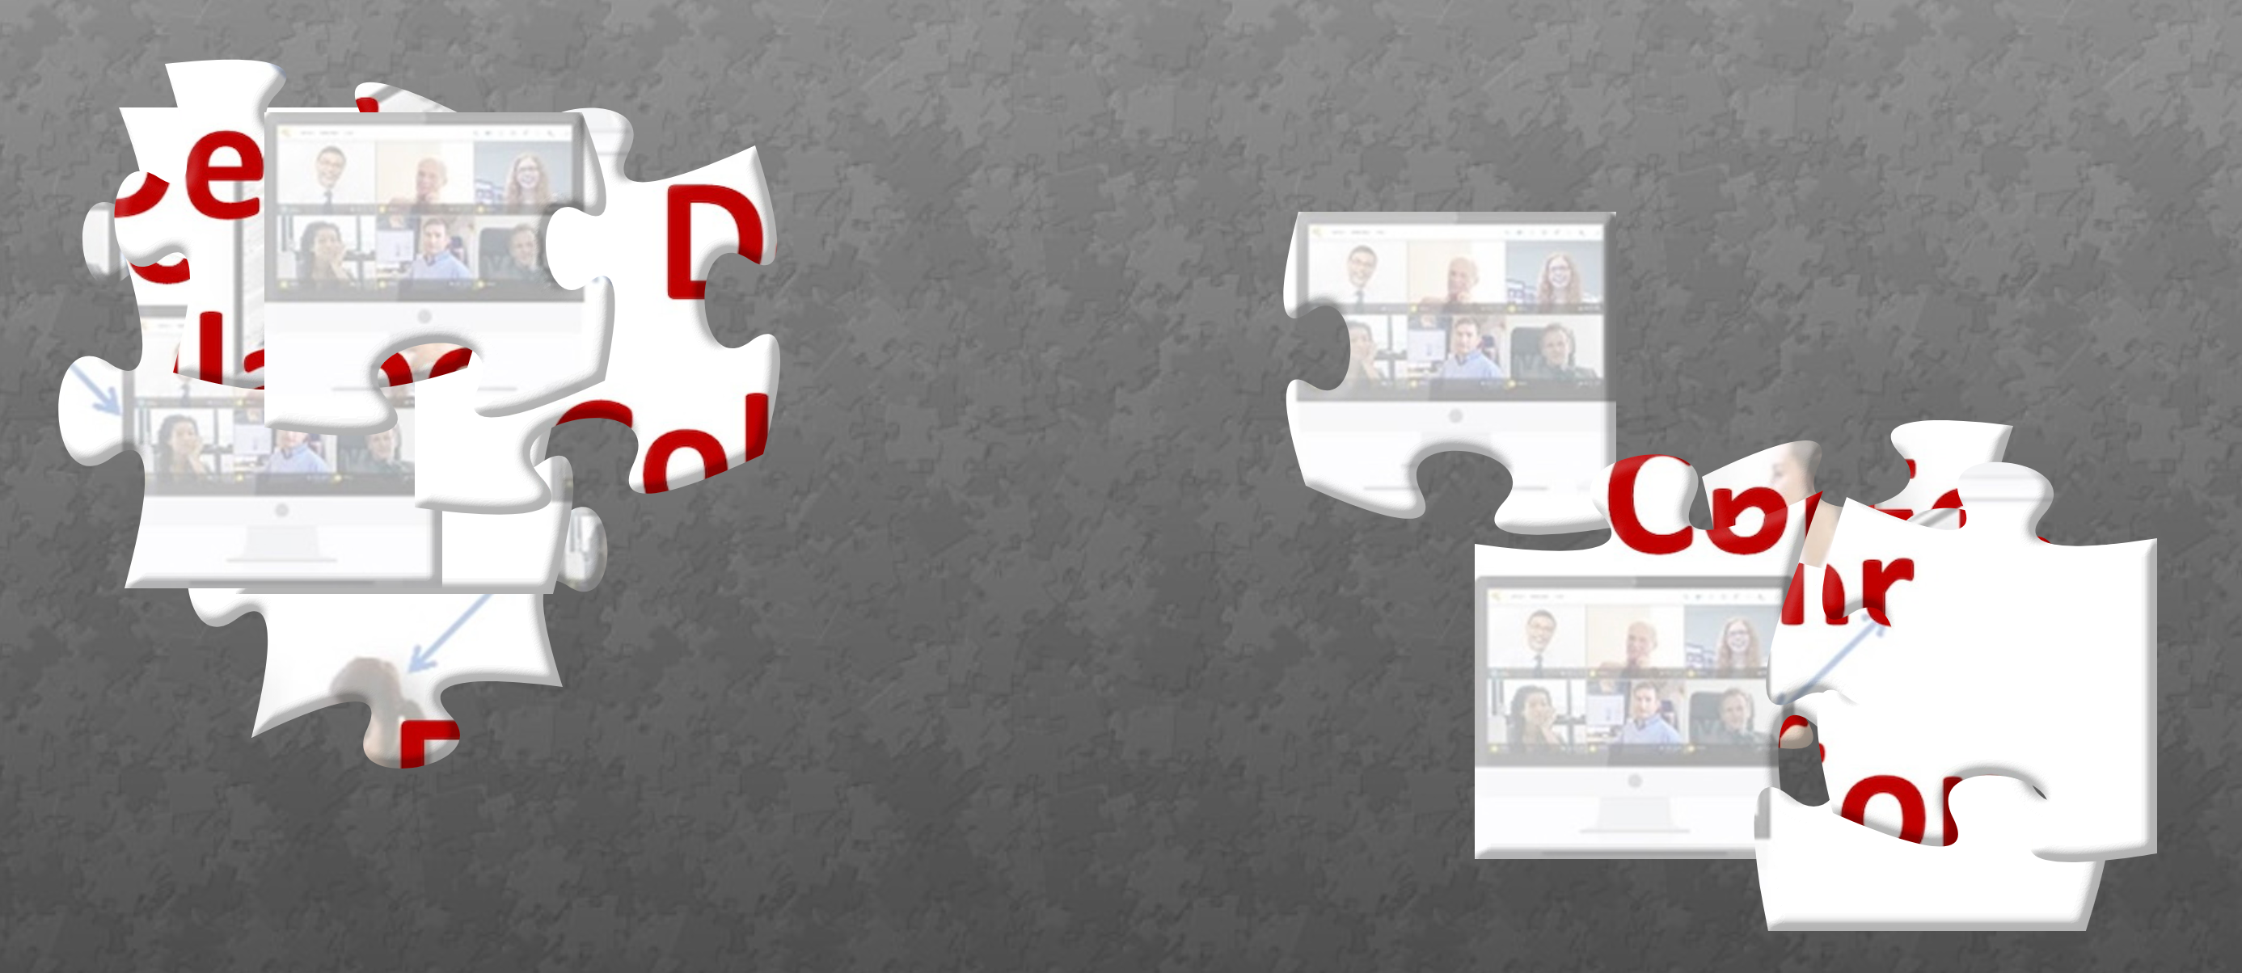
Puzzle Challenge
https://www.jigsawplanet.com/?rc=play&pid=18043a5f67bb
Notes:
https://www.jigsawplanet.com/?rc=play&pid=18043a5f67bb

Slide 17

Puzzle Challenge
How is this Puzzle Like A Blended Solution For Training?
Use Chat

Slide 18
Create Your Opening
Slides and Whiteboards
Notes:
Remind them they can find more idea within the Community in Tips and Activities

Slide 20
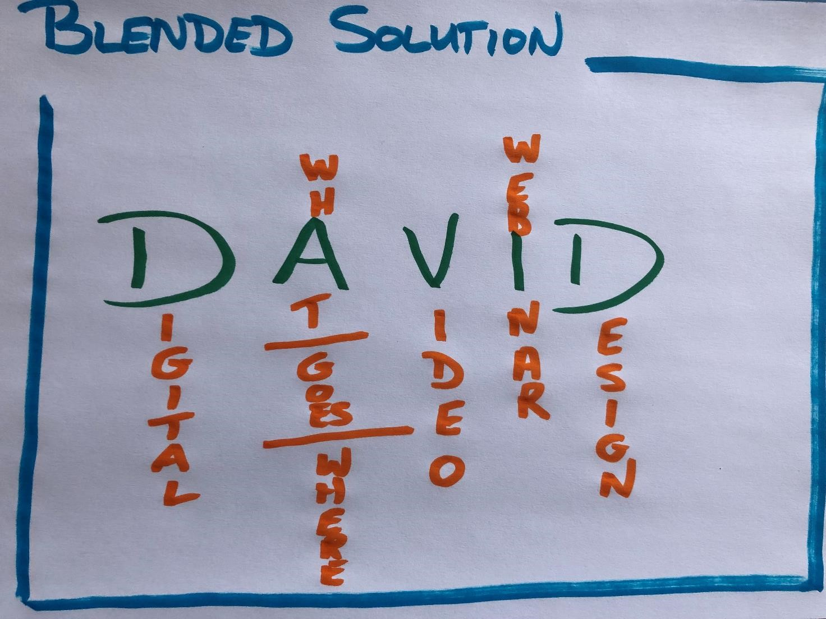

What – Where, When, How

Slide 21
What – Where, When, How

Slide 22
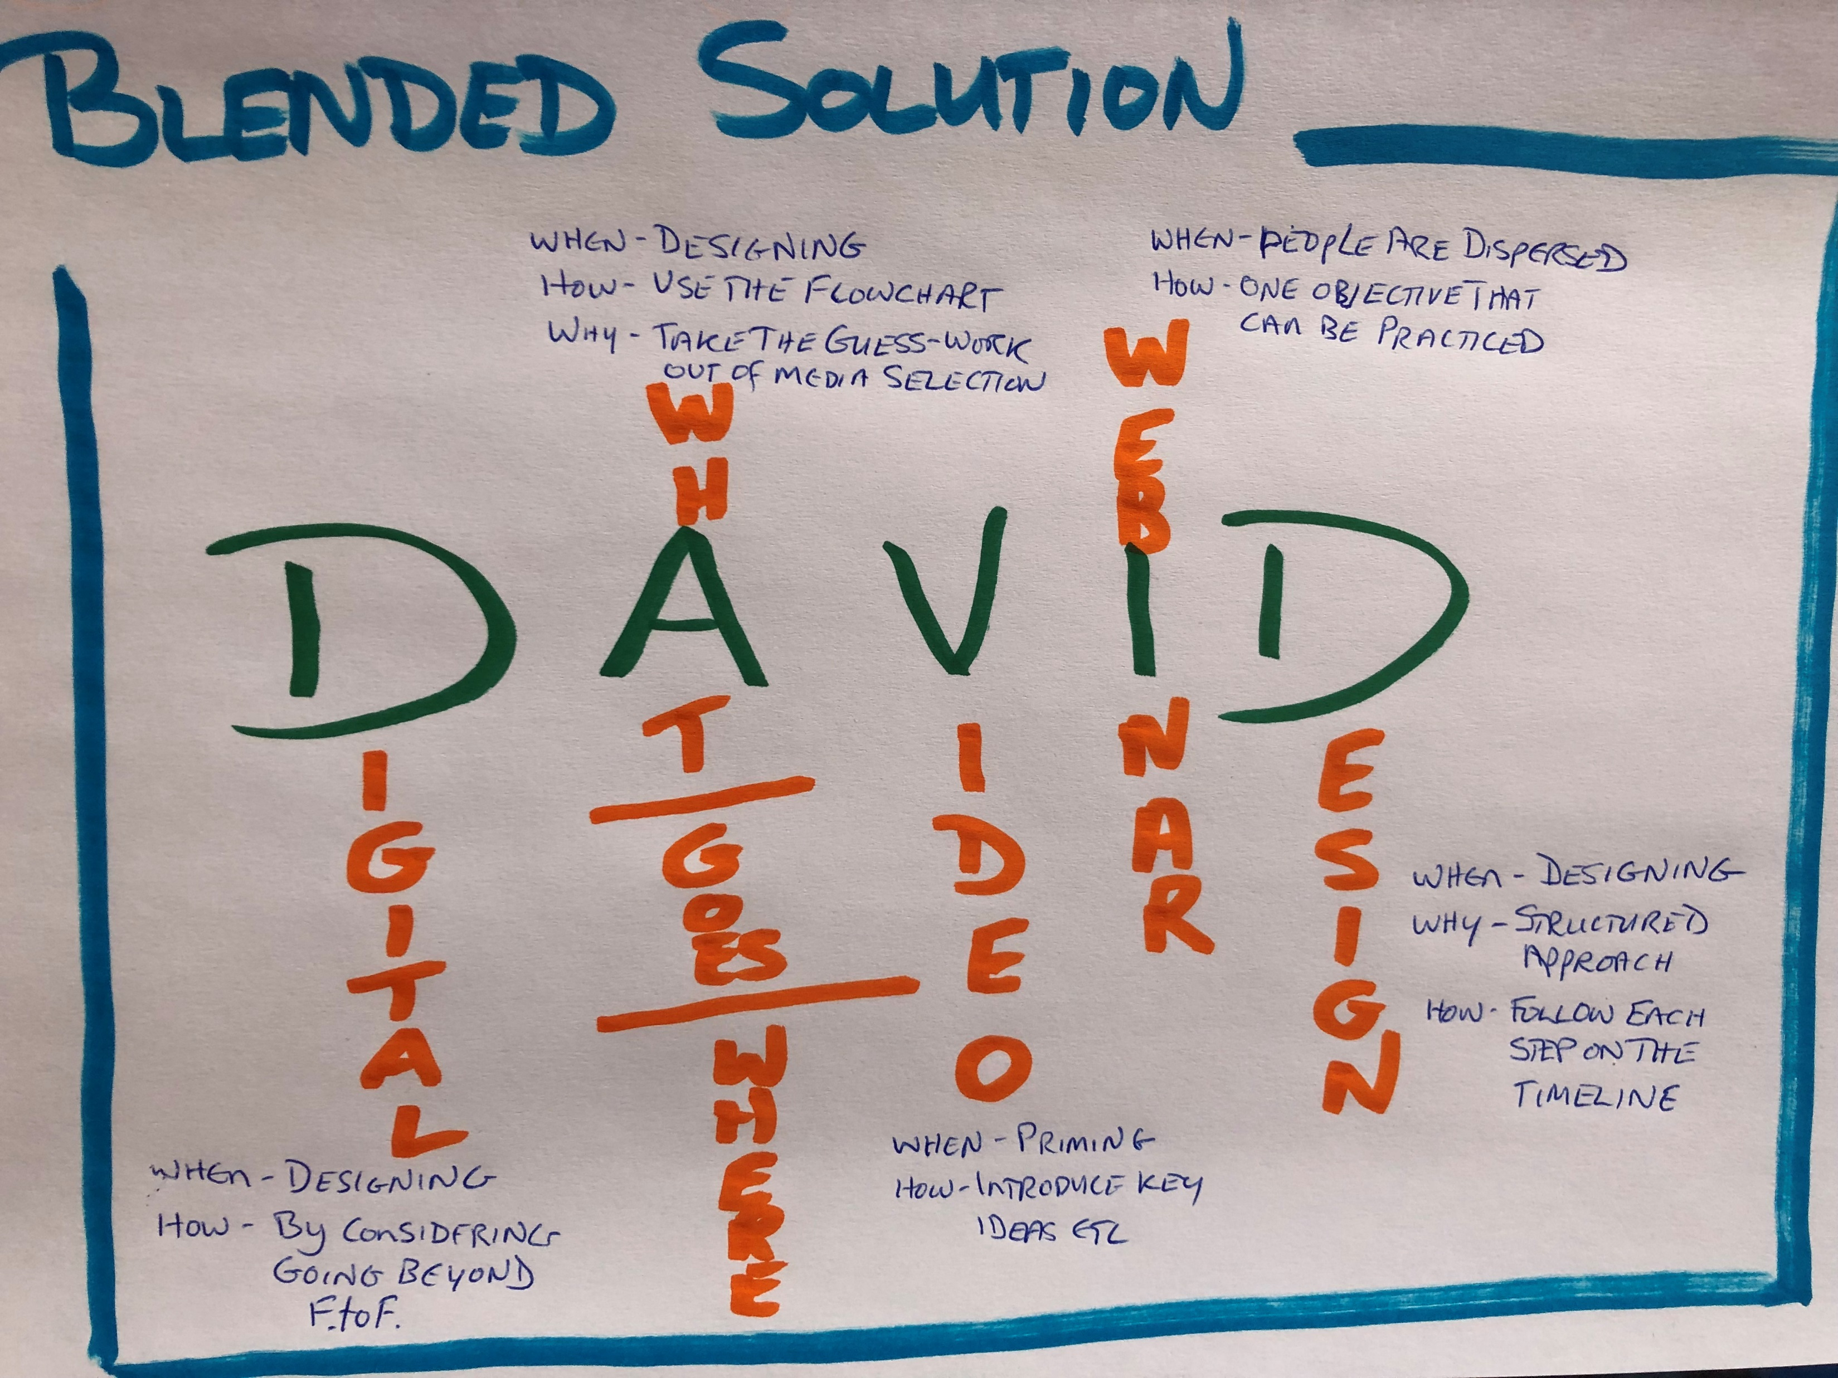
What – Where, When, How

Slide 23
FACT
AhHa
ACTION

Slide 24
START
STOP
CONTINUE

Slide 25
Create Your Close - Slides and Whiteboards

Slide 26
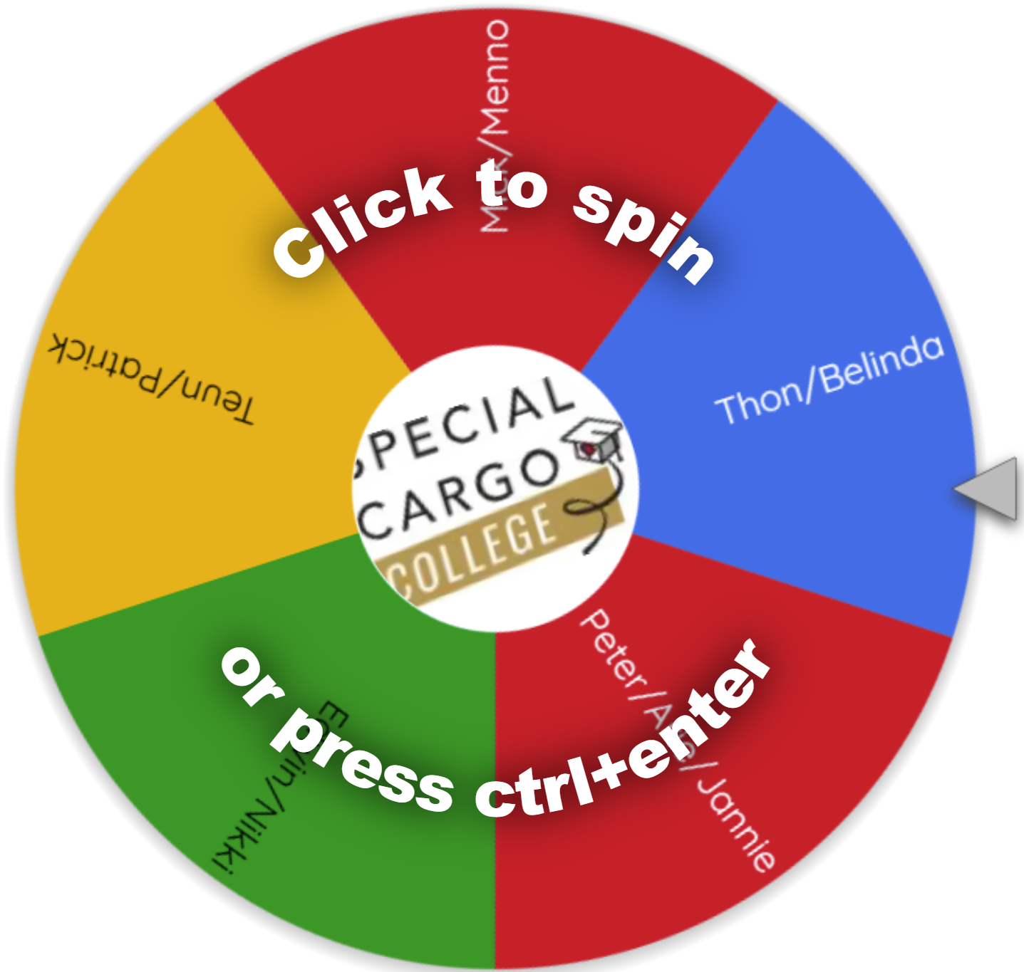
www.wheelofnames.com

