Slide 1


Welcome
Add Interaction BUT
Design for Collaboration

Slide 2

Challenge
Create an Interactive Slide plus
a Collaborative Task

Slide 4
Interaction and Collaboration
Pros
Cons
Notes:
Whiteboard – Pros Cons, Monday feeling video, Tiles then back to slides

Slide 5
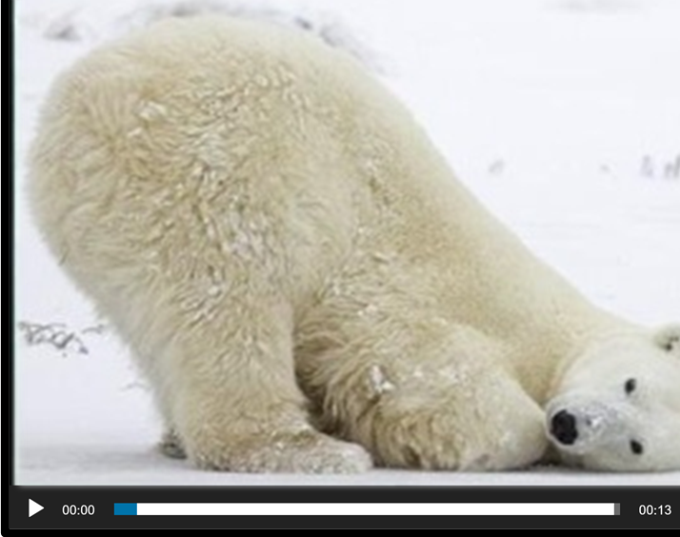
What might make your learners feel like this during their virtual training?

Slide 6
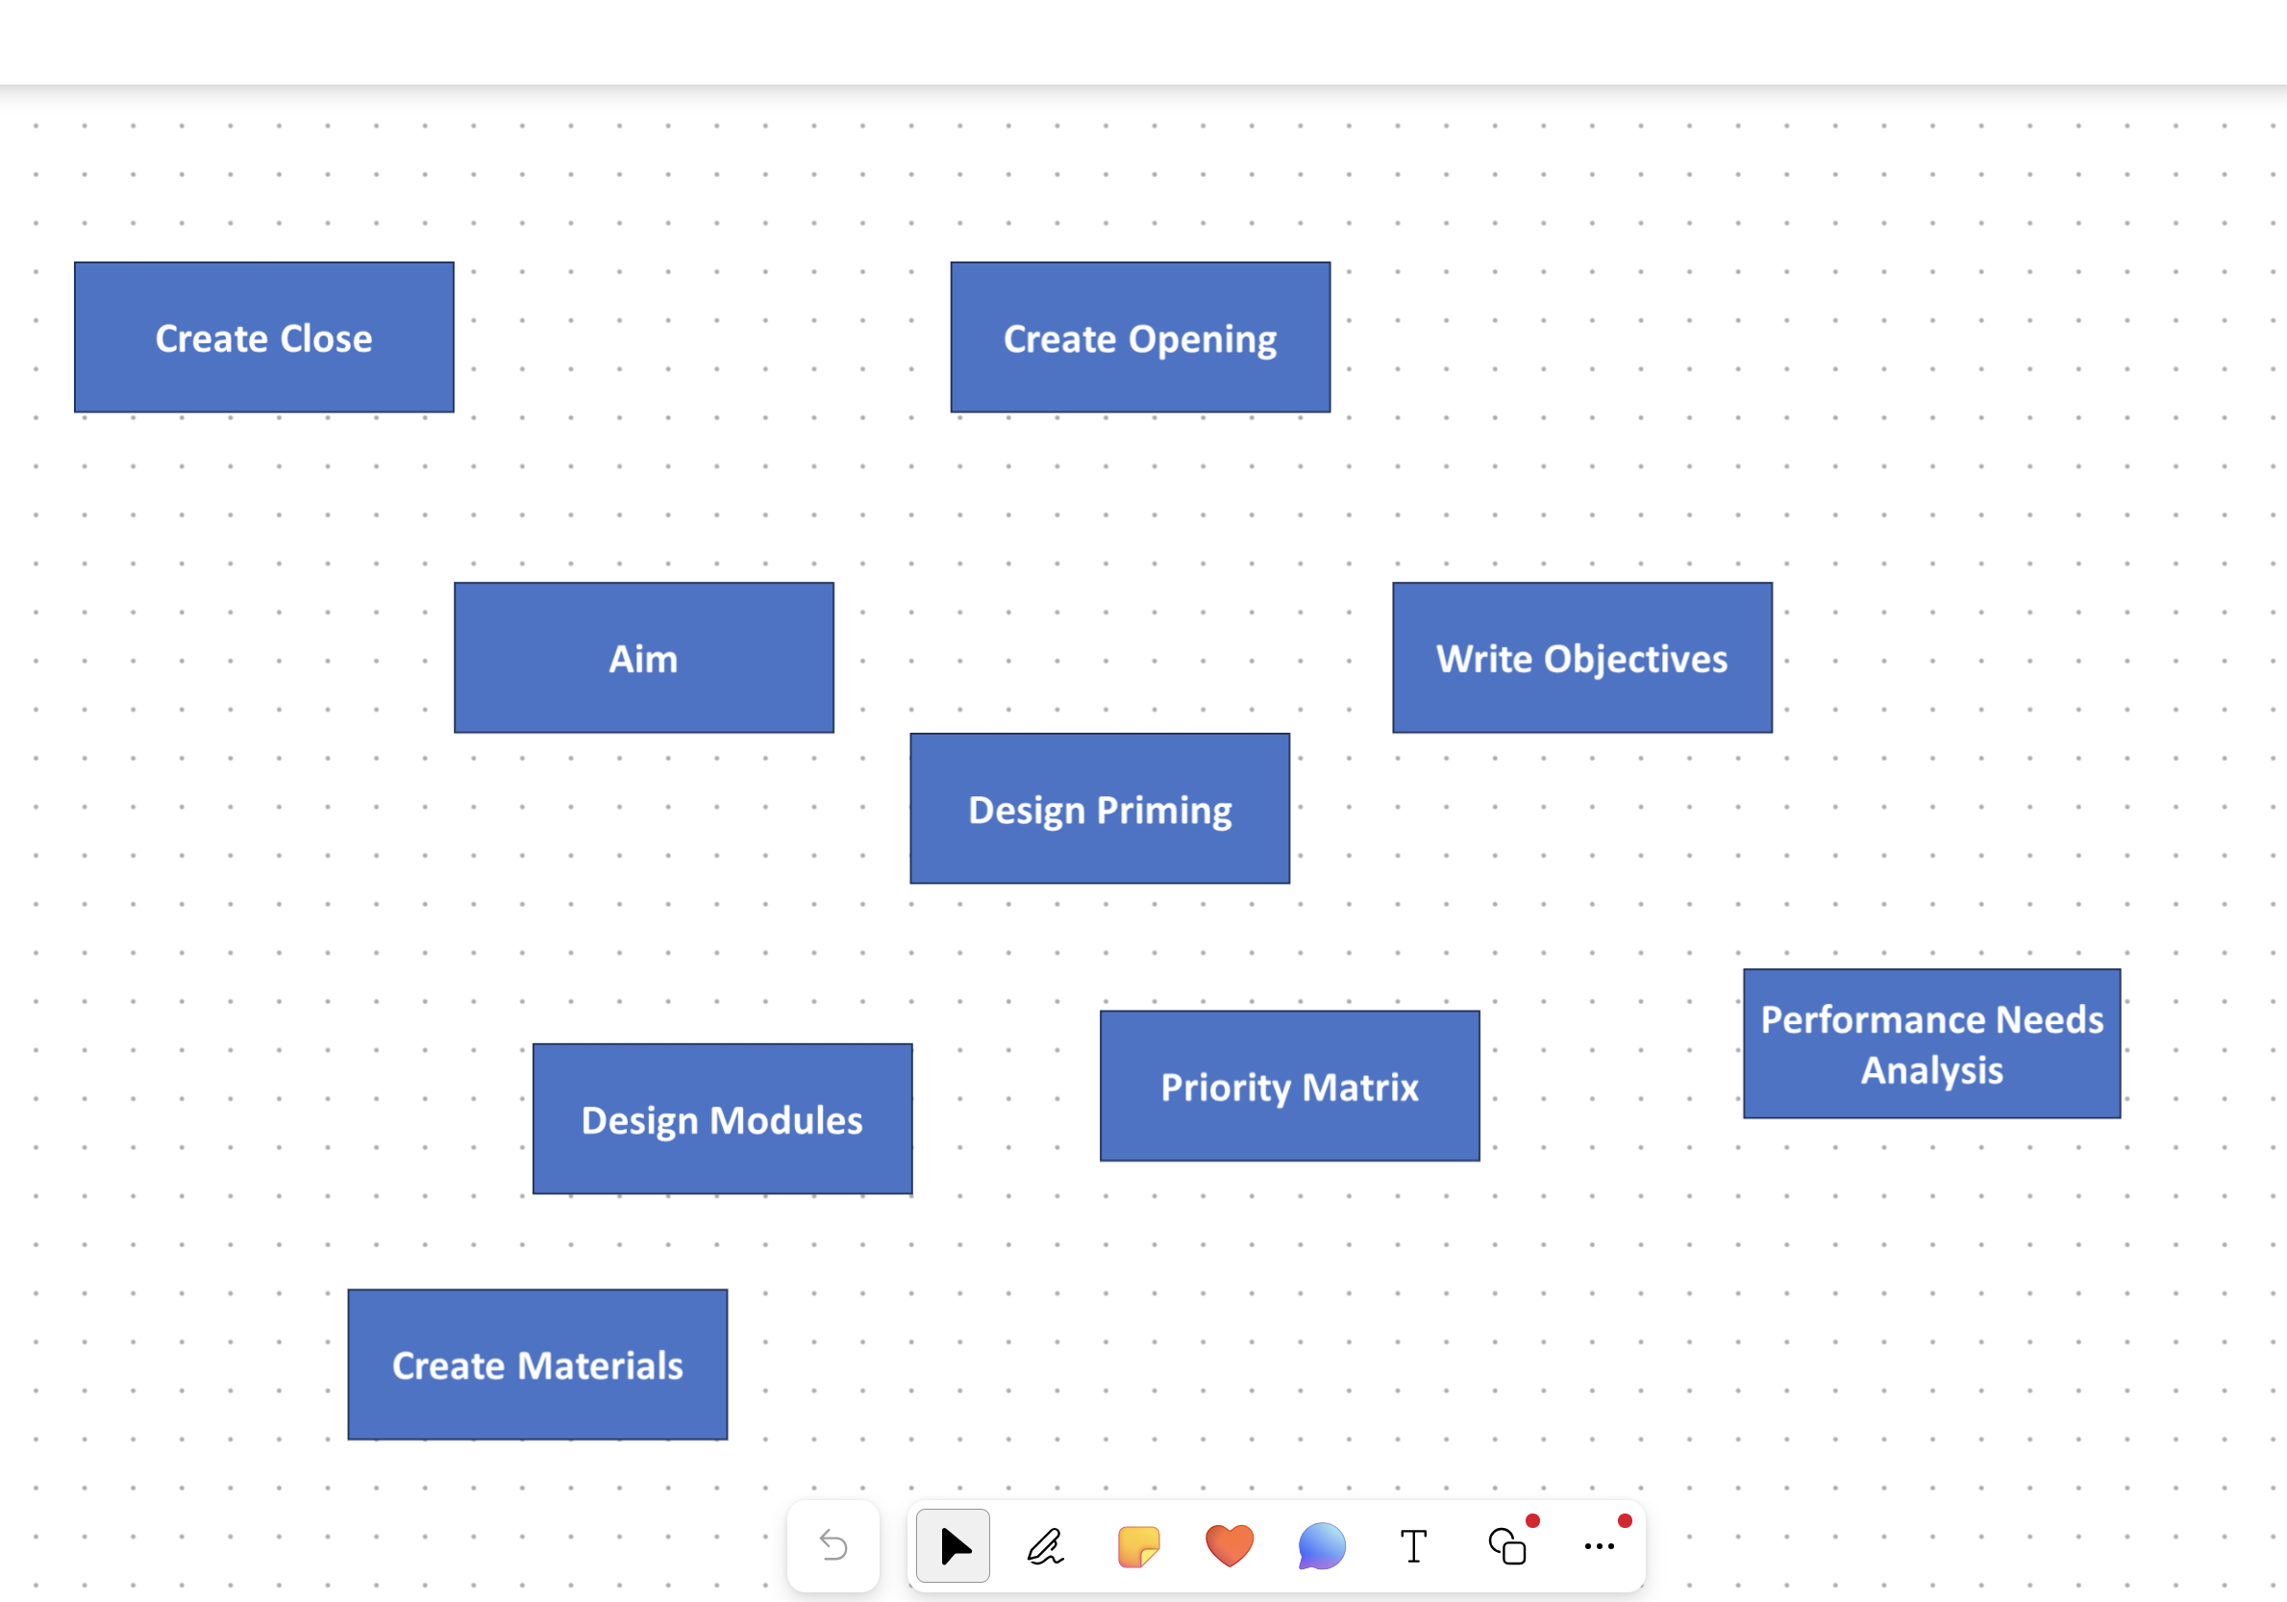
Tiles

Slide 7
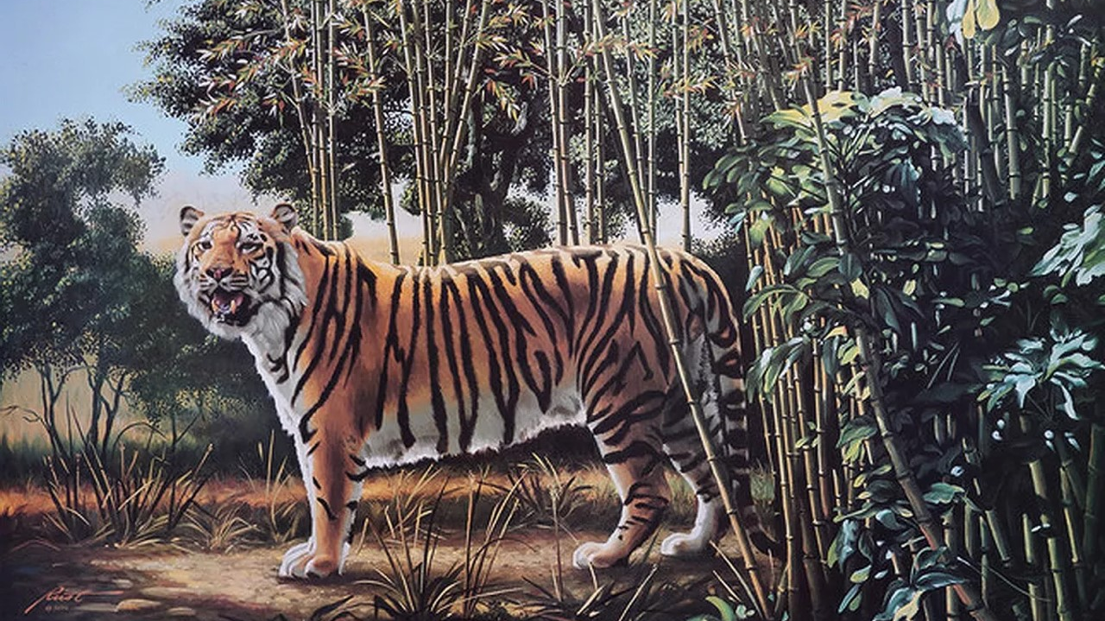
Notes:
Idea – Racism, Preparation Phase

Slide 8
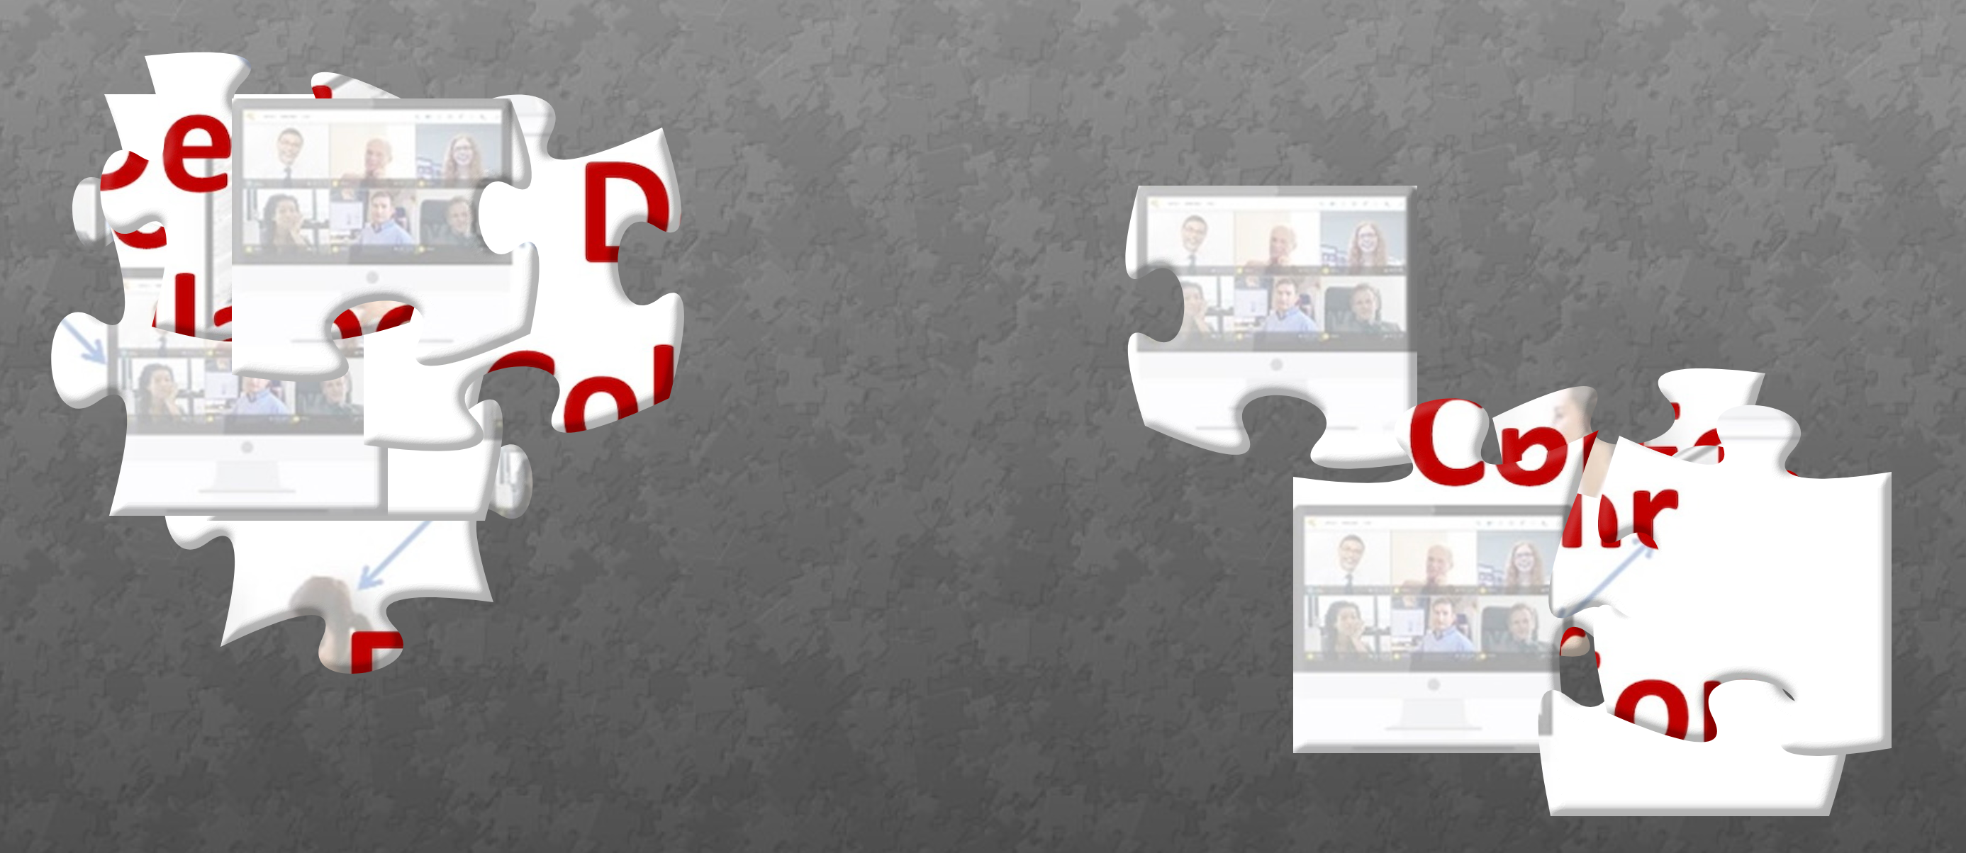
Puzzle Challenge
https://www.jigsawplanet.com/?rc=play&pid=18043a5f67bb

Slide 9
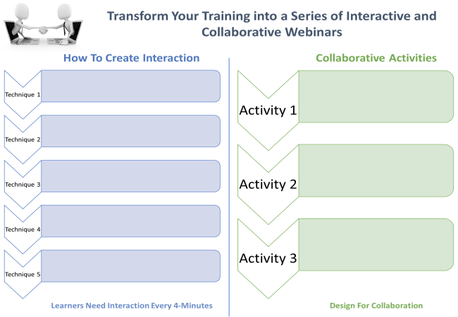


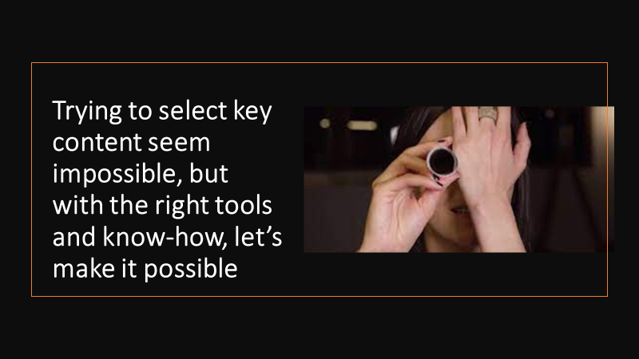
Materials

Slide 10
Scavenger Hunt
1. Navigate to the site - https://eureka-tp.com/tipsfortrainers/
2. Locate the answers
3. Write them down
Quickly back here and prove it by adding
ALL THREE to chat in ONE MESSAGE

Slide 11

Scavenger Hunt
- https://eureka-tp.com/tipsfortrainers/
1. Navigate to the site
2. Locate the answers
3. Write them down
Quickly back here and prove it by adding
ALL THREE to chat in ONE MESSAGE
Questions
How many tips?
How frequent are the development modules?
Is there any 1:1 Support?

Slide 12

Design on Paper an Interactive Activity
Notes:
Show how to create whiteboards

Slide 13


Slide 15
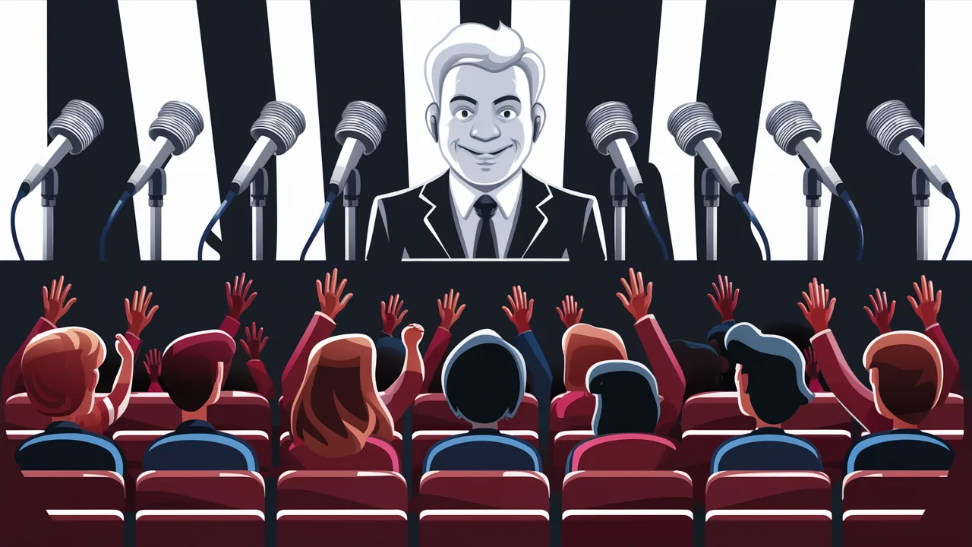
Topic - The Virtual Training Room

Slide 16
Topic - The Virtual Training Room

Slide 17
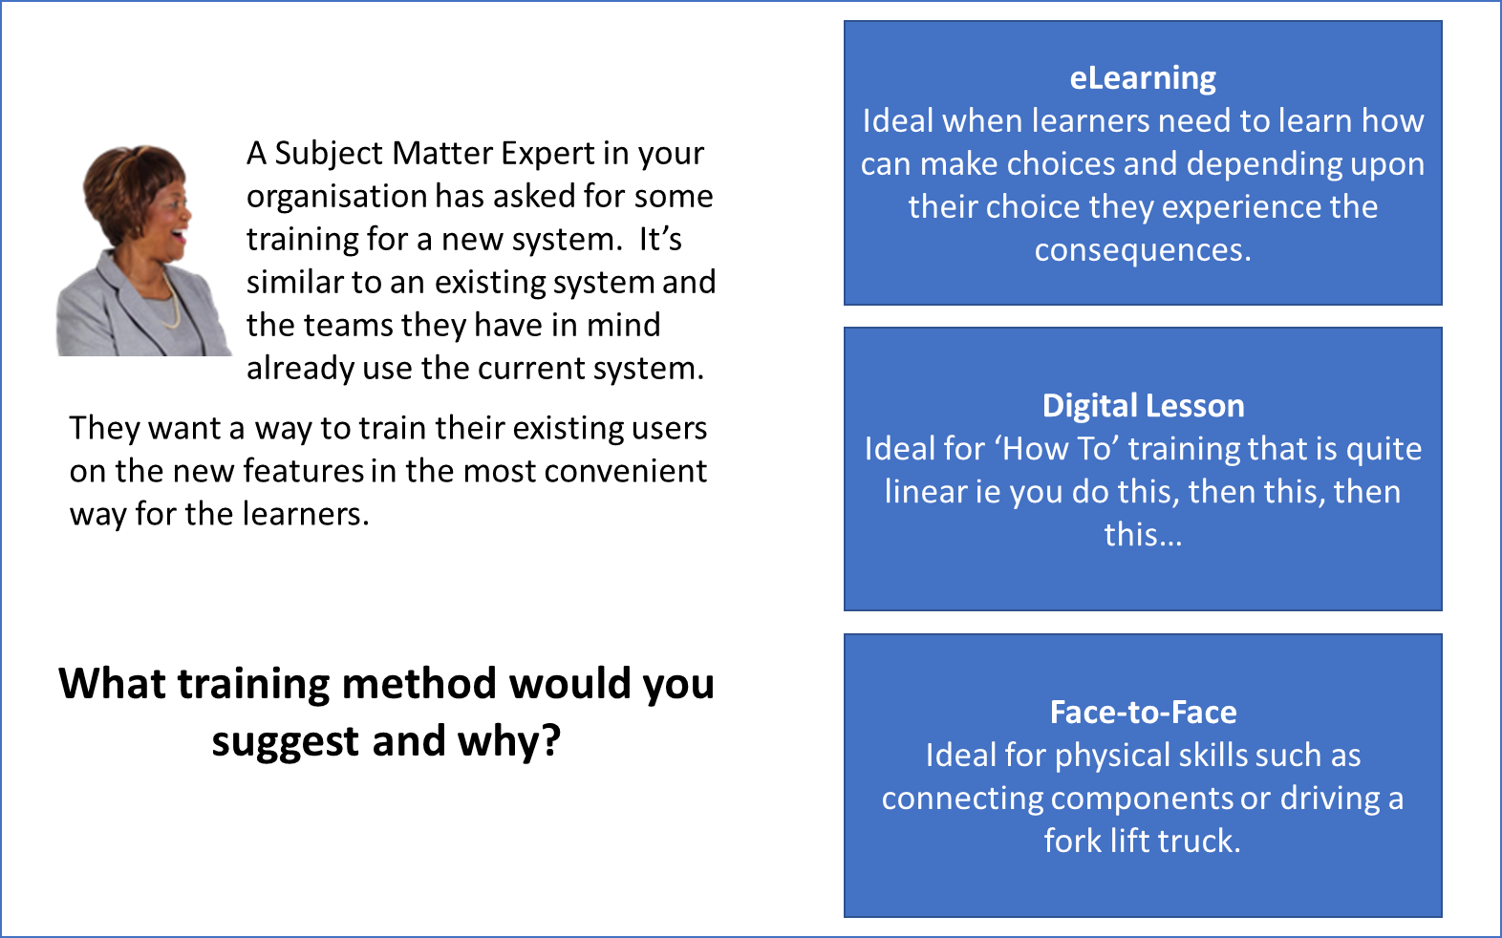
Case Study/Scenario
Notes:
Click on Image to download
https://eureka-tp.com/wp-content/uploads/2024/12/CaseStudy-Breakout.pptx

Slide 18


Time Remaining
15 Mins
Welcome Back
1 Min
2 Mins
3 Mins
4 Mins
5 Mins
6 Mins
7 Mins
8 Mins
9 Mins
10 Mins
11 Mins
12 Mins
13 Mins
14 Mins
Time Remaining
15 Mins
Welcome Back
1 Min
2 Mins
3 Mins
4 Mins
5 Mins
6 Mins
7 Mins
8 Mins
9 Mins
10 Mins
11 Mins
12 Mins
13 Mins
14 Mins

