Slide 1


If you could design a training module within 20-Minutes that is totally Learner Centred …
How would this help you?

Slide 2
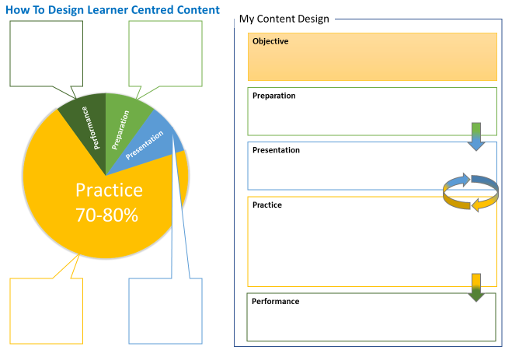

Slide 3
Your Module Objective
Notes:
Work in pairs in breakout rooms

Slide 4
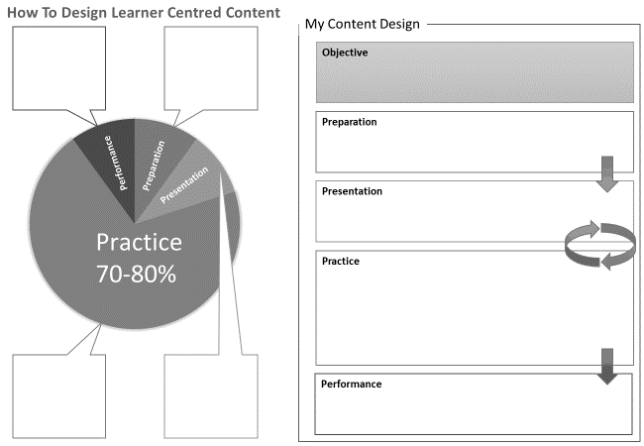
Notes:
Breakout rooms to write objective. Something ‘theory’ based ie not a hands on activity such as installing, troubleshooting etc

Slide 5

In Breakout Rooms
Write Your Objective

Slide 6
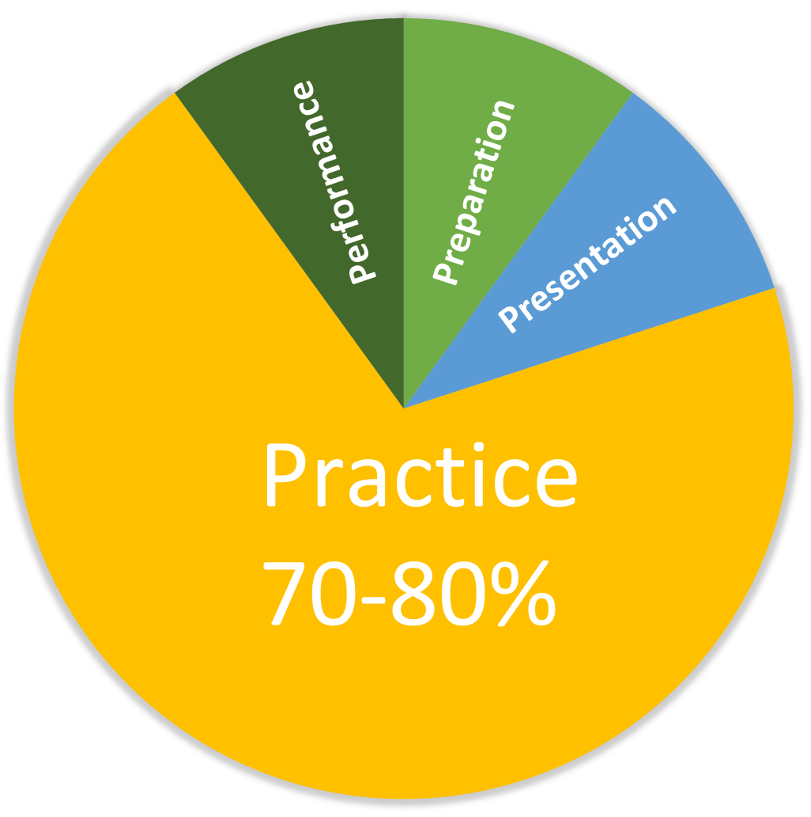
Design Any Content With The Learning Cycle

Slide 7
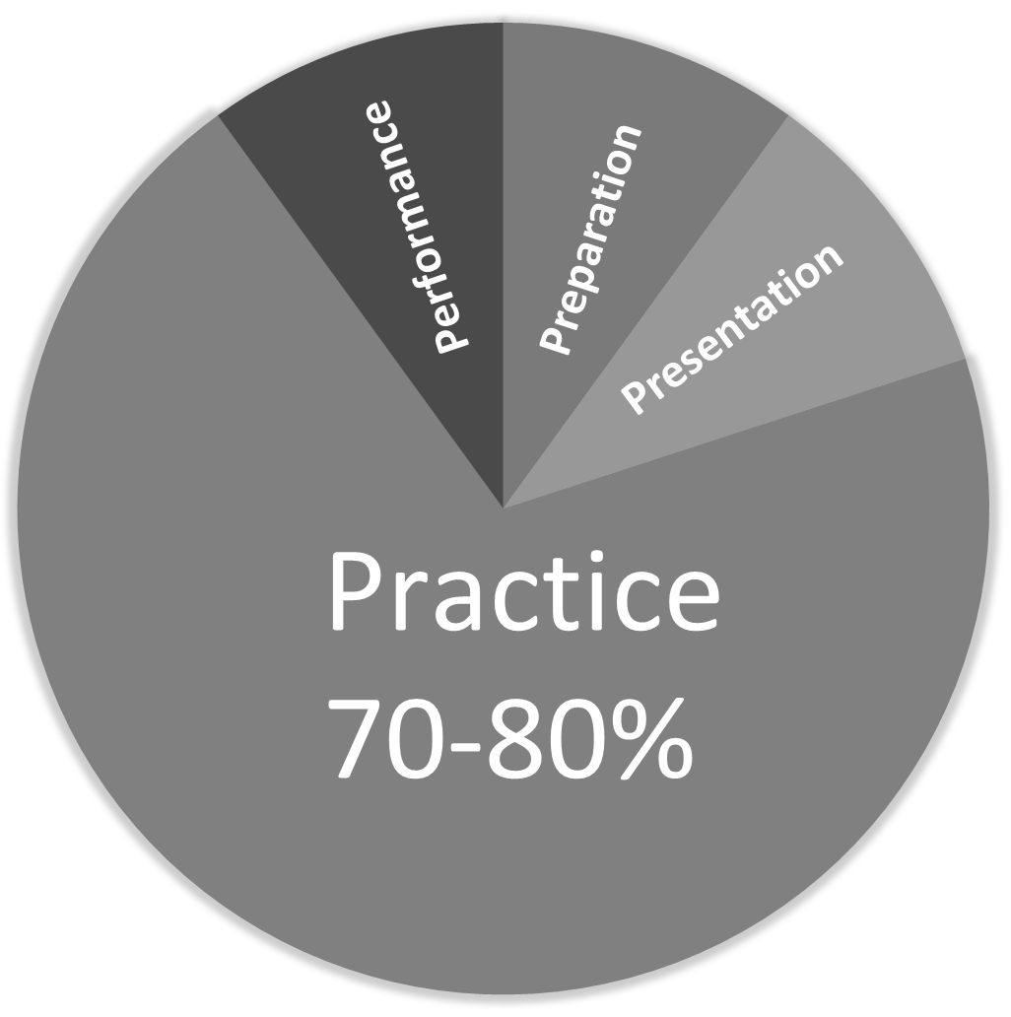
Preparation
How To Prepare Learners for this piece of Content

Slide 8



Ideas For The Preparation Phase
Steps to ….
Step 1 __________________
Step 2 __________________
Step 3 __________________
Step 4 __________________
How This Will Help Me
Pre-test
Prediction
Your Challenge
You’ve been away on business and had to pay accommodation and food yourself. You need to be reimbursed. Your Challenge is to work out how to submit your expense claim.
Notes:
Add - Where we stand

Slide 9

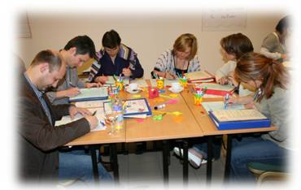


Ideas For The Presentation Phase
How Would You Design The Screen?
Make Notes During Lecture
Expense Form
Date
Expense Type
Amount
Expense Code
REF
Learners Do Research
Video With Task

Slide 10
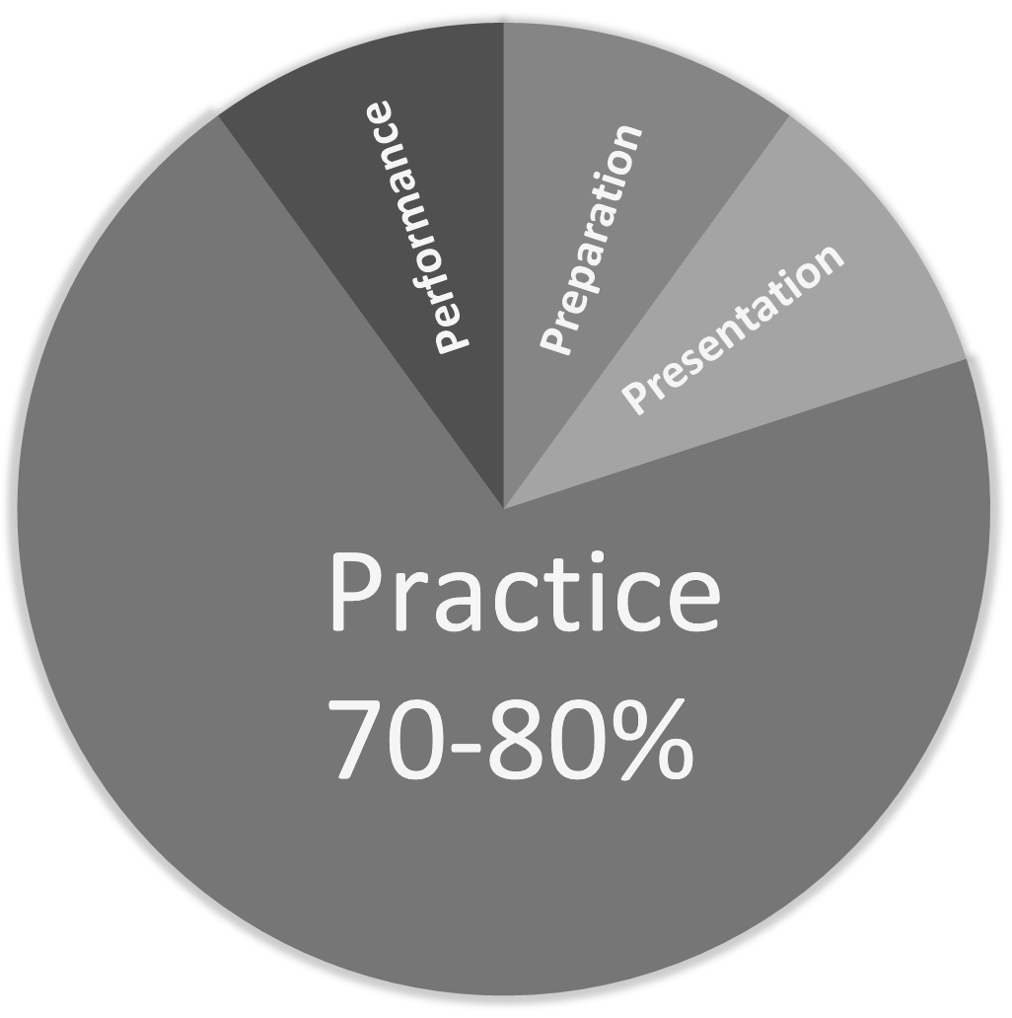
Practice
Learners try the Skill or try applying the Knowledge

Slide 11



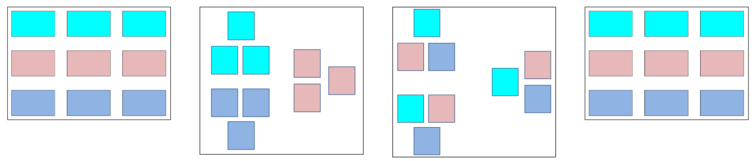
Ideas For The Practice Phase
Create A Case Study For Another Team
Test Teams From Lecture (then apply)
Practice The Skill or Applying The Knowledge
Divide and Conquer

Slide 12
Performance
You Observe Learners DOING what you said they’d be able to do.

Slide 13
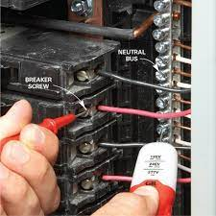


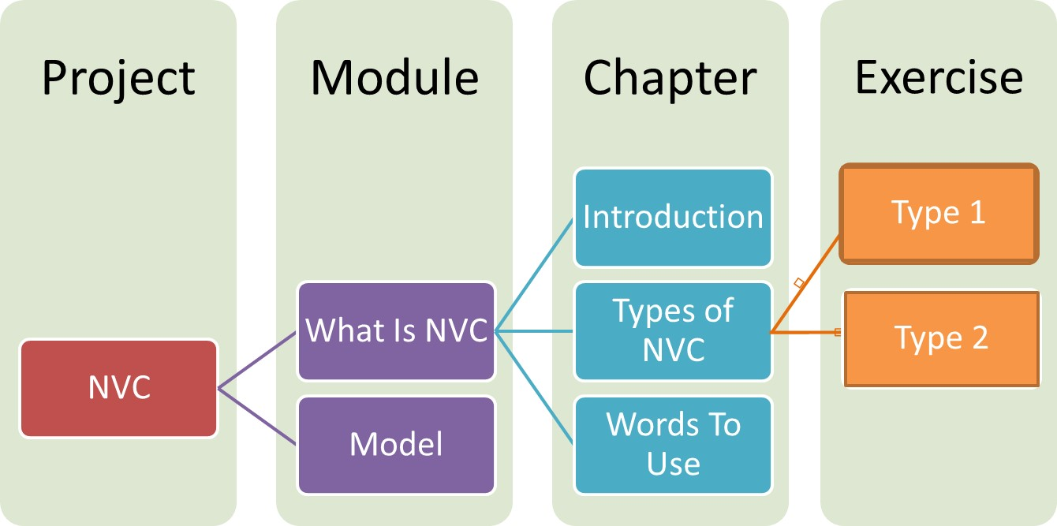

Ideas For The Performance Phase
Complete A The Full Task
Create A Dummies Guide To …
Create a Process Flow Chart, Checklist or FAQ
Set A Challenge For Another Group To Complete
Cause problem for troubleshooting
Create a scenario eg sales request for another team
Shuffle the sequence of a process and ask to recreate

