Slide 1


Welcome
Add Interaction BUT
Design for Collaboration

Slide 2

Questions
Notes:
Qquestions then start with Magic Numbers

Slide 3

Challenge
Create an Interactive Slide plus
a Collaborative Task

Slide 4
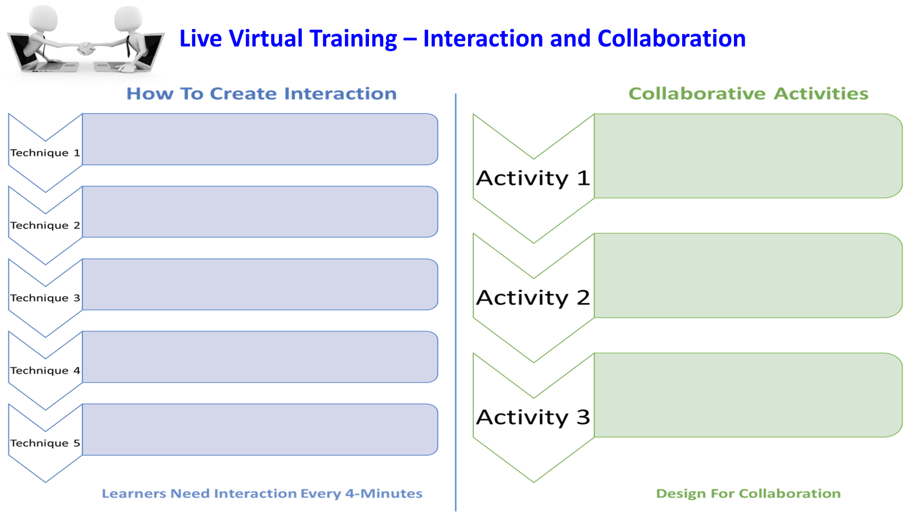

Slide 5
Interaction and Collaboration
Pros
Cons
Notes:
Whiteboard – Pros Cons, Monday feeling video, Tiles then back to slides

Slide 6

What might make your learners feel like this during their virtual training?

Slide 7
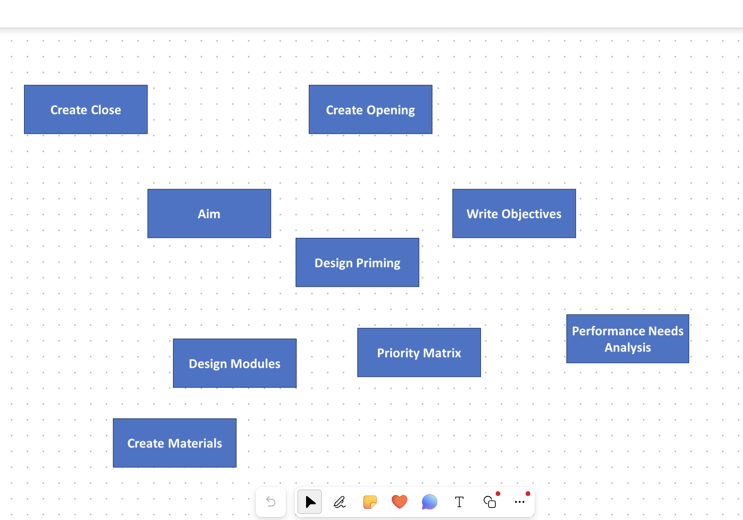
Tiles

Slide 8

Notes:
Idea – Racism, Preparation Phase

Slide 9
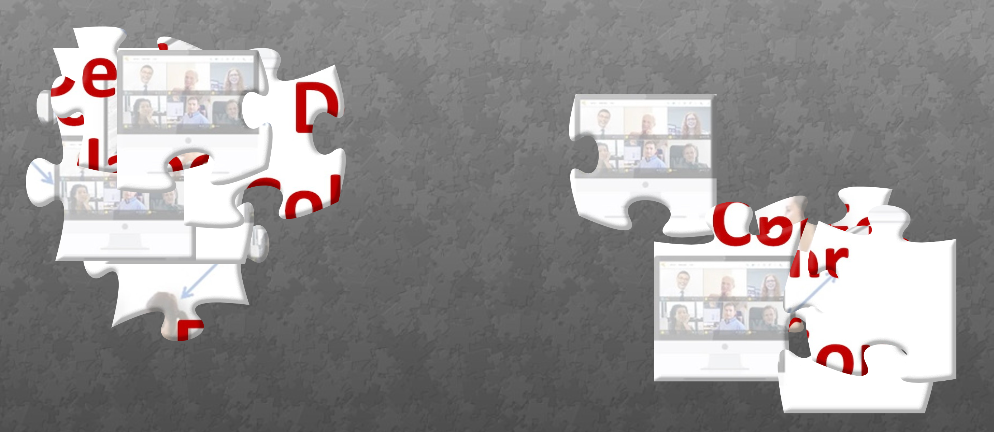
Puzzle Challenge
https://www.jigsawplanet.com/?rc=play&pid=18043a5f67bb

Slide 10
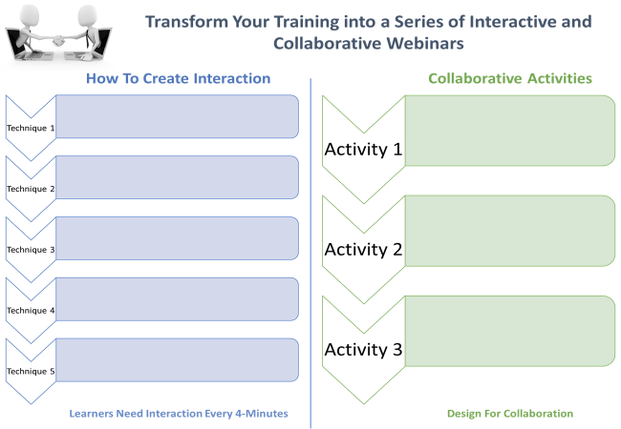



Materials

Slide 11

Scavenger Hunt
- https://eureka-tp.com/tipsfortrainers/
1. Navigate to the site
2. Locate the answers
3. Write them down
Quickly back here and prove it by adding
ALL THREE to chat in ONE MESSAGE
Questions
How many tips?
How frequent are the development modules?
Is there any 1:1 Support?

Slide 12


Slide 14

Topic - The Virtual Training Room

Slide 15
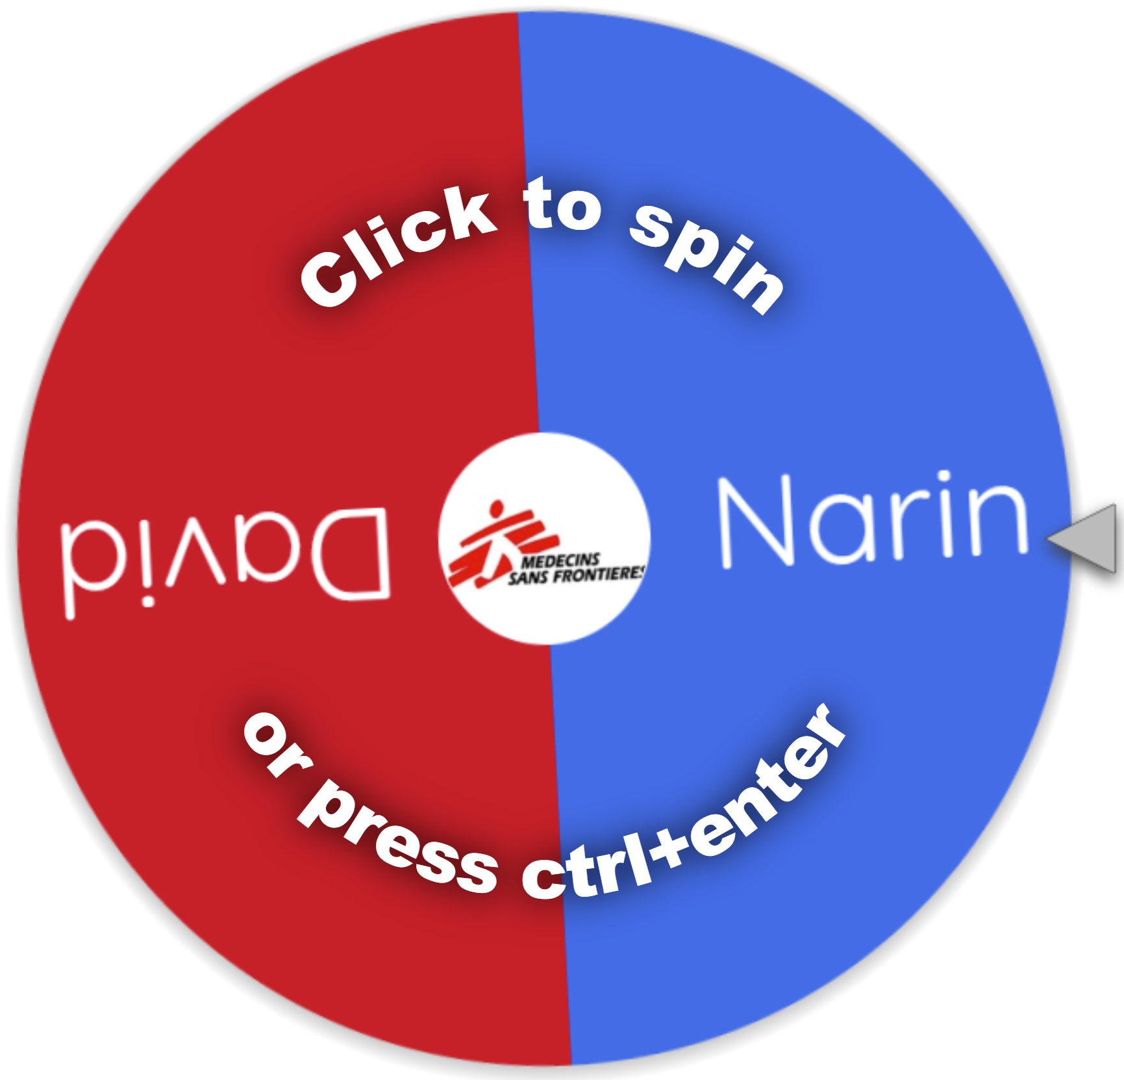
www.wheelofnames.com
Notes:
Close

