Slide 1
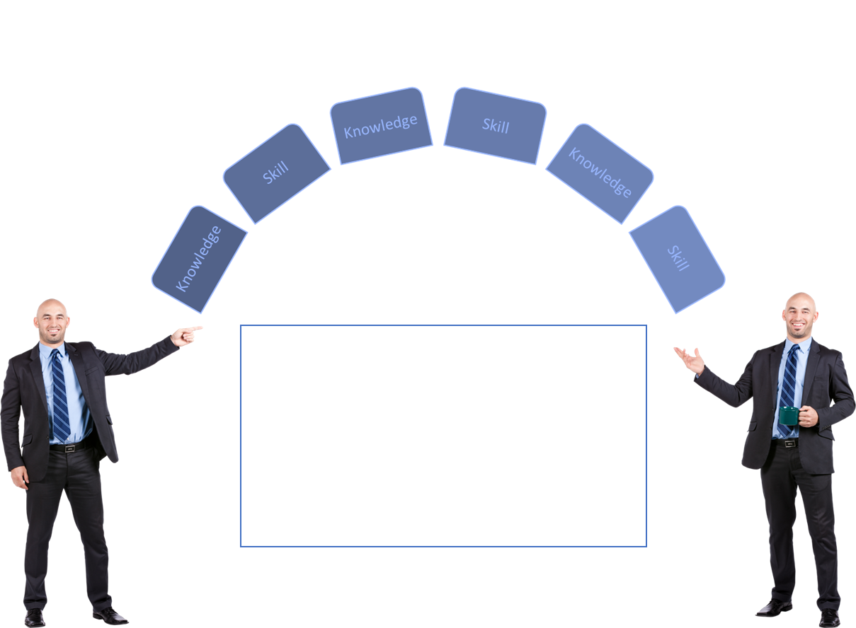
Separating The Need-to-Know From The Nice-to-Know
Title Of My Training
What’s The Purpose Of Training
Main Task | Sub Task | FR | IM | LD | EA | PR
Performance Gap
Aim

