Slide 1


Ideas For Creating Your Priming, Opening And Closing Activities

Slide 2


Slide 3
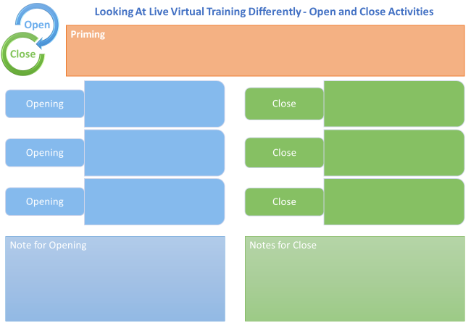

Slide 4

Creating time to be Interactive

Slide 5
34%

Slide 6



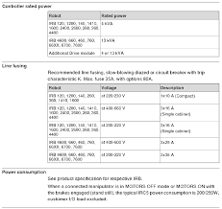
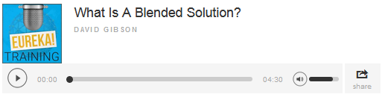

Pre-Communication and Priming
Bio of Presenter
Compliance
Summary
Explainer Video/Welcome Message
Audio File (Podcast)
Product Specification
Web Link

Slide 7


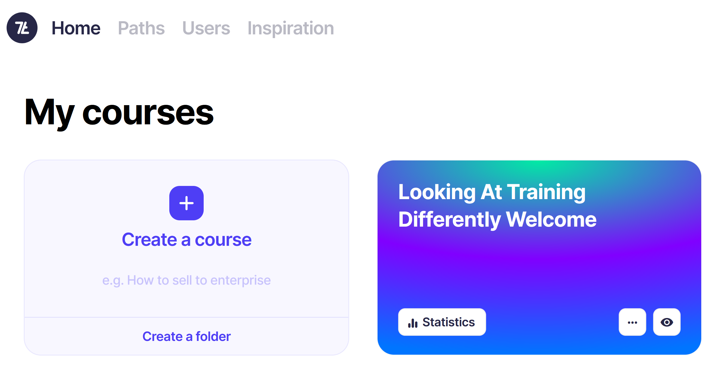
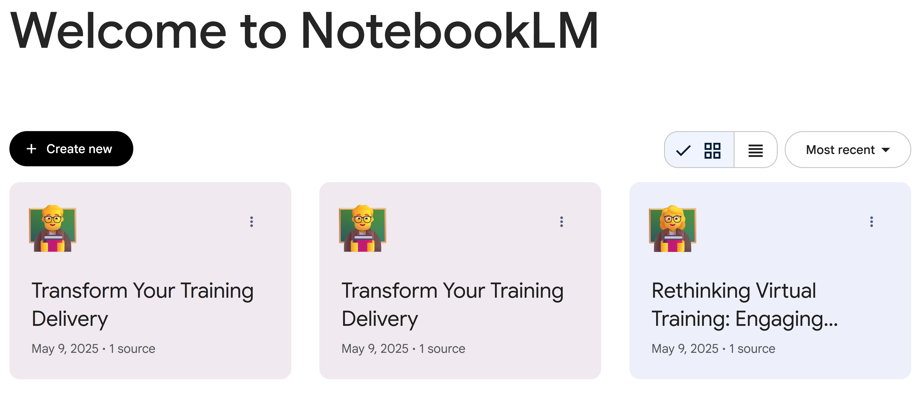
Pre-Training (Priming)
https://app.7taps.com/ZmA4jiJqOLtwn
https://notebooklm.google/

Slide 8
Opening

Slide 9
One Thing I Already Know About Smart Power Solutions
One Question I Have About Smart Power Solutions

Slide 10
A-Z of Smart Power Solutions
A | B | C | D
E | F | G | H
I | J | K | L
M | N | O | P
Q | R | S | T
U | V | W | XYZ

Slide 11
V | D | D | N | X | N | C | W | K | R | A | N | J | Z | W
A | Y | M | N | M | O | W | H | O | Q | O | E | R | E | R
R | Y | X | Y | M | I | M | I | O | K | D | A | B | A | V
I | W | L | Z | H | T | R | T | B | Z | Z | C | N | R | M
E | N | O | K | K | A | S | E | K | F | A | I | U | K | G
T | O | T | F | M | R | G | B | R | M | B | W | Y | N | Z
Y | H | T | E | G | O | M | O | O | E | X | V | I | L | U
R | X | O | X | R | B | O | A | W | J | D | N | G | V | S
X | T | Z | K | R | A | A | R | P | K | E | F | B | U | J
B | O | J | M | F | L | C | D | T | P | E | S | O | L | C
L | X | L | M | A | L | D | T | O | A | R | W | P | O | M
M | L | Y | F | U | O | F | T | I | Z | H | S | P | B | H
R | H | O | I | J | C | F | V | V | O | G | C | F | R | M
S | S | P | P | F | O | U | R | M | I | N | U | T | E | S
K | F | A | V | S | N | O | C | I | T | O | M | E | Z | D
CHATROOM
CLOSE
COLLABORATION
EMOTICONS
FOUR MINUTES
INTERACTION
SOFT OPENING
VARIETY
WEBCAM
WELCOME
WHITEBOARD
WORKBOOK

Slide 12
OAIENRITCTN
ENPO
OESLC
BRCOIOTLNOLAA
NIMRPIG
IBTCEJVEO
ROUF ENUITM
EALVNRET
UFN

Slide 13
My Circles of Skill and Knowledge
Things that I know and use relating to
[Training Topic eg Electrification Solutions]
What do I need from this training [eg how to select the ideal solution]
TAKE AWAYS

Slide 14


Slide 15
Add your answer into chat

Slide 17


Slide 18
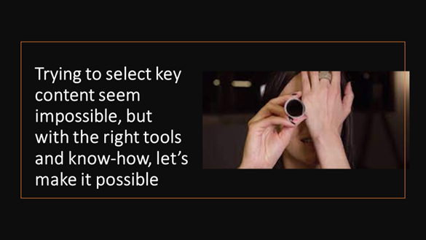

Slide 19
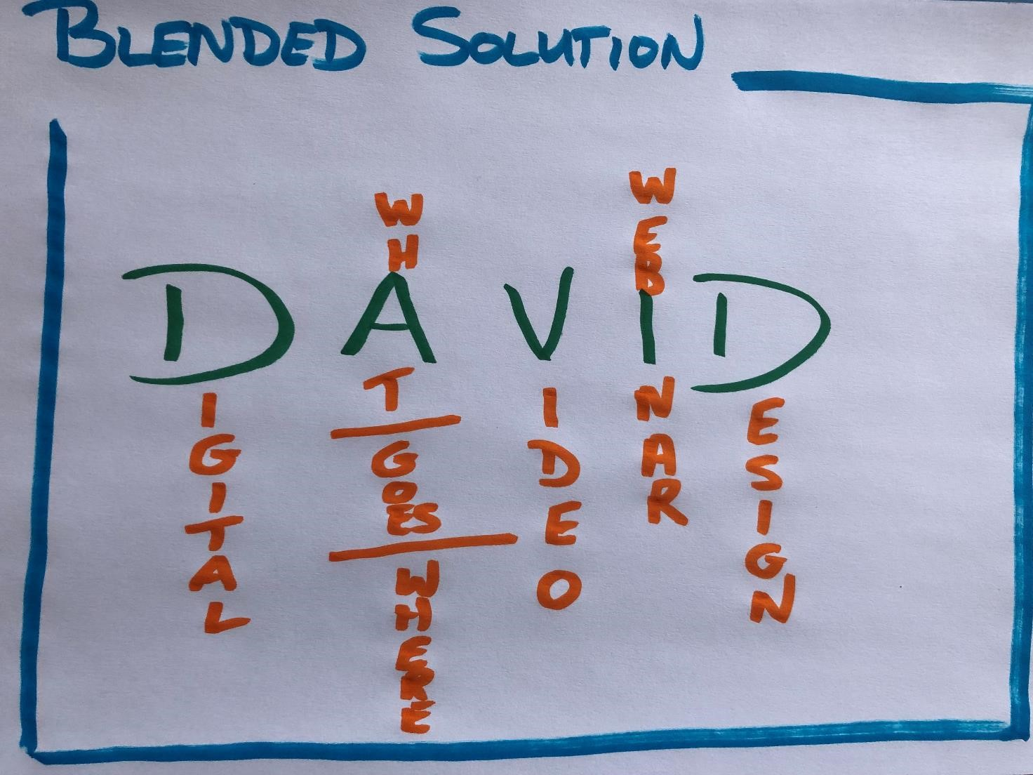

What – Where, When, How

Slide 20
What – Where, When, How

Slide 21
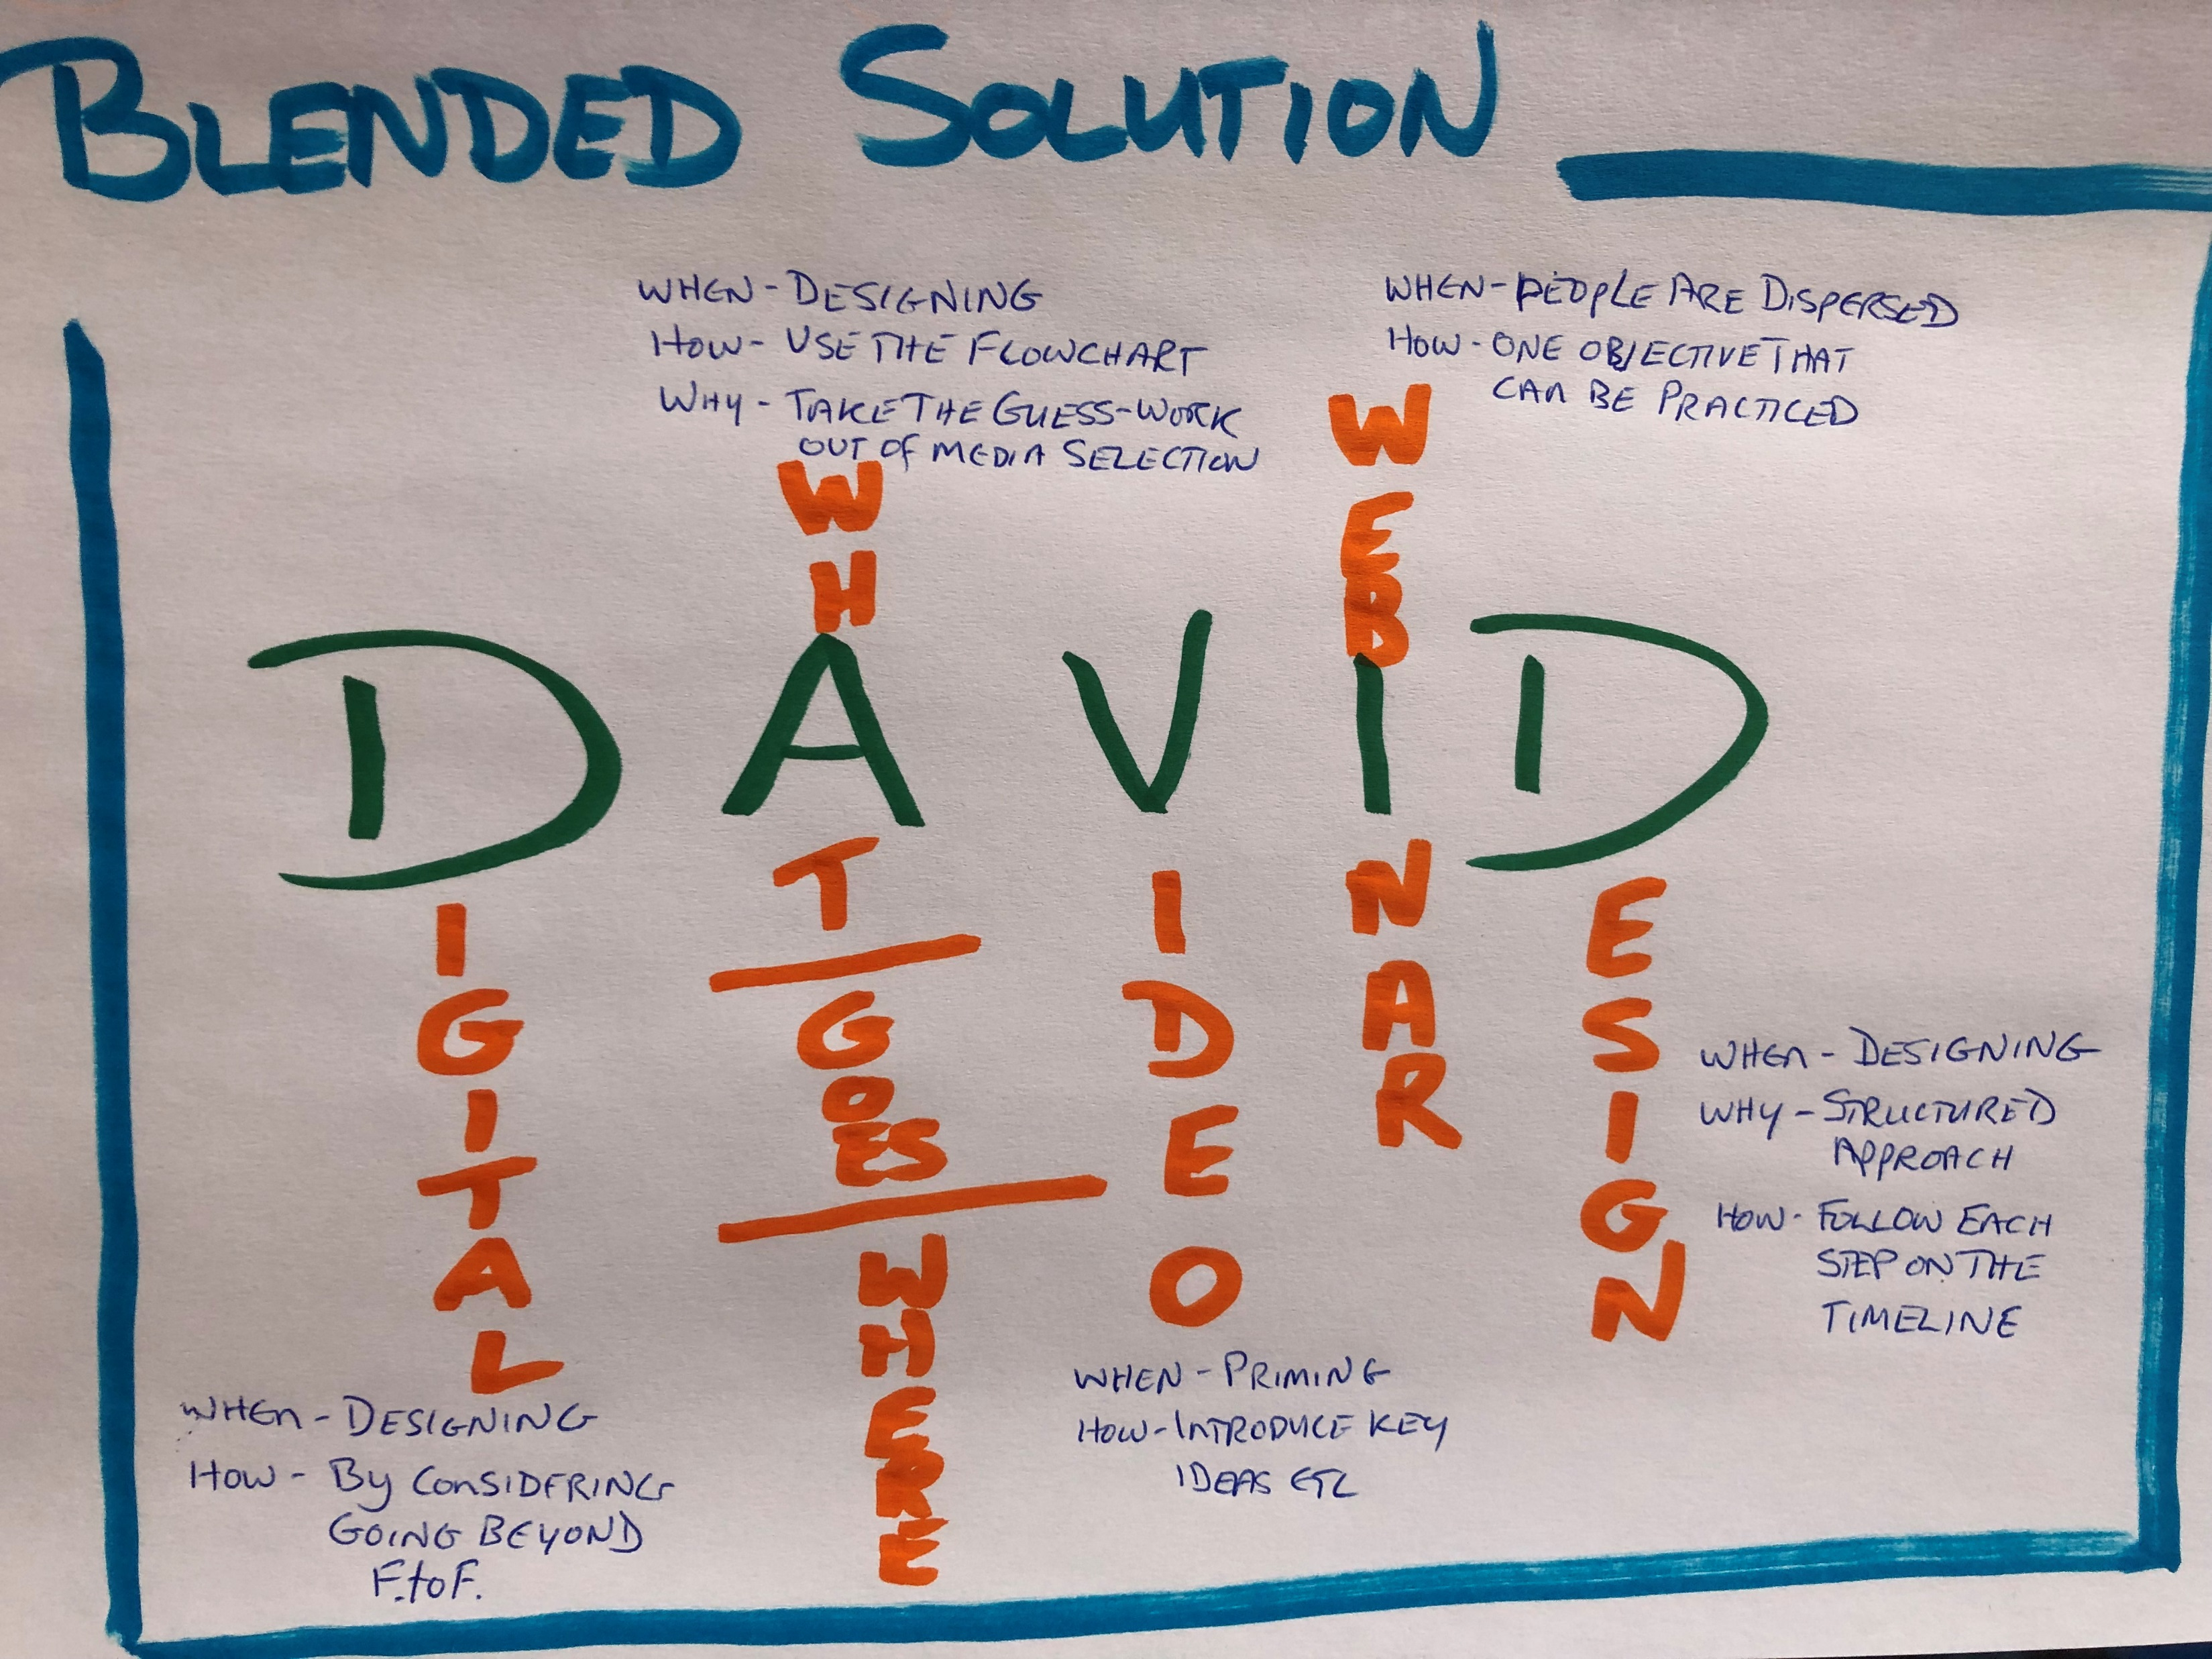
What – Where, When, How

Slide 22
FACT
AhHa
ACTION

Slide 23

Notes:
I’ll add the link to the workshop webpage

Slide 24

www.suno.com
Notes:
www.suno.com

Slide 25

Your Task
Create the Priming for the course you’re preparing.

